Slide 1
AI UNPLUGGED
Getting started with
Artificial Intelligence
Notes:
Quelle: https://docs.google.com/presentation/d/1kSuQyW5DTnkVaZEjGYCkfOxvzCqGEFzWBy4e9Uedd9k/preview?imm_mid=0f9b7e&cmp=em-data-na-na-newsltr_20171213&slide=id.g1e301fae90_1_568

Slide 2

Classification with Decision Trees:
The Good-Monkey-Bad-Monkey Game
Welcome to your job as a Zookeeper at "The UNI Zoo"

Slide 3
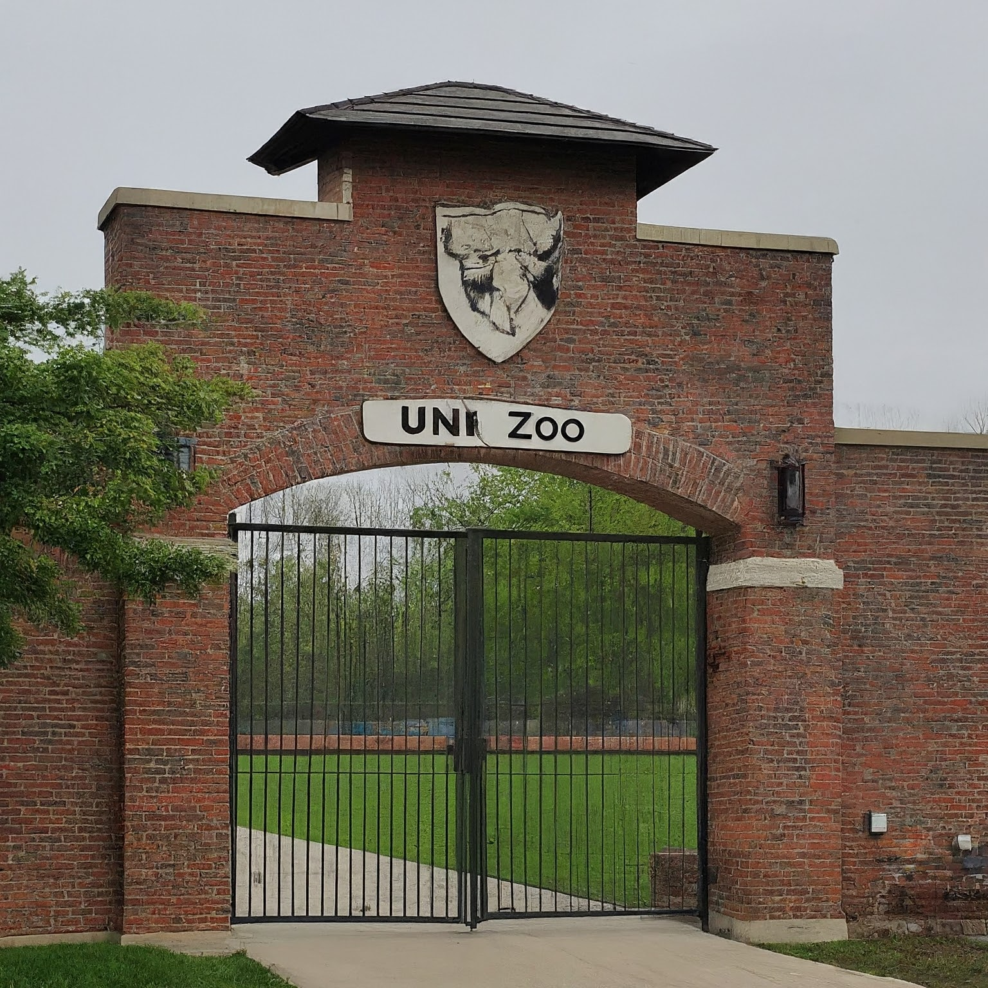
Classification with Decision Trees:
The Good-Monkey-Bad-Monkey Game
Welcome to your job as a Zookeeper at "The UNI Zoo"

Slide 4
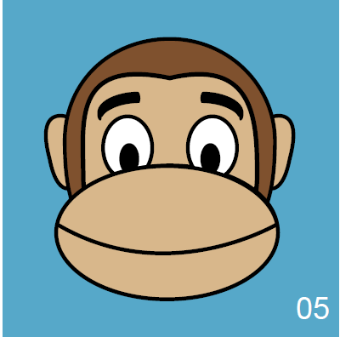
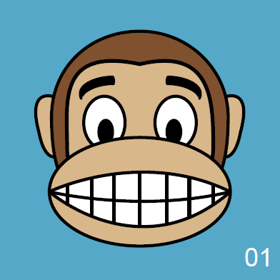
Classification with Decision Trees:
The Good-Monkey-Bad-Monkey Game
One of your jobs at the zoo will be to feed the monkeys.

Slide 5
Classification with Decision Trees:
The Good-Monkey-Bad-Monkey Game
One of your jobs at the zoo will be to feed the monkeys.
One of the challenges of feeding the monkeys is that some of them are nice, but some of them BITE if you get too close.
biting
non-biting

Slide 6
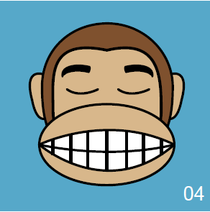
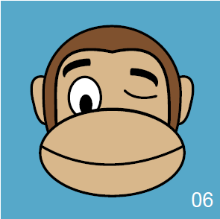
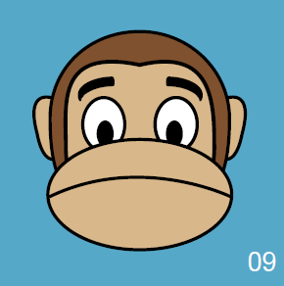
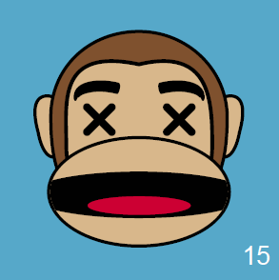
Classification with Decision Trees:
The Good-Monkey-Bad-Monkey Game
For the first part of your training, it is sort of easy.
We can teach you the numbers of the monkeys that are biters.

Slide 7
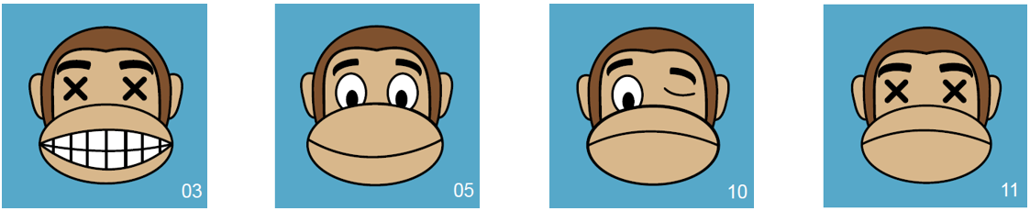
Classification with Decision Trees:
The Good-Monkey-Bad-Monkey Game
But what if we get some new monkeys (to diversify the gene pool of our troop)?

Slide 8
Classification with Decision Trees:
The Good-Monkey-Bad-Monkey Game
But what if we get some new monkeys (to diversify the gene pool of our troop)?
We need to figure out if there is a pattern that we can use to tell us which monkeys bite, and which ones don't.

Slide 9
Computers can be "trained" to make DECISION TREES
Decision trees look at ATTRIBUTES about the items and try to pick out which ones give us information about the items.

Slide 10
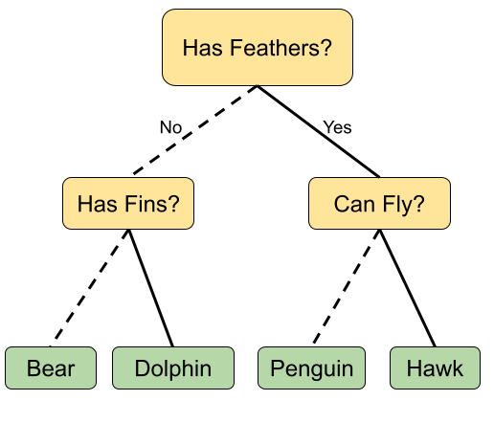
Computers can be "trained" to make DECISION TREES

Slide 11
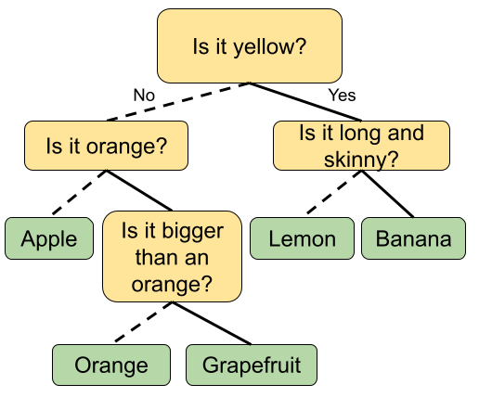
Computers can be "trained" to make DECISION TREES

Slide 12
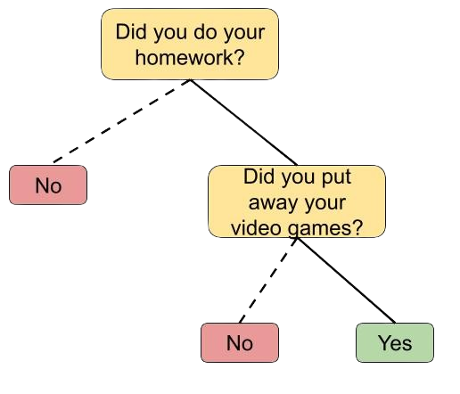
Computers can be "trained" to make DECISION TREES

Slide 13
Computers can be "trained" to make DECISION TREES
What are some of the attributes we could identify about our monkeys?

Slide 14
Version 1

Slide 15
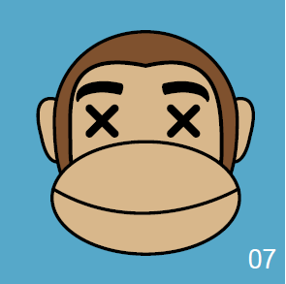
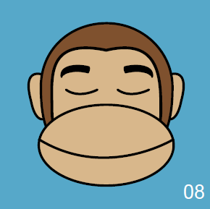
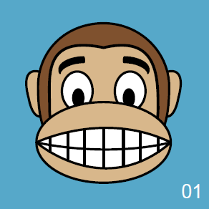
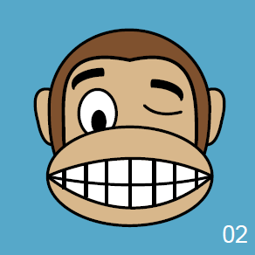
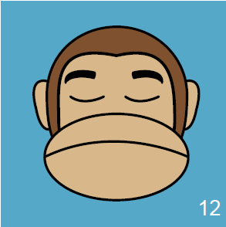
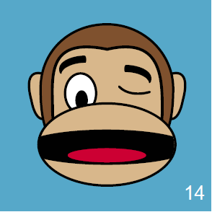
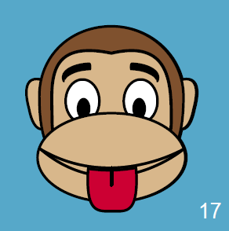
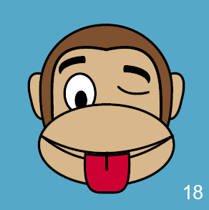
Biting
Non-biting
Notes:
Trainingsdaten

Slide 16

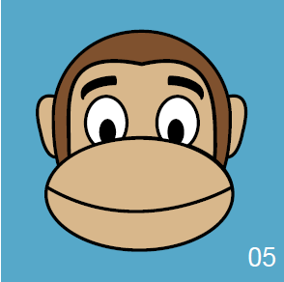
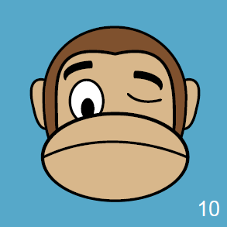
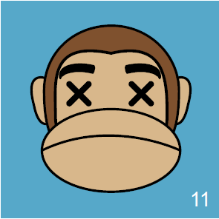
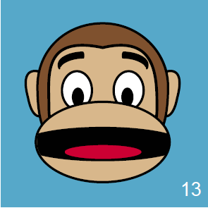
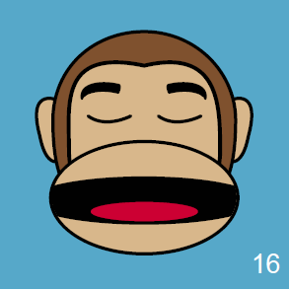
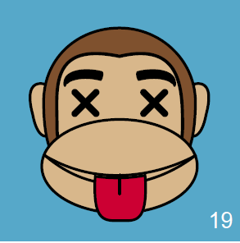
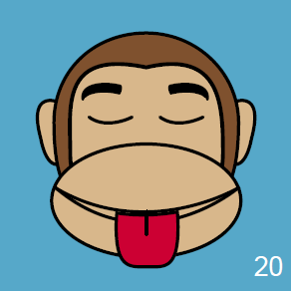
biting
biting
non-biting
biting
non-biting
non-biting
biting
non-biting
Notes:
Testdaten

Slide 17
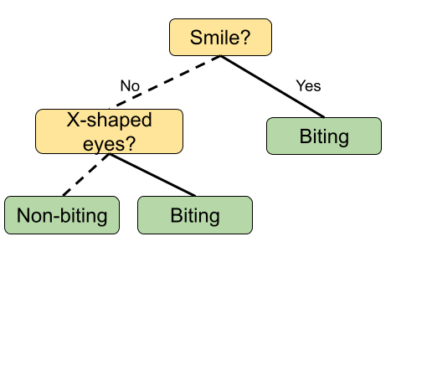
Biting
Non-biting
Notes:
Trainingsdaten

Slide 18
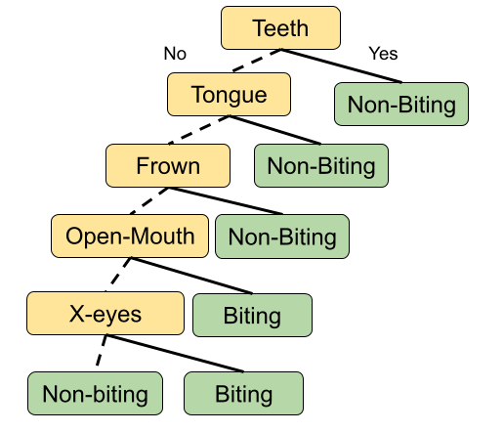
Both of these are "right"
But, which would you rather use?
Notes:
Trainingsdaten

Slide 19
Version 2

Slide 20
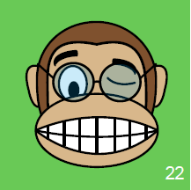
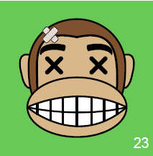
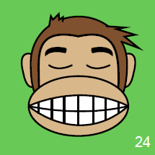
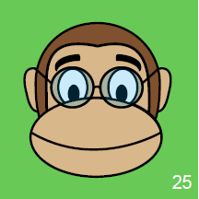
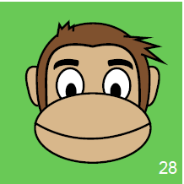
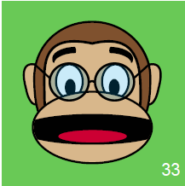
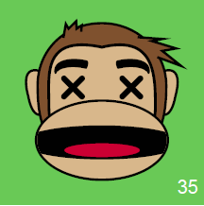
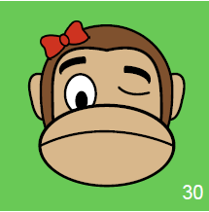
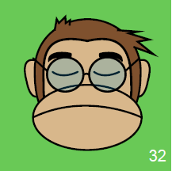
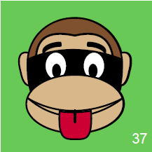
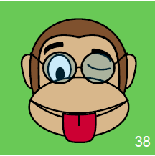
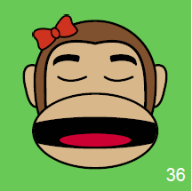
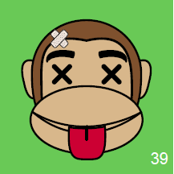
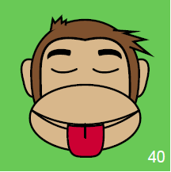
Biting
Non-biting
Notes:
Trainingsdaten

Slide 21
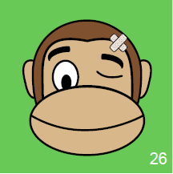
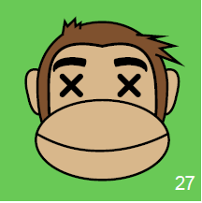
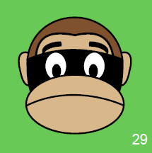
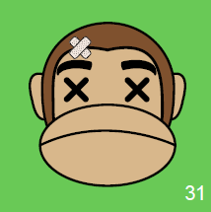
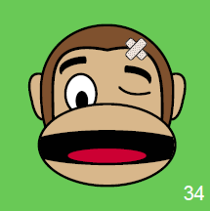
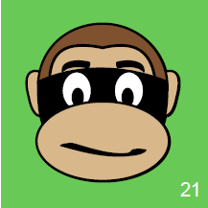
non-biting
biting
non-biting
non-biting
biting
biting
non-biting
non-biting
non-biting
non-biting
non-biting
biting
non-biting
Notes:
Testdaten

Slide 22
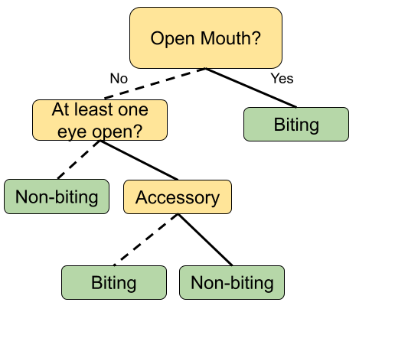
Biting
Non-biting
Notes:
Trainingsdaten

