Slide 1
Fundamentals of Programming
September 28, 2024

Slide 2
Schedule for today
Time | Activity
8:30 - 9:00 | Welcome and Community
9:00 - 9:15 | Peer Instruction - Scratch wrapup
9:15 - 10:15 | PRIMM - You Can Read Python
10:30 - 11:00 | Software and Accounts
11:00 - 12:00 | POGIL - Getting Started with Python
12:00 - 12:15 | Rubber Duck Debugging
12:15 - 12:30 | Feedback and Reflection

Slide 3
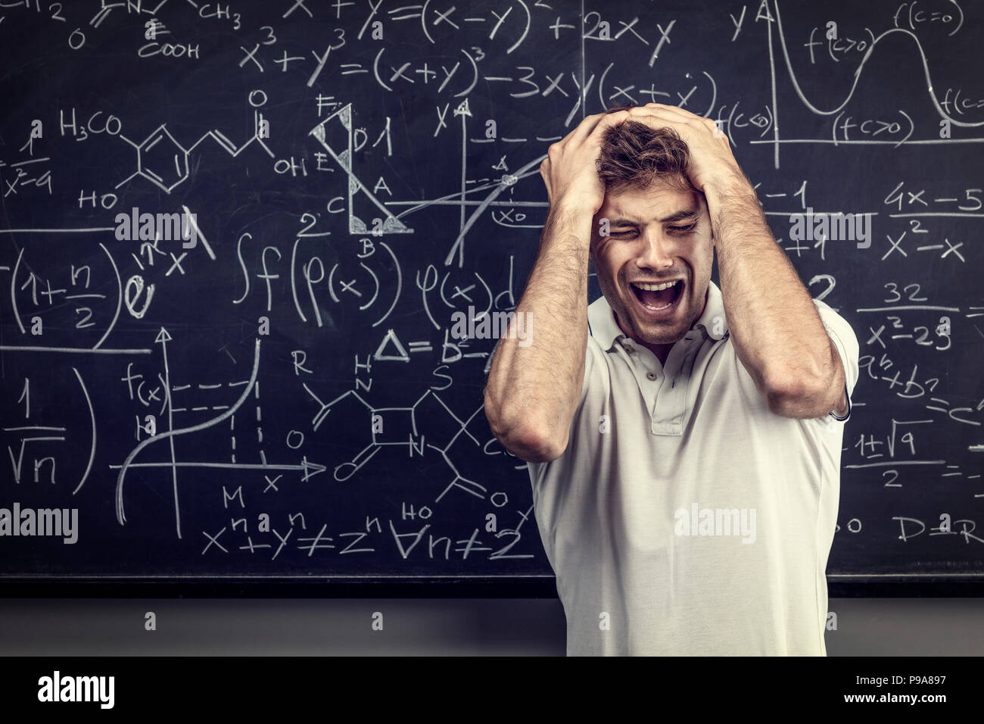
Cheers and Jeers
At your table, how is your school year going so far?
What’s going well?
What is making you scream?

Slide 4
Today is National “Ask a Stupid Question” Day
Seriously:
https://en.wikipedia.org/wiki/Ask_a_Stupid_Question_Day
It was created by teachers in the 1980s to encourage students to ask questions even if they felt they were “stupid”
“There is no such thing as a stupid question”
What “stupid” question do you still have about Scratch?

Slide 5
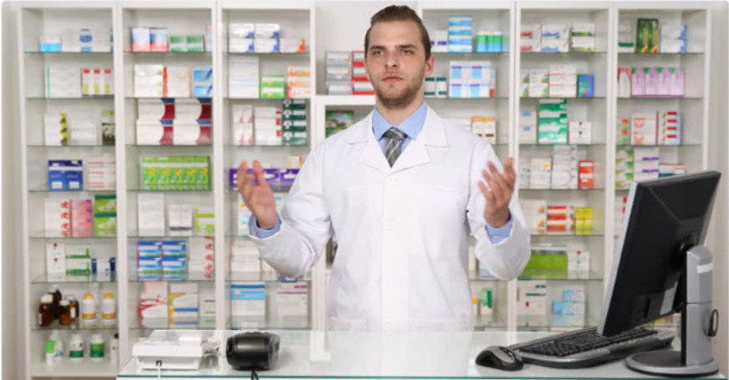
Caption Contest
At your table, come up with a caption for this “bad” stock image.

Slide 6
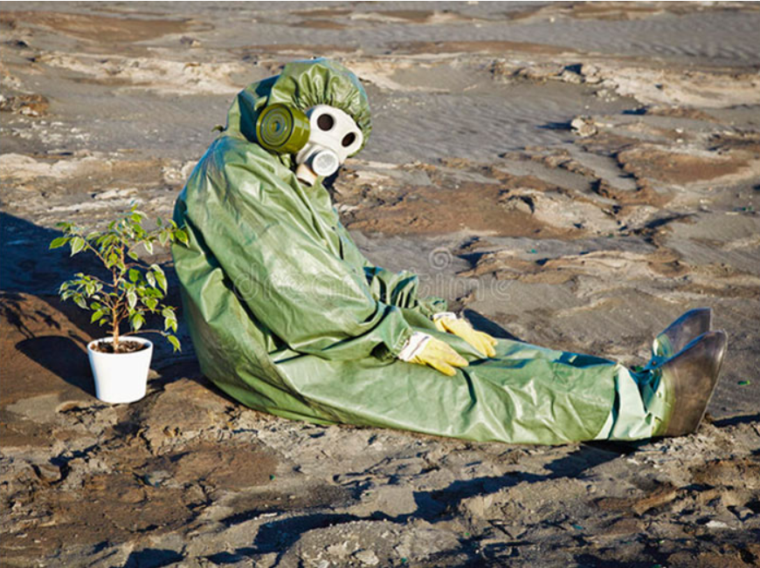
Caption Contest
At your table, come up with a caption for this “bad” stock image.

Slide 7
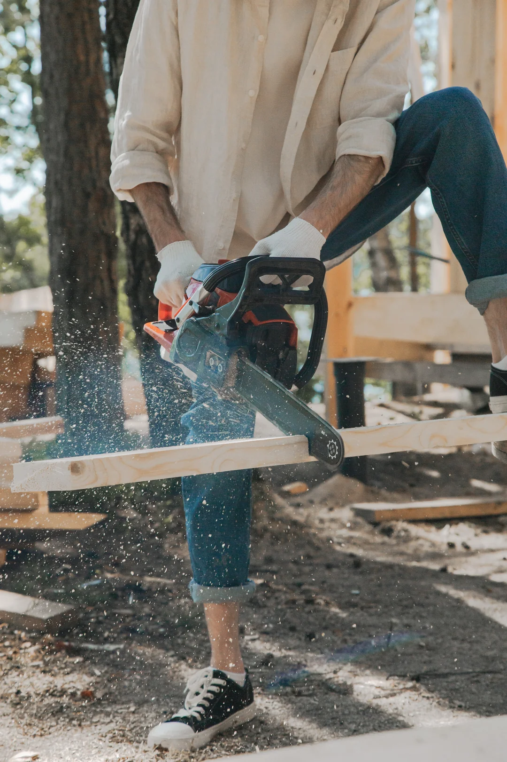
Caption Contest
At your table, come up with a caption for this “bad” stock image.

Slide 8
Caption Contest
At your table, come up with a caption for this “bad” stock image.

Slide 9
Peer Instruction
I’m going to show you a multiple choice question.
I want to you to SILENTLY determine how you would answer the question.

Slide 10
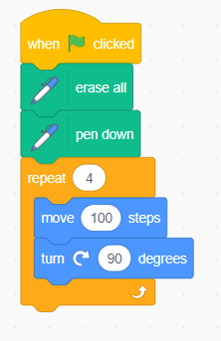
Peer Instruction
Consider the following code:

Slide 11
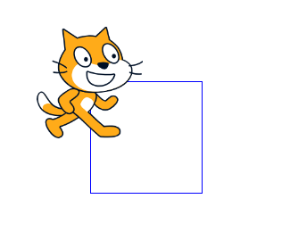
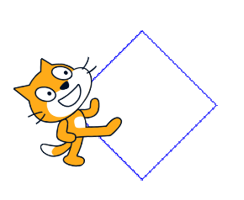
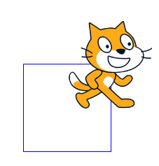
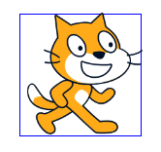
Peer Instruction
Which of these could this produce?
A B
C D
Consider the following code:

Slide 12
Peer Instruction
How many of you think it can be
A?
B?
C?
D?

Slide 13
Peer Instruction
At your table talk about each option:
Why do you think the answer is yes or no?
Your goal is to have the group come to consensus.
If people disagree, discuss why you feel like you are right and they are wrong.

Slide 14
Peer Instruction
Final vote - As an individual, do you think it could be:
A?
B?
C?
D?

Slide 15
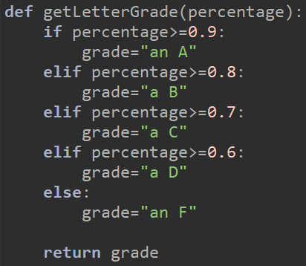
The P in PRIMM - Predict
I bet that you can read Python code already!
Let’s look at a fully functioning Python program and PREDICT what it does.
Notes:
20-25 minutes for small group work to answer questions.

Slide 16
The R in PRIMM - Run
Let’s work together to RUN the code and see if you were correct.
Notes:
Another 30 minutes to have the unpacking discussion

Slide 17
Software and Accounts
Follow the directions on bit.ly/csedinstalls
Download and install Thonny
Login and update password on Runestone Academy
Login and update password on Autolab

Slide 18
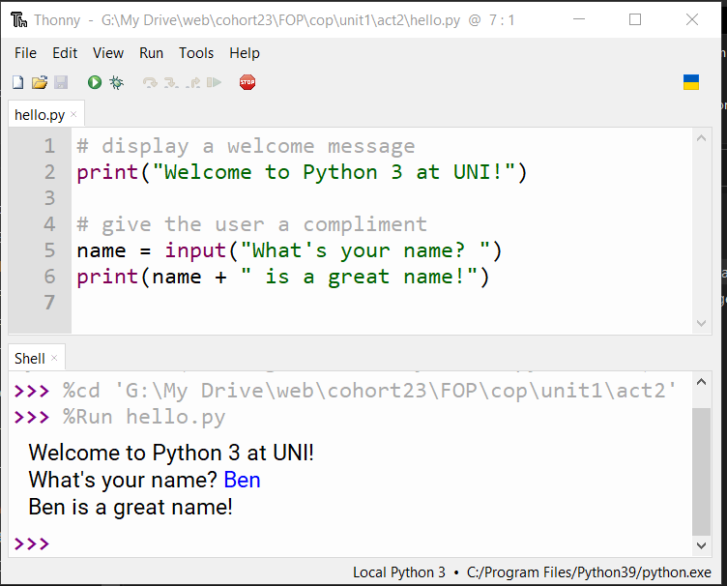
POGIL #1:
Getting started with Python
Let’s figure out how Thonny works and practice some basic python commands.

Slide 19
POGIL #1:
Getting started with Python
What is a POGIL?

Slide 20
Model 1

Slide 21
Model 1
What did you learn?
What questions do you still have?

Slide 22
Model 2

Slide 23
Model 2
What did you learn?
What questions do you still have?

Slide 24
Model 3

Slide 25
Model 3
What did you learn?
What questions do you still have?

Slide 26
Rubber Duck Debugging
https://www.youtube.com/watch?v=hxe03H_-TF0&t=20s
https://en.wikipedia.org/wiki/Rubber_duck_debugging
https://rubberduckdebugging.com/

Slide 27
Feedback and Reflection
https://bit.ly/CSED24FR

