Slide 1
Object Oriented Programming

Slide 2
Terminology
Each object created in a program is an instance of a class.
Each class presents to the outside world a concise and consistent view of the objects that are instances of this class, without going into too much unnecessary detail or giving others access to the inner workings of the objects.
The class definition typically specifies instance variables, also known as data members, that the object contains, as well as the methods, also known as member functions, that the object can execute.

Slide 3
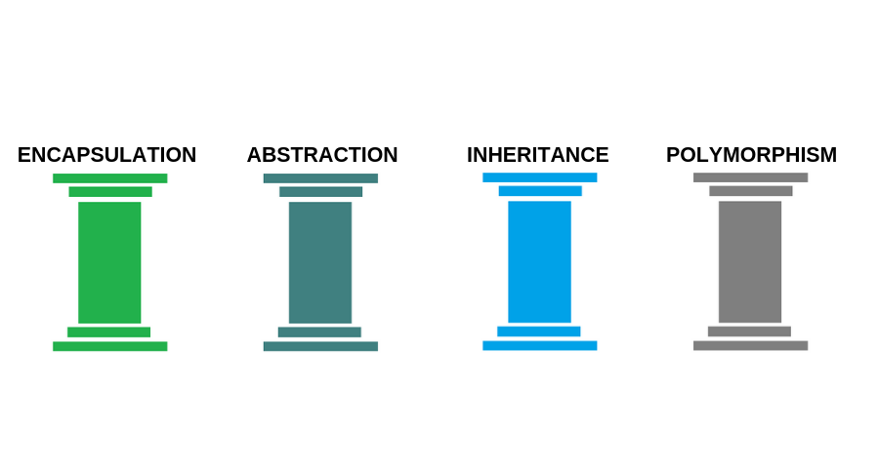
Object Oriented Programming

Slide 4
Abstraction
Abstraction is the process of showing only the essential/necessary features of an to the outside world. We want to hide (abstract away) all other irrelevant information.

Slide 5
Abstraction
For example you know that when you push the power button on your remote your TV turns on.
  It is not required to understand how infra-red waves are getting generated in the TV remote control or how the TV manages to "capture" and use that event.

Slide 6
Abstraction
When you write:
    random.shuffle(data)
You know what happens but you don't know HOW it happens.
And you DON'T care.

Slide 7
Encapsulation
Encapsulation means wrapping up data and actions (member functions, methods) together into a single unit i.e. class.

Slide 8
Encapsulation
Without OOP:
  writePaycheck("Ben Schafer",45,21.75)
With OOP
myTimecard = Timecard("Ben Schafer",21.75)
myTimecard.worked(10)
…
  myTimecard.writecheck()

Slide 9
Encapsulation
In many languages it also means restricting DIRECT access to data and only doing it through certain methods.
I can't just go in and adjust my hourly wage to $1000 an hour.
I have to try
myTimecard.setWage(1000)
[Which probably has some built in restrictions to say I don't have permission to write that code]

Slide 10
Inheritance
The ability to create a new class from an existing class.
Inheritance allows a class (subclass) to acquire the properties and behavior of another class (super-class).
It helps to reuse, customize and enhance the existing code. So it helps to write a code accurately and reduce the development time.

Slide 11
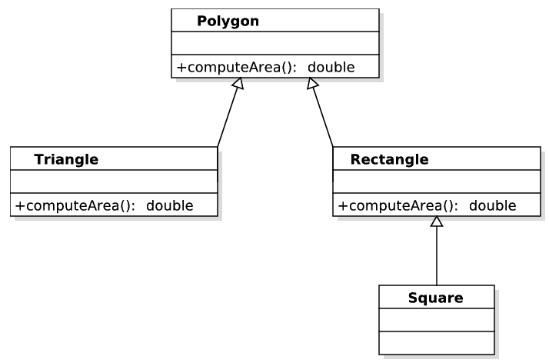
Inheritance
A triangle is a special kind of polygon
A rectangle is a special kind of polygon
A square is a special kind of rectangle

Slide 12
Polymorphism
Polymorphism is derived from 2 Greek words: poly and morphs.
  "poly" means many
  "morphs" means forms
So polymorphism means "many forms".
What happens in python when I say
result = var1 + var2

Slide 13

Duck Typing
Python treats abstractions and polymorphism implicitly using a mechanism known as duck typing.
  A program can treat objects as having certain functionality and they will behave correctly provided those objects provide this expected functionality.
As an interpreted and dynamically typed language, there is no “compile time” checking of data types in Python, and no formal requirement for declarations of abstract base classes.
The term “duck typing” comes from an adage attributed to poet James Whitcomb Riley, stating that “when I see a bird that walks like a duck and swims like a duck and quacks like a duck, I call that bird a duck.”

Slide 14
What IS a class?
Fundamentally a Class is a definition of what individual objects will look like.
  Class = Cookie Cutter
  Objects/Instances = Cookies cut with that cutter
When declaring a class we have to consider 3 things:
  State (data, "instance variables")
  Actions (methods, "instance methods")
  What instances look like when they are constructed (initialization)

Slide 15
Class Definitions
A class serves as the primary means for abstraction in object-oriented programming.
In Python, every piece of data is represented as an instance of some class.
A class provides a set of behaviors in the form of member functions (also known as methods), with implementations that belong to all its instances.
A class also serves as a blueprint for its instances, effectively determining the way that state information for each instance is represented in the form of attributes (also known as fields, instance variables, or data members).

Slide 16
Writing a class in Python

Slide 17
The self Identifier
In Python, the self identifier plays a key role.
In any class, there can possibly be many different instances, and each must maintain its own instance variables.
Therefore, each instance stores its own instance variables to reflect its current state. Syntactically, self identifies the instance upon which a method is invoked.

