Slide 1
Unit 7 - Lesson 7
Recursion

Slide 3
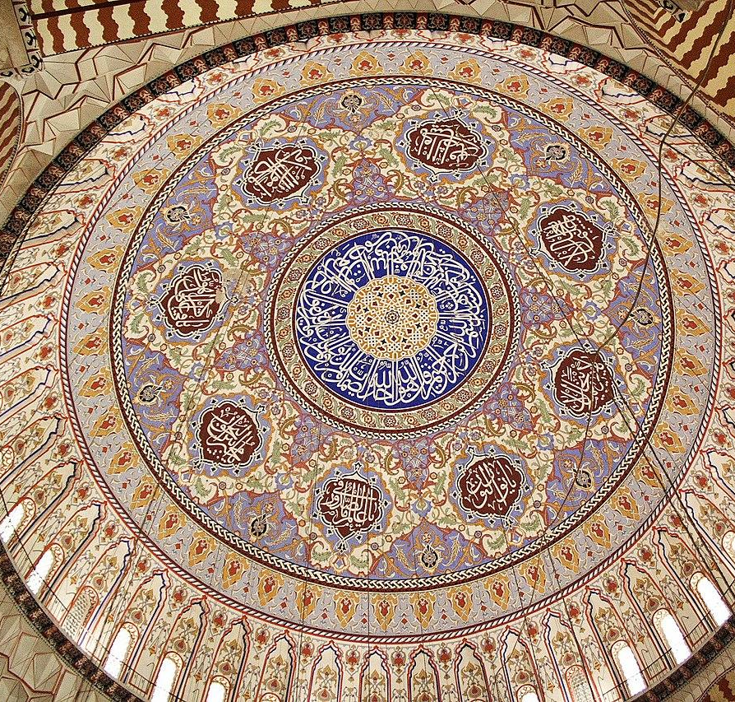
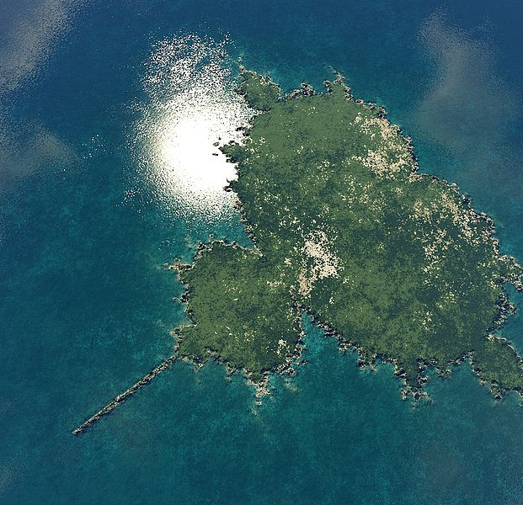
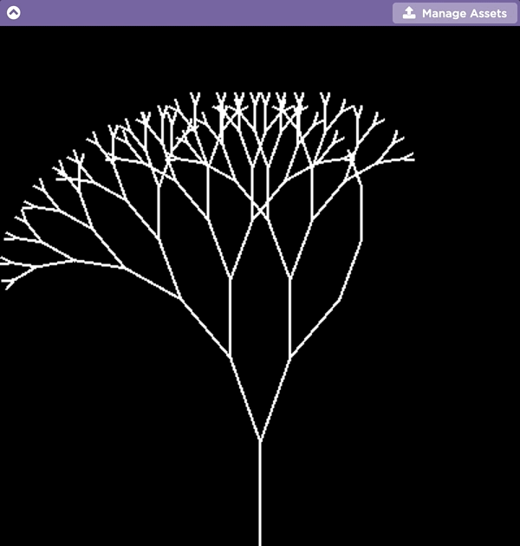
Recursion - Warm Up
Fractal art is created by repeating simple patterns. It can be found in:
computer-generated art
architecture
computer-generated landscapes and scenery

Slide 4
Explore the three Scratch programs provided on Dr. Schafer's website
  Recursive Fern, version 1 (let's you control the speed to help see what is happening
  Recursive Fern, version 2 (let's you adjust several parameters to make different ferns)
  Serpinski Triangle w/ recursion

Slide 5
Recursion - Warm Up
How is repetition used in fractal art?

Slide 7
Recursion - Activity
Explain the purpose and functionality of a recursive method
Identify the recursive call and base case in an algorithm
Trace a recursive method

Slide 8
Recursion - Activity
What is recursion?

Slide 9

Recursion Unplugged
Recursion - Activity
📍You and your partner should have:
Activity Guide
pen / pencil
Coloring page and markers
One set of method cards

Slide 10
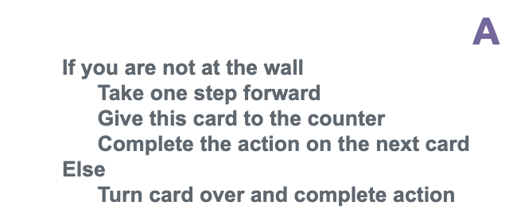

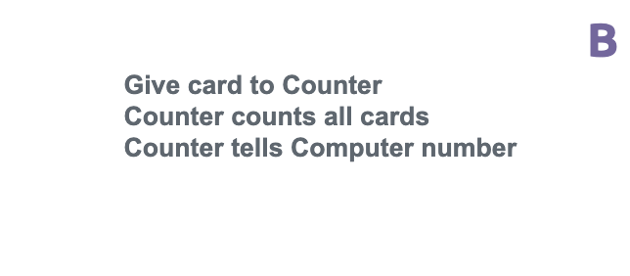
Recursion - Activity
The facilitator will assign you one of the two activities to complete (Activity 3a).
Wall Walk
Coloring

Slide 11
Recursion Unplugged
Recursion - Activity
📍You and your partner should have:
Wall Walking: one set of Wall Walking method cards
Coloring: one coloring sheet, one marker or colored pencil, one set of Coloring method cards

Slide 12
Recursion - Activity
Recursion Unplugged 🔌
One student is on the computer, and the other student is the card collector.
The student acting as the computer starts with the stack of cards. All cards should have Side A facing up.
The computer reads Side A and does the action indicated by the method.
Once they have completed the action, they hand the card to the student acting as the card collector.
The computer repeats Steps 3 and 4 until the card indicates they should stop.
The card collector returns the requested information when indicated by a card.

Slide 13
Recursion - Activity
Recursion Unplugged 🔌
Trade method cards with another group and complete the other activity.

Slide 14
Recursion - Activity
What happened in your activity?
How is this type of algorithm different from any other type of algorithm you’ve seen?

Slide 15
Recursion - Activity
def recursiveSum(int num) :
if num <= 1 :
return num
return num + recursiveSum(num - 1)
The base case is the instance where a recursive method will return a value rather than calling itself.
The recursive case is the instance where the recursive method calls itself.
Recursion is when a method calls itself.
📝 Unit 7 Guide

Slide 16
Recursion - Activity
The base case comes from the part of the iterative method that stops the repetition. It occurs when a certain condition is met.
def nonRecursiveSum(int num) :
sum = 0
for i in range(num):
sum += i
return sum
def recursiveSum(int num) :
if num <= 1 :
return num
return num + recursiveSum(num - 1)
Stops the loop when i becomes equal to num
Stops the recursion when num becomes <= 1
📝 Unit 7 Guide

Slide 17
Recursion - Activity
The recursive case from from the part of the
iterative method that repeats.
def nonRecursiveSum(int num) :
sum = 0
for i in range(num):
sum += i
return sum
def recursiveSum(int num) :
if num <= 1 :
return num
return num + recursiveSum(num - 1)
📝 Unit 7 Guide

Slide 18
Recursion - Activity
def recursiveSum(int num) :
if num <= 1 :
return num
return num + recursiveSum(num - 1)
The parameter values capture the progress of a recursive process, just like how loop control variables capture the progress of a loop.
The recursive call has its own set of local variables, including the formal parameters.

Slide 19
Recursion - Activity
Complete Activity 3a of the Activity Guide by identifying the recursive call and base case for each of these two activities.

Slide 20
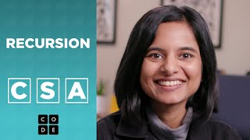
Recursion - Activity
🎥 Recursion
When is recursion useful?

Slide 21
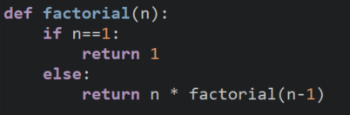
Recursion - Activity
factorial(5)
return 5 * factorial(4)
5 * 24 = 120
factorial(4)
return 4 * factorial(3)
4 * 6 = 24
factorial(3)
return 3 * factorial(2)
What is the result of factorial(5)?
3 * 2 = 6
factorial(2)
return 2 * factorial(1)
120
2 * 1 = 2
factorial(1)
return 1
📝 Unit 7 Guide

Slide 22
Recursion - Activity
Complete Activity 3b of the Activity Guide handout.

Slide 23
Recursion - Wrap Up
Activity 3c
Revisit Dr. Schafer's two fractal art programs.
For each:
  What is the recursive call?
  What is the base case?

Slide 24
Recursion - Wrap Up
Activity 3d
Consider two recursive implementations of the Binary Search
For each:
  What is the recursive call?
  What is the base case?

Slide 26
Recursion - Wrap Up
What are some benefits to writing an algorithm using recursion?
What are some drawbacks?
📝 Unit 7 Guide

Slide 27
Recursion - Wrap Up
The purpose and functionality of a recursive method
How to identify the recursive call and base case in an algorithm
Tracing a recursive method

Slide 28
Recursion - Wrap Up
What is recursion?

Slide 29
💼 Key Vocabulary
Recursion - Wrap Up
base case: the instance where a recursive method will return a value rather than calling itself
recursion: when a method calls itself
recursive case: the instance where a recursive method calls itself

