Slide 1
Unit 8 - Lesson 2
Searching

Slide 3

Searching - Warm Up
World's Worst Magician
Who wants to choose a card?

Slide 4
Searching - Warm Up
Am I the World's Worst Magician?
How many guesses would the World's Best Magician take?
How many guesses did the real World's Worst Magician take?
📝 Unit 8 Guide

Slide 6
Searching - Activity
Analyze the efficiency of the linear search algorithm using execution counts
Differentiate between best case, average case, and worst case
Identify the benefits and limitations of the linear search algorithm

Slide 7
Searching - Activity
How can I determine the efficiency of an algorithm?

Slide 8
Searching - Activity
Activity 1
Investigate the code in activity1.py
Modify the code as directed in the Activity 1a portion of activity guide and record your results.

Slide 9


Searching - Activity
What did you notice about
the code in this program?
What do you wonder about
the code in this program?

Slide 10
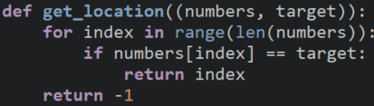
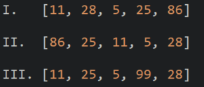

Searching - Activity
Check for Understanding
Consider
And
Which of the following replacements for
##missing code## will cause the loop in this
method to run the maximum number of iterations?
I only
II only
III only
I and II only
I and III only

Slide 11
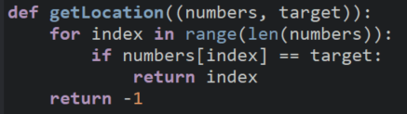
Searching - Activity
Check for Understanding
Consider
And
Which of the following replacements for
##missing code## will cause the loop in this
method to run the maximum number of iterations?
I only
II only
III only
I and II only
I and III only

Slide 12
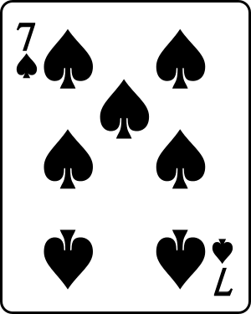
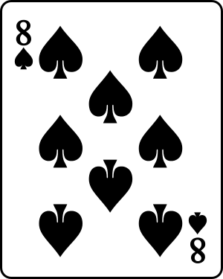
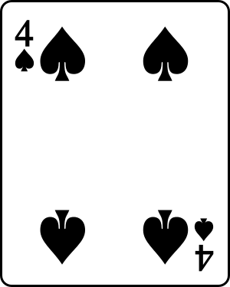
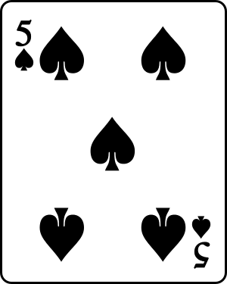
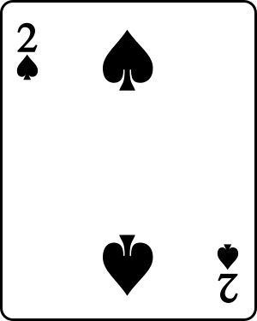
Searching - Activity
A linear (or sequential) search is a search algorithm that checks each item in order until the target is found.
Target: 4 of Spades
📝 Unit 8 Guide

Slide 13
Searching - Activity
When a linear search is used on a 2D array, it checks each element in each row one at a time.
Target: 50
10 | 20 | 30
40 | 50 | 60

Slide 14
Searching - Activity
We can analyze an algorithm to determine its:
Best case: the least number of executions an algorithm can take to complete its goal
Average case: the average number of executions an algorithm can take to complete its goal
Worst case: the most number of executions an algorithm can take to complete its goal
📝 Unit 8 Guide

Slide 15
Searching - Activity
What is the best case for the World's Worst Magician?
What is the average case for the World's Worst Magician?
What is the worst case for the World's Worst Magician?
📝 Unit 8 Guide

Slide 16
Searching - Activity
By counting the number of guesses, you've been counting
the number of executions of the algorithm.
Target: 4 of Spades
You've been tracking the execution count, or
number of times a code segment runs.
📝 Unit 8 Guide

Slide 17

Searching - Activity
Complete the Activity 1b on today's activity guide.

Slide 18

Searching - Activity
Compare your findings with a partner.

Slide 20


Searching - Wrap Up
An end user is the person who will use the program.
A user story is an informal explanation of a program feature written from the perspective of the user.

Slide 21
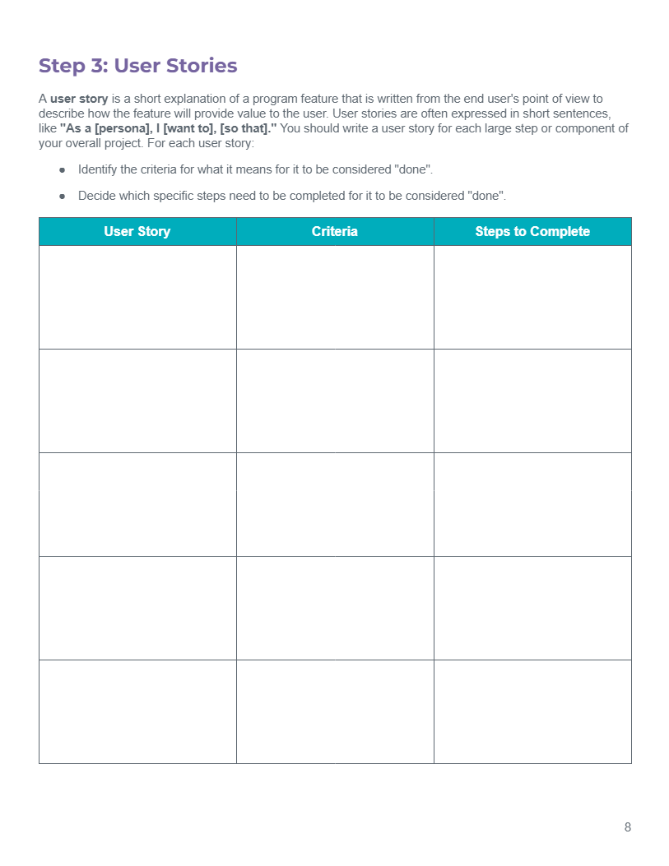
Searching - Wrap Up
Write user stories for your project on page 8 of your Project Planning Guide.

Slide 22
Searching - Wrap Up
Analyzing the efficiency of the linear search algorithm using execution counts
The difference between best case, average case, and worst case
The benefits and limitations of the linear search algorithm

Slide 23
Searching - Wrap Up
How can I determine the efficiency of an algorithm?

Slide 24
💼 Key Vocabulary
Searching - Wrap Up
average case: the average number of executions an algorithm can take to complete its goal
best case: the least number of executions an algorithm can take to complete its goal
execution count: the number of times a code segment runs
linear/sequential search: a search algorithm that checks each item in order until the target is found
worst case: the most number of executions an algorithm can take to complete its goal

