Slide 1
Travelling in Romania
Suppose you travelling in Romania
Currently you are in Arad
Your flight leaves Bucharest tomorrow morning so you need to get to the airport

Slide 2
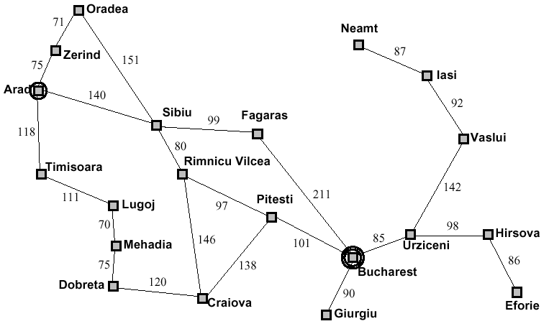
Problem Solving Agents

Slide 3
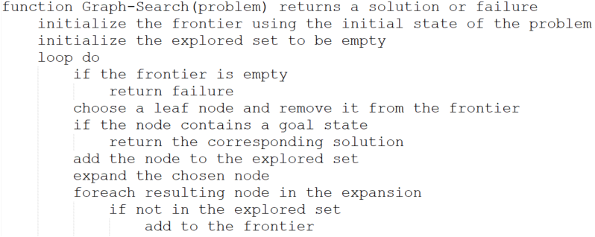
General Tree Search

Slide 4
Review
Review: tree search a strategy is defined by picking the order of node expansion

Slide 5
Uninformed Search Strategies
Uninformed strategies use only information available in the problem definition
Breadth-first search
Uniform-cost search
Depth-first search
Depth-limited search
Iterative deepening search

Slide 6
Agents that Search
But what if we have "Informed" search?
AKA heuristic search

Slide 7
What looks "better?"
If I ask you to look at this map and find your way from Arad to Bucharest, what do you do?

Slide 8
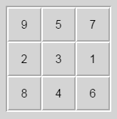
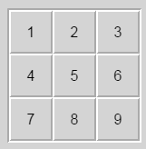
What looks "better?"
You know there are 8 options.
But which one(s) look more appealing? Why?

Slide 9
Heuristic Search
Heuristic searches use knowledge about the problem to include “forward looking” information.
That is, which move do I THINK would get me closest to the goal.

Slide 10
Heuristic Search
Best-first search: use an evaluation function for each node
Estimate of “desirability”
Expand most desirable unexpanded node
Implementation: frontier is a queue sorted in decreasing order of desirability
Special cases:
Greedy search
A* search

Slide 11
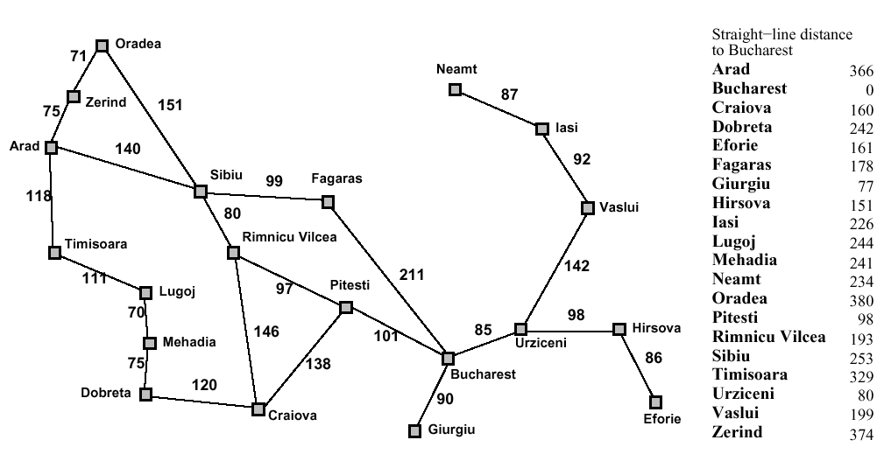
Heuristic Search
Romania with step costs in km

Slide 12
Heuristic Search
Greedy search
Evaluation function h(n) (heuristic) = estimate of cost from n to closest goal
Example: h_{SLD}(n) = straight-line distance from n to Bucharest
Greedy search expands the node that appears to be closest to goal

Slide 13
Heuristic search
Greedy search example

Slide 14
Heuristic search
Greedy search example

Slide 15
Heuristic Search
Greedy search example

Slide 16
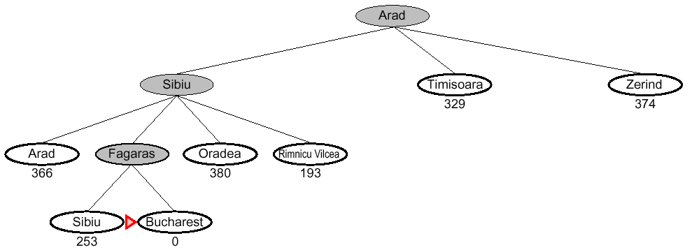
Heuristic Search
Greedy search example

Slide 17
Heuristic Search
Properties of greedy search
Complete??

Slide 18
Heuristic Search
Complete?? No – can get stuck in loops, e.g., start in Iasi with Oradea as goal….
Iasi → Neamt → Iasi → Neamt →
Complete in finite space with repeated-state checking

Slide 19
Heuristic Search
Properties of greedy search
Complete?? No – can get stuck in loops, e.g.,
Complete in finite space with repeated-state checking
Time??

Slide 20
Heuristic Search
Properties of greedy search
Complete?? No – can get stuck in loops, e.g.,
Complete in finite space with repeated-state checking
Time?? O(b^{m}), but a good heuristic can give dramatic improvement

Slide 21
Heuristic Search
Properties of greedy search
Complete?? No – can get stuck in loops, e.g.,
Complete in finite space with repeated-state checking
Time?? O(b^{m}), but a good heuristic can give dramatic improvement
Space??

Slide 22
Heuristic Search
Properties of greedy search
Complete?? No – can get stuck in loops, e.g.,
Complete in finite space with repeated-state checking
Time?? O(b^{m}), but a good heuristic can give dramatic improvement
Space?? O(b^{m}) – keeps all nodes in memory

Slide 23
Heuristic Search
Properties of greedy search
Complete?? No – can get stuck in loops, e.g.,
Complete in finite space with repeated-state checking
Time?? O(b^{m}), but a good heuristic can give dramatic improvement
Space?? O(b^{m}) – keeps all nodes in memory
Optimal??

Slide 24
Heuristic Search
Properties of greedy search
Complete?? No – can get stuck in loops, e.g.,
Complete in finite space with repeated-state checking
Time?? O(b^{m}), but a good heuristic can give dramatic improvement
Space?? O(b^{m}) – keeps all nodes in memory
Optimal?? No

Slide 25
Heuristic Search
A* search
Premise - Avoid expanding paths that are already expansive
Evaluation function f(n) = g(n) + h(n) g(n) = cost so far to reach n h(n) = estimated cost to goal from n f(n) = estimated total cost of path through n to goal

Slide 26
Heuristic Search
A* search
A* search uses an admissible heuristic i.e., h(n) ≤ h*(n) where h*(n) is the true cost from n. (also require h(n) ≥0, so h(G) = 0 for any goal G.) example, h_{SLD}(n) never overestimates the actual road distance.

Slide 27
Heuristic Search
A* search example

Slide 28
Heuristic Search
A* search example

Slide 29
Heuristic Search
A* search example

Slide 30
Heuristic Search
A* search example

Slide 31
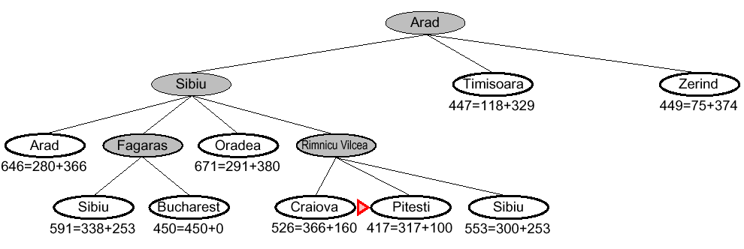
Heuristic Search
A* search example

Slide 32
Heuristic Search
Properties of A*
Complete?? Yes, unless there are infinitely many nodes with f ≤ f(G)
Time?? Exponential based on the [relative error in h x length of solution.]
Space?? Keeps all nodes in memory
Optimal?? Yes – cannot expand f _{i+1} until f_{i} is finished A* expands all nodes with f(n) < C* A* expands some nodes with f(n) = C* A* expands no nodes with f(n) > C*

Slide 33
Heuristic Search
A* search
A* search uses an admissible heuristic
i.e., h(n) ≤ h*(n) where h*(n) is the true cost from n. (also require h(n) ≥0, so h(G) = 0 for any goal G.) example, h_{SLD}(n) never overestimates the actual road distance.

Slide 34
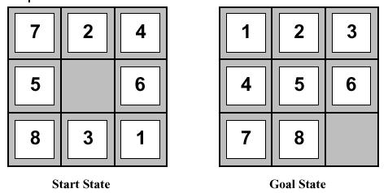
Heuristic Functions
Admissible heuristic example: for the 8-puzzle
h₁(n) = number of misplaced tiles
h₂(n) = total Manhattan distance [num of squares from desired location of each tile]
h₁(S) = ?? h₂(S) = ??

Slide 35
Heuristic Functions
Admissible heuristic example: for the 8-puzzle
h₁(n) = number of misplaced tiles
h₂(n) = total Manhattan distance [num of squares from desired location of each tile]
h₁(S) = 6 h₂(S) = ??

Slide 36
Heuristic Functions
Admissible heuristic example: for the 8-puzzle
h₁(n) = number of misplaced tiles
h₂(n) = total Manhattan distance [num of squares from desired location of each tile]
h₁(S) = 6 h₂(S) = 4+0+3+3+1+0+2+1 = 14

Slide 37
Heuristic Functions
Dominance
if h₂(n) ≥ h₁(n) for all n (both admissible) then h₂ dominates h₁ and is better for search Typical search costs: d = 14 A*(h₁) = 539 nodes A*(h₂) = 113 nodes d = 24 A*(h₁) = 39,135 nodes A*(h₂) = 1,641 nodes

