Slide 1
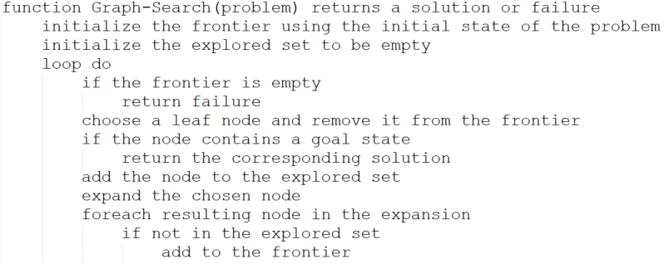
Implementation: General Tree Search

Slide 2
Implementation: General Tree Search

Slide 3
Uninformed Search Strategies
Uninformed strategies use only information available in the problem definition
Breadth-first search
Uniform-cost search
Depth-first search
Depth-limited search
Iterative deepening search

Slide 4
Uninformed Search Strategies
Uninformed strategies use only information available in the problem definition
Breadth-first search
Uniform-cost search
Depth-first search
Depth-limited search
Iterative deepening search

Slide 5
Search Strategies
A strategy is defined by picking the order of node expansion
Strategies are evaluated along the following dimensions:
completeness – does it always find a solution if one exists?
time complexity – number of nodes generated/expanded
space complexity – maximum number of nodes in memory
optimality – does it always find a least-cost solution

Slide 6
Search Strategies
Time and space complexity are measured in terms of b – maximum branching factor of the search tree d – depth of the least-cost solution m – maximum depth of the state space (may be infinite)

Slide 7
Properties of Breadth-First Search
Complete?? Yes (if b is finite)
Time?? 1 + b + b² + b³ + … + b^{d} + b(b^{d} – 1) = O( b^{d+1} ), ie, exp. in d
Space?? O( b^{d+1} ) (keep every node in memory)
Optimal?? Yes (if cost = 1 per step); not optimal in general
Space is the big problem: can easily generate nodes at 100MB/sec, so 24hours = 8.60 TB

Slide 8
Properties of Depth-first Search
Complete?? No: fails in infinite-depth spaces, spaces with loops Modify to avoid repeated states along path ⇒ complete in finite spaces
Time?? O(b^{m}): terrible if m is much larger than d but if solutions are dense, may be much faster than breadth-first
Space?? O(bm), i.e., linear space!
Optimal?? No.

Slide 9
Uninformed Search Strategies
Uninformed strategies use only information available in the problem definition
Breadth-first search
Uniform-cost search
Depth-first search
Depth-limited search
Iterative deepening search

Slide 10
Properties of Breadth-First Search
Complete?? Yes (if b is finite)
Time?? 1 + b + b² + b³ + … + b^{d} + b(b^{d} – 1) = O( b^{d+1} ), ie, exp. in d
Space?? O( b^{d+1} ) (keep every node in memory)
Optimal?? Yes (if cost = 1 per step); not optimal in general
Space is the big problem: can easily generate nodes at 100MB/sec, so 24hours = 8.60 TB

Slide 11
Properties of Breadth-First Search
Complete?? Yes (if b is finite)
Time?? 1 + b + b² + b³ + … + b^{d} + b(b^{d} – 1) = O( b^{d+1} ), ie, exp. in d
Space?? O( b^{d+1} ) (keep every node in memory)
Optimal?? Yes (if cost = 1 per step); not optimal in general
Space is the big problem: can easily generate nodes at 100MB/sec, so 24hours = 8.60 TB

Slide 12
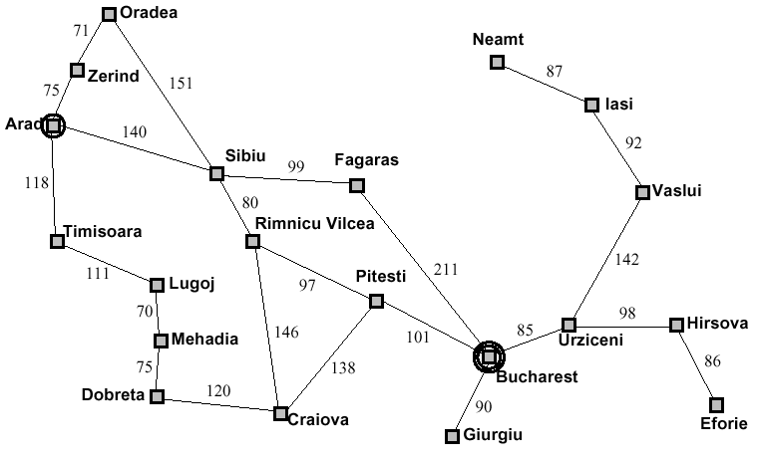
Problem Solving Agents

Slide 13
Uniform-cost Search
Expand least-cost unexpanded node
Implementation:
Frontier = queue ordered by path cost
Equivalent to breadth-first if step costs all equal

Slide 14
Problem Solving Agents
0

Slide 15
Problem Solving Agents
75
140
118

Slide 16
Problem Solving Agents
75
140
118

Slide 17
Problem Solving Agents
146
150
140
118

Slide 18
Problem Solving Agents
150
140
118

Slide 19
Problem Solving Agents
146
150
140
236
118
229

Slide 20
Problem Solving Agents
146
150
140
236
229

Slide 21
Problem Solving Agents
146
150
140
236
229

Slide 22
Problem Solving Agents
146
146
302
150
236
140
140
239
280
229
220

Slide 23
Let's skip forward, hiding some details

Slide 24
Problem Solving Agents
146
146
302
150
236
239
280
229
220

Slide 25
Problem Solving Agents
302
150
236
239
280
229
220

Slide 26
Problem Solving Agents
302
236
239
280
229
220

Slide 27
Problem Solving Agents
239
229
220

Slide 28
Problem Solving Agents
239
229
317
366

Slide 29
Problem Solving Agents
239
299
317
366

Slide 30
Problem Solving Agents
299
450
317
366

Slide 31
Problem Solving Agents
450
317
366
374

Slide 32
Problem Solving Agents
450
366
418
374

Slide 33
Problem Solving Agents
504
450
418
374

Slide 34
Problem Solving Agents
504
450
494
418

Slide 35
Problem Solving Agents
504
450
494
418

Slide 36
Problem Solving Agents
Note: Recall that we aren't showing the "loop back" nodes in this diagram.
By my calculation there are 78 nodes in memory when Bucharest is finally found.
504
450
494
418

Slide 37
Uniform-cost Search
Expand least-cost unexpanded node
Implementation:
Frontier = queue ordered by path cost
Equivalent to breadth-first if step costs all equal
Complete??

Slide 38
Uniform-cost Search
Expand least-cost unexpanded node
Implementation:
Frontier = queue ordered by path cost
Equivalent to breadth-first if step costs all equal
Complete?? Yes, if step cost ≥ε

Slide 39
Uniform-cost Search
Expand least-cost unexpanded node
Implementation:
Frontier = queue ordered by path cost
Equivalent to breadth-first if step costs all equal
Complete?? Yes, if step cost ≥ε
Time??

Slide 40
Uniform-cost Search
Expand least-cost unexpanded node
Implementation:
Frontier = queue ordered by path cost
Equivalent to breadth-first if step costs all equal
Complete?? Yes, if step cost ≥ε
Time?? # of nodes with g ≤ cost of optimal solution, O(b ^{⎡C*/ε⎤}) where C* is cost of optimal solution

Slide 41
Uniform-cost Search
Expand least-cost unexpanded node
Implementation:
Frontier = queue ordered by path cost
Equivalent to breadth-first if step costs all equal
Complete?? Yes, if step cost ≥ε
Time?? # of nodes with g ≤ cost of optimal solution, O(b ^{⎡C*/ε⎤}) where C* is cost of optimal solution
Space??

Slide 42
Uniform-cost Search
Expand least-cost unexpanded node
Implementation:
Frontier = queue ordered by path cost
Equivalent to breadth-first if step costs all equal
Complete?? Yes, if step cost ≥ε
Time?? # of nodes with g ≤ cost of optimal solution, O(b ^{⎡C*/ε⎤}) where C* is cost of optimal solution
Space?? # of nodes with g ≤ cost of optimal solution, O(b ^{⎡C*/ε⎤})

Slide 43
Uniform-cost Search
Expand least-cost unexpanded node
Implementation:
Frontier = queue ordered by path cost
Equivalent to breadth-first if step costs all equal
Complete?? Yes, if step cost ≥ε
Time?? # of nodes with g ≤ cost of optimal solution, O(b ^{⎡C*/ε⎤}) where C* is cost of optimal solution
Space?? # of nodes with g ≤ cost of optimal solution, O(b ^{⎡C*/ε⎤})
Optimal??

Slide 44
Uniform-cost Search
Expand least-cost unexpanded node
Implementation:
Frontier = queue ordered by path cost
Equivalent to breadth-first if step costs all equal
Complete?? Yes, if step cost ≥ε
Time?? # of nodes with g ≤ cost of optimal solution, O(b ^{⎡C*/ε⎤}) where C* is cost of optimal solution
Space?? # of nodes with g ≤ cost of optimal solution, O(b ^{⎡C*/ε⎤})
Optimal?? Yes – nodes expanded in increasing order of g(n)

