Slide 1
Unit 8 - Lesson 3
Binary Search

Slide 3
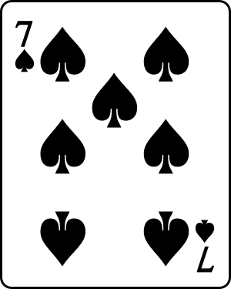
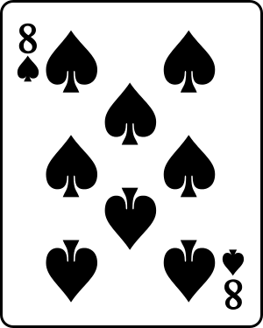
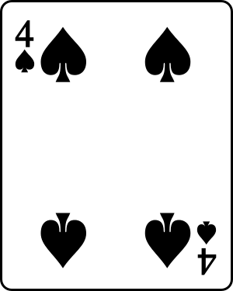
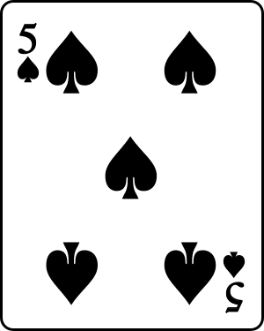
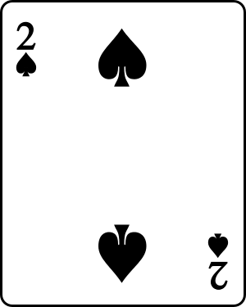
Binary Search - Warm Up
What would the worst case execution count be if we used a linear search to find a specific card?
📝 Unit 8 Guide

Slide 4
Binary Search - Warm Up
What if this was the deck we needed to search?
📝 Unit 8 Guide

Slide 5
Binary Search - Warm Up
Target: 4 of Spades

Slide 7
Binary Search - Activity
Compare the efficiency of the binary search algorithm with the linear search algorithm using execution counts
Identify the benefits and limitations of the binary search algorithm

Slide 8
Binary Search - Activity
How is a binary search more efficient than a linear search?

Slide 9
Binary Search - Activity
Activity 2
Predict the output of the program
There are no wrong answers!
Run it to compare your prediction with the results

Slide 10
Binary Search - Activity
What did you notice about the code in this program?
What do you wonder about the code in this program?

Slide 11
Binary Search - Activity
The binary search algorithm finds a target element in a sorted list by dividing the list in half in each iteration.
60
5
10
0
60
5
10
0
20
1
20
1
30
2
30
2
40
3
50
4
50
4
low
mid
low
mid
mid
high
Target: 40
📝 Unit 8 Guide

Slide 12
Binary Search
Binary Search - Activity
📍You and your partner should have:
Activity guide (section 2b)
One suit from a deck of cards
pen / pencil

Slide 13
Binary Search - Activity
Share your execution counts and answers for your trace table with the class.

Slide 14
Binary Search - Activity
How does increasing the length of the array impact the execution count?
📝 Unit 8 Guide

Slide 15
Binary Search - Activity
How does the execution counts for the binary search algorithm compare to the execution counts for the linear search algorithm?
📝 Unit 8 Guide

Slide 16
Recursion - Activity
public int recursiveSum(int num) {
if (num <= 1) {
return num;
}
return num + recursiveSum(num - 1);
}
The base case is the instance where a recursive method will return a value rather than calling itself.
The recursive case is the instance where the recursive method calls itself.
Recursion is when a method calls itself.

Slide 17
Binary Search - Activity
Navigate to Lesson 3, Level 2
Investigate the code on Levels 2 through 4
Make changes as prompted and observe the results

Slide 18
Binary Search - Activity
What did you notice about the code in this program?
What do you wonder about the code in this program?

Slide 19
Binary Search - Activity
Searcher.java
public static int binarySearch(int[] nums, int left, int right, int target) {
if (left > right) {
return -1;
}
int middle = (left + right) / 2;
if (target < nums[middle]) {
return binarySearch(nums, left, middle - 1, target);
}
else if (target > nums[middle]) {
return binarySearch(nums, middle + 1, right, target);
}
else {
return middle;
}
}
The recursive binary search method has parameters for the array to search, the index for the left position, the index for the right position, and the value to find.
The base case returns -1 if the left position is greater than the right position.
This indicates that the target was not found in the array.
If the value to find is less than the value at the middle position, we call the method with the right position set to the middle position minus 1.
If the value to find is greater than the value at the middle position, we call the method with the left position set to the middle position plus 1.
Otherwise, the value to find is equal to the middle position so we return the middle position.
📝 Unit 8 Guide

Slide 21
Binary Search - Wrap Up
Revisit your Need to Knows!
Check off answered questions in the Need to Know column.
Add what you have learned and answers to any questions in the Learned column
Add any new questions to the Need to Know column

Slide 22
Binary Search - Wrap Up
Share your updates with a partner.

Slide 23
Binary Search - Wrap Up
Comparing the efficiency of the binary search algorithm with the linear search algorithm using execution counts
The benefits and limitations of the binary search algorithm

Slide 24
Binary Search - Wrap Up
How is a binary search more efficient than a linear search?

Slide 25
💼 Key Vocabulary
Binary Search - Wrap Up
binary search: a search algorithm that finds a target element in a sorted list by dividing the list in half in each iteration

