Slide 1
Agents that Search

Slide 2
Consider this problem
Three missionaries and three cannibals
Want to cross a river using one canoe.
Canoe can hold up to two people.
Can never be more cannibals than missionaries on either side of the river.
Aim: To get all safely across the river without any missionaries being eaten.

Slide 3
Why am I teaching you search?
Gives us a chance to:
  design a non-trivial problem
  talk about (use) the first two ADTs
  build one or two domain specific data types (classes)
  really apply the complexity operations we introduced with searching/sorting

Slide 4
Search Problem Formulation
A problem is defined by four items:
  initial state
  successor function (which actually defines all reachable states)
  goal test
  path cost (additive)
    e.g., sum of distances, # of actions executed, etc.
    C(x,a,y) is the step cost, assumed to be ≥ 0

Slide 5
Consider this problem
Three missionaries and three cannibals
Want to cross a river using one canoe.
Canoe can hold up to two people.
Can never be more cannibals than missionaries on either side of the river.
States?? Actions?? Goal test?? Path cost??

Slide 6
Problem Representation : Cannibals and Missionaries
Initial State
  We can show number of cannibals, missionaries and canoes on each side of the river.
  Start state is therefore:
    [3,3,1,0,0,0]

Slide 7
Problem Representation : Cannibals and Missionaries
Initial State
  However, since the system is closed, we only need to represent one side of the river, as we can deduce the other side.
  We will represent the starting side of the river, and omit the ending side.
  So start state is:
    [3,3,1]

Slide 8
Problem Representation : Cannibals and Missionaries
Goal State(s)
  [0,0,0]
  TECHNICALLY also [0,0,1]

Slide 9
Problem Representation : Cannibals and Missionaries
Successor Function (3 actions)
    Move one missionary.
    Move one cannibal.
    Move one missionary and one cannibal.

Slide 10
Problem Representation : Cannibals and Missionaries
Successor Function
  To be a little more mathematical/computer like, we want to represent this in a true successor function format…
      S(state) ⇒ state
    Move one cannibal across the river.
      S([x,y,1]) ⇒ [x-1,y,0]
      S([x,y,0]) ⇒ [x+1,y,1]
  [Note, this is a slight simplification.
  We also require, 0 ≤ x, y, [x+1 or x-1] ≤ 3]

Slide 11
Problem Representation : Cannibals and Missionaries
Successor Function
      S([x,y,0]) ⇒ [x+1,y,1] //1 missionary
      S([x,y,1]) ⇒ [x-1,y,0]
      S([x,y,0]) ⇒ [x,y+1,1] //1 cannibal
      S([x,y,1]) ⇒ [x,y-1,0]
      S([x,y,0]) ⇒ [x+1,y+1,1] // 1 of each
      S([x,y,1]) ⇒ [x-1,y-1,0]

Slide 12
Problem Representation : Cannibals and Missionaries
Path Cost
  One unit per trip across the river.

Slide 13
Solution
What is the Solution?
How did you arrive at that solution?

Slide 14
Travelling in Romania
Suppose you travelling in Romania
Currently you are in Arad
Your flight leaves Bucharest tomorrow morning so you need to get to the airport

Slide 15
You Try It
https://replit.com/@CSED5320-F22/Arad-To-Bucharest#main.py
Once the page loads press the run button towards the top of the page.
Be patient. It takes 3-4 seconds to fully load.
Record your process on scratch paper

Slide 16
Solution
What Solution(s) did you find?
How did you arrive at that solution(s)?

Slide 17
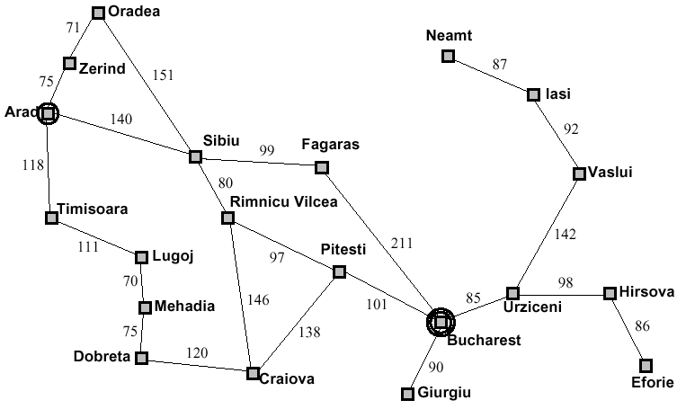
Problem Solving Agents

Slide 18
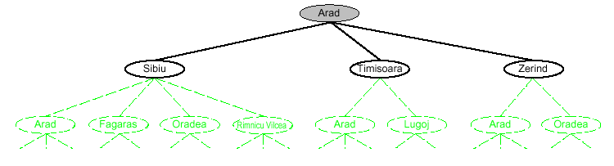
Tree Search Example

Slide 19
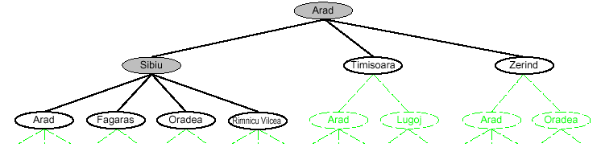
Tree Search Example

Slide 20
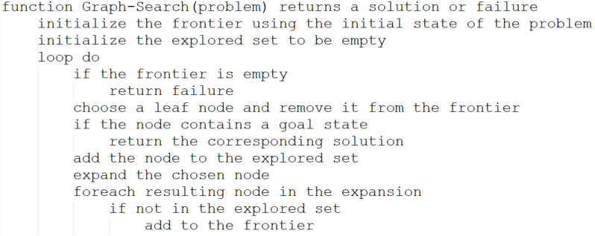
Implementation: General Tree Search

Slide 21
Implementation: General Tree Search

Slide 22
Uninformed Search Strategies
Uninformed strategies use only information available in the problem definition
  Breadth-first search
  Uniform-cost search
  Depth-first search
  Depth-limited search
  Iterative deepening search

Slide 23
Uninformed Search Strategies
Uninformed strategies use only information available in the problem definition
  Breadth-first search
  Uniform-cost search
  Depth-first search
  Depth-limited search
  Iterative deepening search

Slide 24
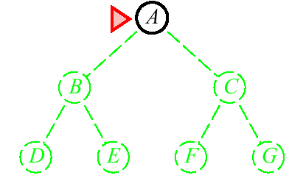
Breadth-First Search
Expanding shallowest unexpanded node
Implementation
fringe is a FIFO queue, i.e.,
new successors go at end

Slide 25
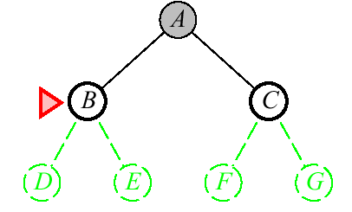
Breadth-First Search
Expanding shallowest unexpanded node
Implementation
fringe is a FIFO queue, i.e.,
new successors go at end

Slide 26
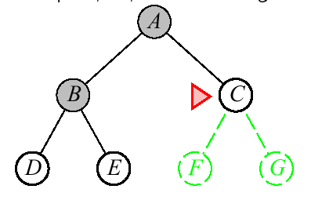
Breadth-First Search
Expanding shallowest unexpanded node
Implementation
fringe is a FIFO queue, i.e.,
new successors go at end

Slide 27
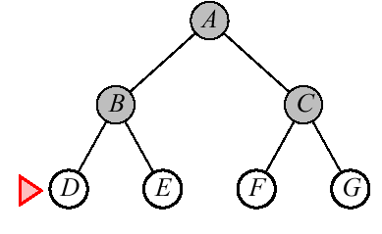
Breadth-First Search
Expanding shallowest unexpanded node
Implementation
fringe is a FIFO queue, i.e.,
new successors go at end

Slide 28
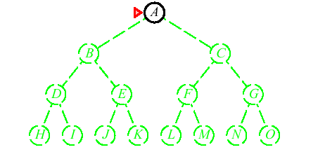
Depth-First Search
Expand deepest unexpanded node
Implementation:
fringe = LIFO queue, I.e., put successors
at front

Slide 29
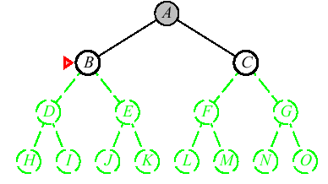
Depth-First Search
Expand deepest unexpanded node
Implementation:
fringe = LIFO queue, I.e., put successors
at front

Slide 30
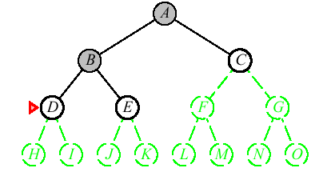
Depth-First Search
Expand deepest unexpanded node
Implementation:
fringe = LIFO queue, I.e., put successors
at front

Slide 31
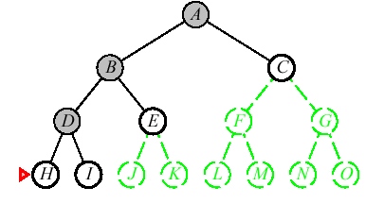
Depth-First Search
Expand deepest unexpanded node
Implementation:
fringe = LIFO queue, I.e., put successors
at front

Slide 32
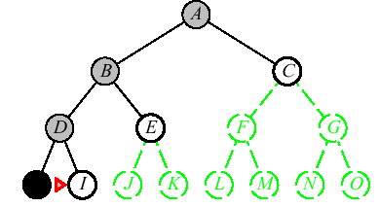
Depth-First Search
Expand deepest unexpanded node
Implementation:
fringe = LIFO queue, I.e., put successors
at front

Slide 33
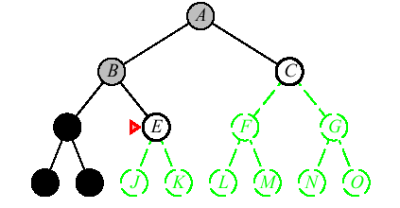
Depth-First Search
Expand deepest unexpanded node
Implementation:
fringe = LIFO queue, I.e., put successors
at front

Slide 34
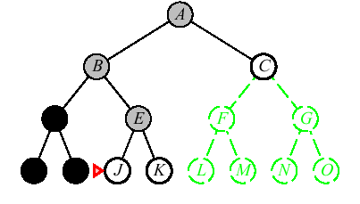
Depth-First Search
Expand deepest unexpanded node
Implementation:
fringe = LIFO queue, I.e., put successors
at front

Slide 35
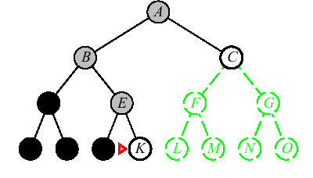
Depth-First Search
Expand deepest unexpanded node
Implementation:
fringe = LIFO queue, I.e., put successors
at front

Slide 36
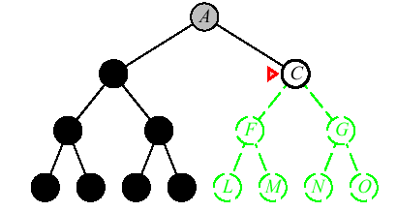
Depth-First Search
Expand deepest unexpanded node
Implementation:
fringe = LIFO queue, I.e., put successors
at front

Slide 37
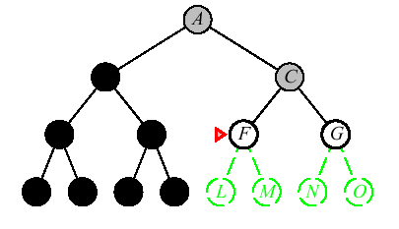
Depth-First Search
Expand deepest unexpanded node
Implementation:
fringe = LIFO queue, I.e., put successors
at front

Slide 38
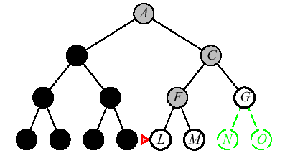
Depth-First Search
Expand deepest unexpanded node
Implementation:
fringe = LIFO queue, I.e., put successors
at front

Slide 39
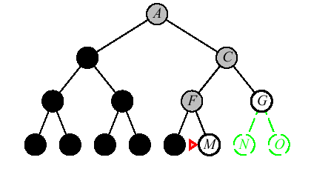
Depth-First Search
Expand deepest unexpanded node
Implementation:
fringe = LIFO queue, I.e., put successors
at front

Slide 40
Search Strategies
A strategy is defined by picking the order of node expansion
Strategies are evaluated along the following dimensions:
completeness – does it always find a
solution if one exists?
time complexity – number of nodes
generated/expanded
space complexity – maximum number of
nodes in memory
optimality – does it always find a least-cost
solution

Slide 41
Search Strategies
Time and space complexity are measured in terms of
b – maximum branching factor of the search tree
d – depth of the least-cost solution
m – maximum depth of the state space (may be infinite)

Slide 42
Properties of Breadth-First Search
Complete??

Slide 43
Properties of Breadth-First Search
Complete?? Yes (if b is finite)
Time??

Slide 44
Properties of Breadth-First Search
Complete?? Yes (if b is finite)
Time?? 1 + b + b² + b³ + … + b^{d} + b(b^{d} – 1)
= O( b^{d+1} ), ie, exp. in d
Space??

Slide 45
Properties of Breadth-First Search
Complete?? Yes (if b is finite)
Time?? 1 + b + b² + b³ + … + b^{d} + b(b^{d} – 1)
= O( b^{d+1} ), ie, exp. in d
Space?? O( b^{d+1} ) (keep every node in memory)
Optimal??

Slide 46
Properties of Breadth-First Search
Complete?? Yes (if b is finite)
Time?? 1 + b + b² + b³ + … + b^{d} + b(b^{d} – 1)
= O( b^{d+1} ), ie, exp. in d
Space?? O( b^{d+1} ) (keep every node in memory)
Optimal?? Yes (if cost = 1 per step); not optimal in general
Space is the big problem: can easily generate nodes at 10MB/sec, so 24hours = 860GB.

Slide 47
Properties of Depth-first Search
Complete??

Slide 48
Properties of Depth-first Search
Complete?? No: fails in infinite-depth spaces, spaces with loops
Modify to avoid repeated states along path
⇒complete in finite spaces
Time??

Slide 49
Properties of Depth-first Search
Complete?? No: fails in infinite-depth spaces, spaces with loops
Modify to avoid repeated states along path
⇒complete in finite spaces
Time?? O(b^{m}): terrible if m is much larger than d
but if solutions are dense, may be much faster than breadth-first
Space??

Slide 50
Properties of Depth-first Search
Complete?? No: fails in infinite-depth spaces, spaces with loops
Modify to avoid repeated states along path
⇒complete in finite spaces
Time?? O(b^{m}): terrible if m is much larger than d
but if solutions are dense, may be much faster than breadth-first
Space?? O(bm), i.e., linear space!
Optimal??

Slide 51
Properties of Depth-first Search
Complete?? No: fails in infinite-depth spaces, spaces with loops
Modify to avoid repeated states along path
⇒complete in finite spaces
Time?? O(b^{m}): terrible if m is much larger than d
but if solutions are dense, may be much faster than breadth-first
Space?? O(bm), I.e., linear space!
Optimal?? No.

Slide 52
This is where I stopped in the video

Slide 53
Uninformed Search Strategies
Uninformed strategies use only information available in the problem definition
  Breadth-first search
  Uniform-cost search
  Depth-first search
  Depth-limited search
  Iterative deepening search

Slide 54
Properties of Breadth-First Search
Complete?? Yes (if b is finite)
Time?? 1 + b + b² + b³ + … + b^{d} + b(b^{d} – 1)
= O( b^{d+1} ), ie, exp. in d
Space?? O( b^{d+1} ) (keep every node in memory)
Optimal?? Yes (if cost = 1 per step); not optimal in general
Space is the big problem: can easily generate nodes at 10MB/sec, so 24hours = 860GB.

Slide 55
Properties of Breadth-First Search
Complete?? Yes (if b is finite)
Time?? 1 + b + b² + b³ + … + b^{d} + b(b^{d} – 1)
= O( b^{d+1} ), ie, exp. in d
Space?? O( b^{d+1} ) (keep every node in memory)
Optimal?? Yes (if cost = 1 per step); not optimal in general
Space is the big problem: can easily generate nodes at 10MB/sec, so 24hours = 860GB.

Slide 56
Problem Solving Agents

Slide 57
Uniform-cost Search
Expand least-cost unexpanded node
Implementation:
  fringe = queue ordered by path cost
  Equivalent to breadth-first if step costs all equal

Slide 58
Problem Solving Agents
0

Slide 59
Problem Solving Agents
75
140
118

Slide 60
Problem Solving Agents
75
140
118

Slide 61
Problem Solving Agents
146
150
140
118

Slide 62
Problem Solving Agents
150
140
118

Slide 63
Problem Solving Agents
146
150
140
236
118
229

Slide 64
Problem Solving Agents
146
150
140
236
229

Slide 65
Problem Solving Agents
146
150
140
236
229

Slide 66
Problem Solving Agents
146
146
302
150
236
140
140
239
280
229
220

Slide 67
Let's skip forward, hiding some details

Slide 68
Problem Solving Agents
146
146
302
150
236
239
280
229
220

Slide 69
Problem Solving Agents
302
150
236
239
280
229
220

Slide 70
Problem Solving Agents
302
236
239
280
229
220

Slide 71
Problem Solving Agents
239
229
220

Slide 72
Problem Solving Agents
239
229
317
366

Slide 73
Problem Solving Agents
239
299
317
366

Slide 74
Problem Solving Agents
299
450
317
366

Slide 75
Problem Solving Agents
450
317
366
374

Slide 76
Problem Solving Agents
450
366
418
374

Slide 77
Problem Solving Agents
504
450
418
374

Slide 78
Problem Solving Agents
504
450
494
418

Slide 79
Problem Solving Agents
504
450
494
418

Slide 80
Problem Solving Agents
Note: Recall that we aren't showing the "loop back" nodes in this diagram.
By my calculation there are 78 nodes in memory when Bucharest is finally found.
504
450
494
418

Slide 81
Uniform-cost Search
Expand least-cost unexpanded node
Implementation:
  fringe = queue ordered by path cost
  Equivalent to breadth-first if step costs all equal
Complete??

Slide 82
Uniform-cost Search
Expand least-cost unexpanded node
Implementation:
  fringe = queue ordered by path cost
  Equivalent to breadth-first if step costs all equal
Complete?? Yes, if step cost ≥ε

Slide 83
Uniform-cost Search
Expand least-cost unexpanded node
Implementation:
  fringe = queue ordered by path cost
  Equivalent to breadth-first if step costs all equal
Complete?? Yes, if step cost ≥ε
Time??

Slide 84
Uniform-cost Search
Expand least-cost unexpanded node
Implementation:
  fringe = queue ordered by path cost
  Equivalent to breadth-first if step costs all equal
Complete?? Yes, if step cost ≥ε
Time?? # of nodes with g ≤ cost of optimal solution, O(b ^{⎡C*/ε⎤}) where C* is cost of optimal solution

Slide 85
Uniform-cost Search
Expand least-cost unexpanded node
Implementation:
  fringe = queue ordered by path cost
  Equivalent to breadth-first if step costs all equal
Complete?? Yes, if step cost ≥ε
Time?? # of nodes with g ≤ cost of optimal solution, O(b ^{⎡C*/ε⎤}) where C* is cost of optimal solution
Space??

Slide 86
Uniform-cost Search
Expand least-cost unexpanded node
Implementation:
  fringe = queue ordered by path cost
  Equivalent to breadth-first if step costs all equal
Complete?? Yes, if step cost ≥ε
Time?? # of nodes with g ≤ cost of optimal solution, O(b ^{⎡C*/ε⎤}) where C* is cost of optimal solution
Space?? # of nodes with g ≤ cost of optimal solution, O(b ^{⎡C*/ε⎤})

Slide 87
Uniform-cost Search
Expand least-cost unexpanded node
Implementation:
  fringe = queue ordered by path cost
  Equivalent to breadth-first if step costs all equal
Complete?? Yes, if step cost ≥ε
Time?? # of nodes with g ≤ cost of optimal solution, O(b ^{⎡C*/ε⎤}) where C* is cost of optimal solution
Space?? # of nodes with g ≤ cost of optimal solution, O(b ^{⎡C*/ε⎤})
Optimal??

Slide 88
Uniform-cost Search
Expand least-cost unexpanded node
Implementation:
  fringe = queue ordered by path cost
  Equivalent to breadth-first if step costs all equal
Complete?? Yes, if step cost ≥ε
Time?? # of nodes with g ≤ cost of optimal solution, O(b ^{⎡C*/ε⎤}) where C* is cost of optimal solution
Space?? # of nodes with g ≤ cost of optimal solution, O(b ^{⎡C*/ε⎤})
Optimal?? Yes – nodes expanded in increasing order of g(n)

Slide 89
Properties of Depth-first Search
Complete?? No: fails in infinite-depth spaces, spaces with loops
Modify to avoid repeated states along path
⇒complete in finite spaces
Time?? O(b^{m}): terrible if m is much larger than d
but if solutions are dense, may be much faster than breadth-first
Space?? O(bm), I.e., linear space!
Optimal?? No

Slide 90
Properties of Depth-first Search
Complete?? No: fails in infinite-depth spaces, spaces with loops
Modify to avoid repeated states along path
⇒complete in finite spaces
Time?? O(b^{m}): terrible if m is much larger than d
but if solutions are dense, may be much faster than breadth-first
Space?? O(bm), I.e., linear space!
Optimal?? No

Slide 91
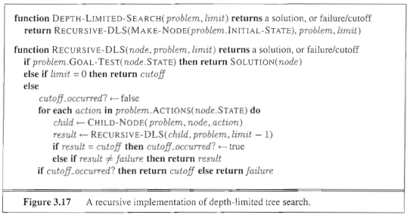
Depth-limited Search
= depth-first search with depth limit L,
i.e., nodes at depth L have no successors
Recursive implementation:

Slide 92
Properties of Depth Limited
Complete?? Yes – IF the L>=d
Time?? O(b^{L}): terrible if L is much larger than d
but if solutions are dense, may be much faster than breadth-first
Space?? O(bL), I.e., linear space!
Optimal?? No

Slide 93
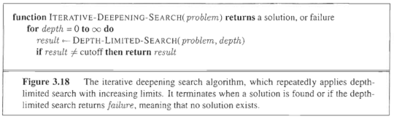
Iterative Deepening Search

Slide 94
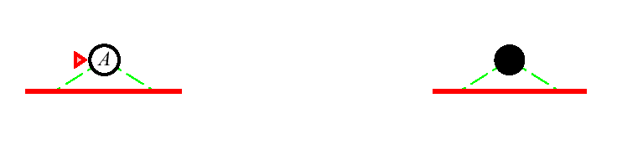
Iterative Deepening Search l = 0
Limit = 0

Slide 95

Iterative Deepening Search l = 1
Limit = 1

Slide 96
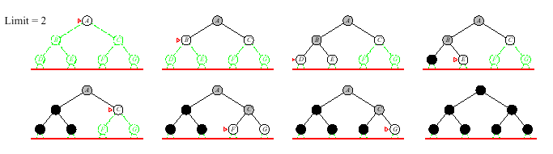
Iterative Deepening Search l = 2
Limit = 2

Slide 97
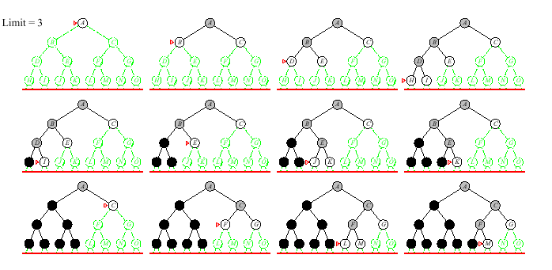
Iterative Deepening Search l = 3
Limit = 3

Slide 98
Properties of Iterative Deepening Search
Complete??

Slide 99
Properties of Iterative Deepening Search
Complete?? Yes
Time??

Slide 100
Properties of Iterative Deepening Search
Complete?? Yes
Time?? (d+1)b⁰ + db¹ + (d-1)b² + … + b^{d} = O(b^{d})
Space??

Slide 101
Properties of Iterative Deepening Search
Complete?? Yes
Time?? (d+1)b⁰ + db¹ + (d-1)b² + … + b^{d} = O(b^{d})
Space?? O(bd)
Optimal??

Slide 102
Properties of Iterative Deepening Search
Complete?? Yes
Time?? (d+1)b⁰ + db¹ + (d-1)b² + … + b^{d} = O(b^{d})
Space?? O(bd)
Optimal?? Yes, if step cost = 1
Can be modified to explore uniform-cost tree
Numerical comparison for b=10 and d=5, solution at far right:
N(IDS) = 50 + 400 + 3,000 + 20,000 + 100,000 = 123,450
N(BFS) = 10 + 100 + 1,000 + 10,000 + 100,000 + 999,990 = 1,111,100

Slide 103
Uninformed Search Strategies
Uninformed strategies use only information available in the problem definition
  Breadth-first search
  Uniform-cost search
  Depth-first search
  Depth-limited search
  Iterative deepening search

Slide 104
Iterative Deepening Search

Slide 105
Iterative Deepening Search l = 0
Limit = 0

Slide 106
Iterative Deepening Search l = 1
Limit = 1

Slide 107
Iterative Deepening Search l = 2
Limit = 2

Slide 108
Iterative Deepening Search l = 3
Limit = 3

Slide 109
Properties of Iterative Deepening Search
Complete?? Yes
Time?? (d+1)b⁰ + db¹ + (d-1)b² + … + b^{d} = O(b^{d})
Space?? O(bd)
Optimal?? Yes, if step cost = 1
Can be modified to explore uniform-cost tree
Numerical comparison for b=10 and d=5, solution at far right:
N(IDS) = 50 + 400 + 3,000 + 20,000 + 100,000 = 123,450
N(BFS) = 10 + 100 + 1,000 + 10,000 + 100,000 + 999,990 = 1,111,100

Slide 110
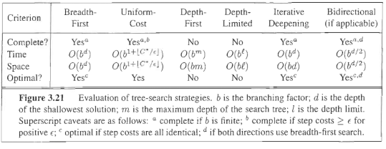
Summary of algorithms

Slide 111
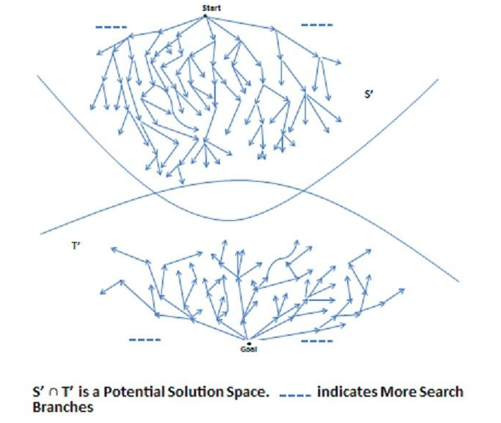
Bidirectional Search

Slide 112
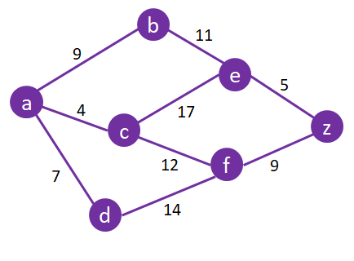
Let’s Try Another
Breadth First
Depth First
Uniform Cost
Iterative Deepening

Slide 113
Search Strategies
A strategy is defined by picking the order of node expansion
Strategies are evaluated along the following dimensions:
completeness – does it always find a
solution if one exists?
time complexity – number of nodes
generated/expanded
space complexity – maximum number of
nodes in memory
optimality – does it always find a least-cost
solution

Slide 114
Search Strategies
Time and space complexity are measured in terms of
b – maximum branching factor of the search tree
d – depth of the least-cost solution
m – maximum depth of the state space (may be infinite)

Slide 115
Properties of Breadth-First Search
Complete?? Yes (if b is finite)
Time?? 1 + b + b² + b³ + … + b^{d} + b(b^{d} – 1)
= O( b^{d+1} ), ie, exp. in d
Space?? O( b^{d+1} ) (keep every node in memory)
Optimal?? Yes (if cost = 1 per step); not optimal in general

Slide 116
Activity
Start State : the number 1
Successor Function : for state n returns two states, numbers 2n and 2n+1.
Goal state : 13
Path Cost : 1 per "move"
  List the order in which nodes will be visited for breadth-first search.
  What nodes are "in memory" when the goal state is reached?

Slide 117
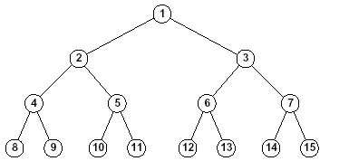
Solution
Breadth First visit order
  1, 2, 3, 4, 5, 6, 7, 8 , 9, 10,
  11, 12, 13
Nodes in memory
  1 through 25

Slide 118
Properties of Depth-first Search
Complete?? No: fails in infinite-depth spaces, spaces with loops
Modify to avoid repeated states along path
⇒complete in finite spaces
Time?? O(b^{m}): terrible if m is much larger than d
but if solutions are dense, may be much faster than breadth-first
Space?? O(bm), i.e., linear space!
Optimal?? No.

Slide 119
Activity
Start State : the number 1
Successor Function : for state n returns two states, numbers 2n and 2n+1.
Goal state : 13
Path Cost : 1 per "move"
  List the order in which nodes will be visited for depth-first search.
  What nodes are "in memory" when the goal state is reached?

Slide 120
Solution
Depth First visit order
  Trick Question
  1, 2, 4, 8, 16, 32, ….

Slide 121
Activity
Consider a state space where the start state is number 1 and the successor function for state n returns two states, numbers 2n and 2n+1.
  Suppose the goal state is 11.
  List the order in which nodes will be visited in depth limited search with limit 4

Slide 122
Solution
Depth Limited, l=4
  1, 2, 4, 8, 16, 17, 9, 18, 19, 5, 10, 20, 21, 11

Slide 123
Activity
Consider a state space where the start state is number 1 and the successor function for state n returns two states, numbers 2n and 2n+1.
  Suppose the goal state is 11.
  List the order in which nodes will be visited using iterative deepening.

Slide 124
Solution
Iterative Deepening
  1, 1, 2, 3, 1, 2, 4, 5, 3, 6, 7, 1, 2, 4, 8, 9, 5, 10, 11

