Slide 1
Agents that Search
Review: "Uninformed" Search

Slide 2
Search Problem Formulation
A problem is defined by four items:
initial state
successor function (which actually defines all reachable states)
goal test
path cost (additive)
e.g., sum of distances, # of actions executed, etc.
C(x,a,y) is the step cost, assumed to be ≥ 0

Slide 3
Travelling in Romania
Suppose you travelling in Romania
Currently you are in Arad
Your flight leaves Bucharest tomorrow morning so you need to get to the airport

Slide 4
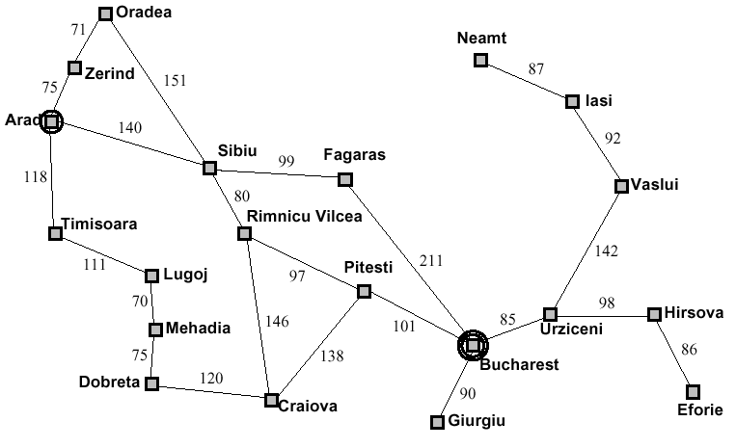
Problem Solving Agents

Slide 5
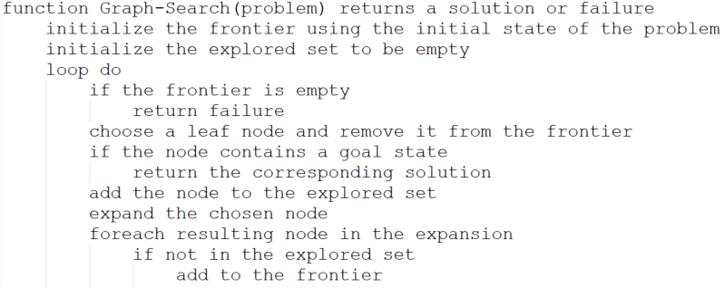
Implementation: General Tree Search

Slide 6
Implementation: General Tree Search

Slide 7
Uninformed Search Strategies
Uninformed strategies use only information available in the problem definition
Breadth-first search
Uniform-cost search
Depth-first search
Depth-limited search
Iterative deepening search

Slide 8
Search Strategies
A strategy is defined by picking the order of node expansion
Strategies are evaluated along the following dimensions: completeness – does it always find a solution if one exists? time complexity – number of nodes generated/expanded space complexity – maximum number of nodes in memory optimality – does it always find a least-cost solution

Slide 9
Search Strategies
Time and space complexity are measured in terms of b – maximum branching factor of the search tree d – depth of the least-cost solution m – maximum depth of the state space (may be infinite)

Slide 10
Properties of Breadth-First Search
Complete?? Yes (if b is finite)
Time?? 1 + b + b² + b³ + … + b^{d} + b(b^{d} – 1) = O( b^{d+1} ), ie, exp. in d
Space?? O( b^{d+1} ) (keep every node in memory)
Optimal?? Yes (if cost = 1 per step); not optimal in general
Space is the big problem: can easily generate nodes at 10MB/sec, so 24hours = 860GB.

Slide 11
Properties of Depth-first Search
Complete?? No: fails in infinite-depth spaces, spaces with loops Modify to avoid repeated states along path ⇒complete in finite spaces
Time?? O(b^{m}): terrible if m is much larger than d but if solutions are dense, may be much faster than breadth-first
Space?? O(bm), I.e., linear space!
Optimal?? No.

Slide 12
Heuristic Search aka "Informed" search

Slide 13
Review
Review: tree search a strategy is defined by picking the order of node expansion

Slide 14
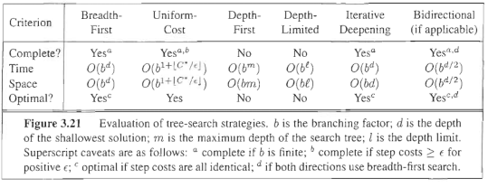
Summary of algorithms

Slide 15
Review
Review: tree search a strategy is defined by picking the order of node expansion
Even when we try to use knowledge about the problem (uniform cost search) we are limited to what we have “learned” This makes it a “backward looking” search.

Slide 16
But, when I ask you to get from Arad to Bucharest, what do you do?

Slide 17
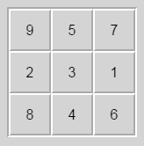
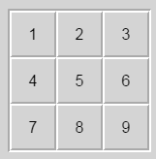
Twiddle
You know there are 8 options.
But which one(s) look more appealing? Why?

Slide 18
Heuristic Search
Heuristic searches use knowledge about the problem to include “forward looking” information.
That is, which move do I THINK would get me closest to the goal.

Slide 19
Heuristic Search
Best-first search: use an evaluation function for each node
Estimate of “desirability”
Expand most desirable unexpanded node
Implementation: frontier is a queue sorted in decreasing order of desirability
Special cases:
Greedy search
A* search

Slide 20
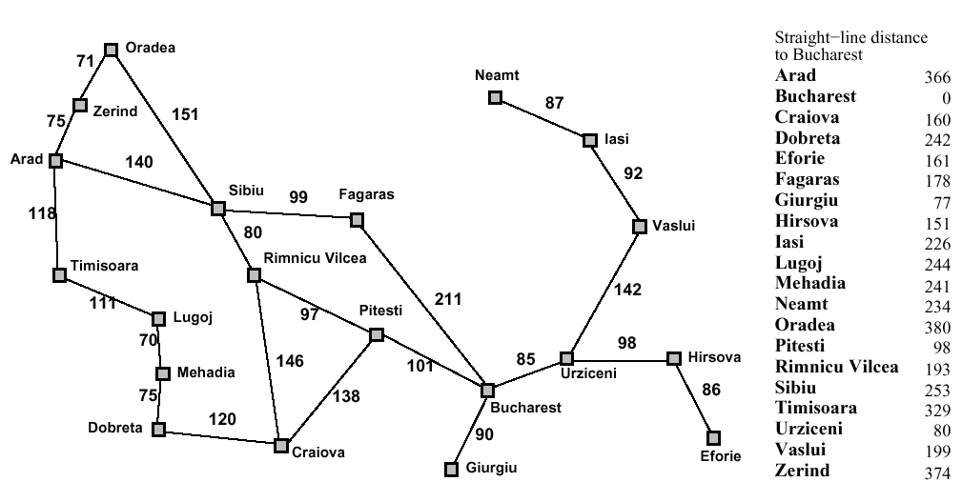
Heuristic Search
Romania with step costs in km

Slide 21
Heuristic Search
Greedy search
Evaluation function h(n) (heuristic) = estimate of cost from n to closest goal
Example: h_{SLD}(n) = straight-line distance from n to Bucharest
Greedy search expands the node that appears to be closest to goal

Slide 22
Heuristic search
Greedy search example

Slide 23
Heuristic Search
Greedy search example

Slide 24
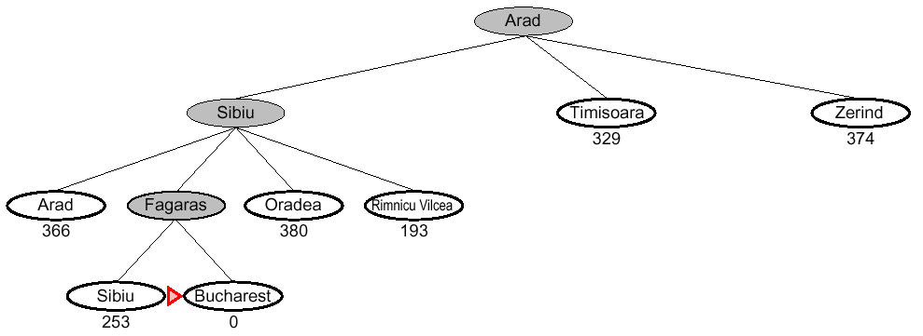
Heuristic Search
Greedy search example

Slide 25
Heuristic Search
Properties of greedy search
Complete??

Slide 26
Heuristic Search
Complete?? No – can get stuck in loops, e.g., start in Iasi with Oradea as goal….
Iasi → Neamt → Iasi → Neamt →
Complete in finite space with repeated-state checking

Slide 27
Heuristic Search
Properties of greedy search
Complete?? No – can get stuck in loops, e.g.,
Complete in finite space with repeated-state checking
Time??

Slide 28
Heuristic Search
Properties of greedy search
Complete?? No – can get stuck in loops, e.g.,
Complete in finite space with repeated-state checking
Time?? O(b^{m}), but a good heuristic can give dramatic improvement

Slide 29
Heuristic Search
Properties of greedy search
Complete?? No – can get stuck in loops, e.g.,
Complete in finite space with repeated-state checking
Time?? O(b^{m}), but a good heuristic can give dramatic improvement
Space??

Slide 30
Heuristic Search
Properties of greedy search
Complete?? No – can get stuck in loops, e.g.,
Complete in finite space with repeated-state checking
Time?? O(b^{m}), but a good heuristic can give dramatic improvement
Space?? O(b^{m}) – keeps all nodes in memory

Slide 31
Heuristic Search
Properties of greedy search
Complete?? No – can get stuck in loops, e.g.,
Complete in finite space with repeated-state checking
Time?? O(b^{m}), but a good heuristic can give dramatic improvement
Space?? O(b^{m}) – keeps all nodes in memory
Optimal??

Slide 32
Heuristic Search
Properties of greedy search
Complete?? No – can get stuck in loops, e.g.,
Complete in finite space with repeated-state checking
Time?? O(b^{m}), but a good heuristic can give dramatic improvement
Space?? O(b^{m}) – keeps all nodes in memory
Optimal?? No

Slide 33
Heuristic Search
A* search
Premise - Avoid expanding paths that are already expansive
Evaluation function f(n) = g(n) + h(n) g(n) = cost so far to reach n h(n) = estimated cost to goal from n f(n) = estimated total cost of path through n to goal

Slide 34
Heuristic Search
A* search
A* search uses an admissible heuristic i.e., h(n) ≤ h*(n) where h*(n) is the true cost from n. (also require h(n) ≥0, so h(G) = 0 for any goal G.) example, h_{SLD}(n) never overestimates the actual road distance.

Slide 35
Heuristic Search
A* search example

Slide 36
Heuristic Search
A* search example

Slide 37
Heuristic Search
A* search example

Slide 38
Heuristic Search
A* search example

Slide 39
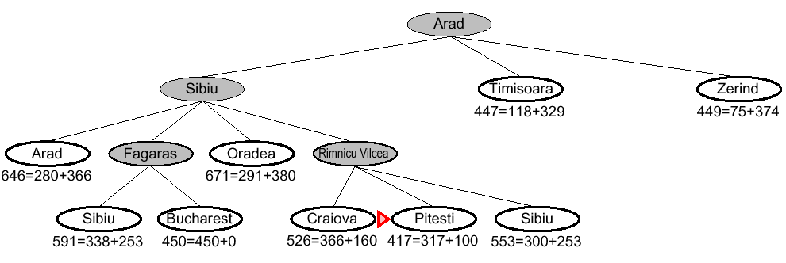
Heuristic Search
A* search example

Slide 40
Heuristic Search
Properties of A*
Complete?? Yes, unless there are infinitely many nodes with f ≤ f(G)
Time?? Exponential in [relative error in h x length of solution.]
Space?? Keeps all nodes in memory
Optimal?? Yes – cannot expand f _{i+1} until f_{i} is finished A* expands all nodes with f(n) < C* A* expands some nodes with f(n) = C* A* expands no nodes with f(n) > C*

Slide 41
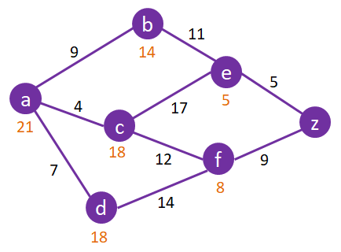
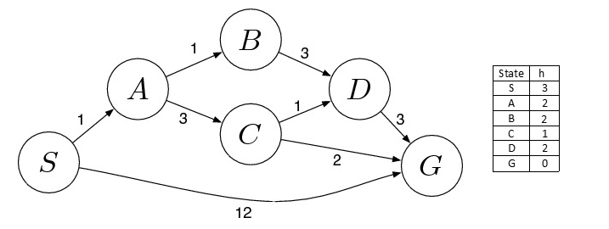
A* Search from Worksheet

Slide 42
Heuristic Search
A* search
A* search uses an admissible heuristic
i.e., h(n) ≤ h*(n) where h*(n) is the true cost from n. (also require h(n) ≥0, so h(G) = 0 for any goal G.) example, h_{SLD}(n) never overestimates the actual road distance.

Slide 43
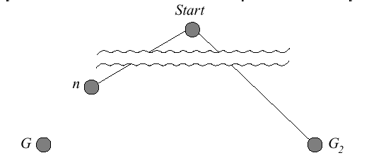
Heuristic Search
A* algorithm
Optimality of A* (standard proof)
Suppose some suboptimal goal G₂ has been generated and is in the queue. Let n be an unexpanded node on a shortest path to an optimal goal G₁.

Slide 44
Heuristic Search
A* algorithm
f(G₂) = g(G₂) since h(G₂) = 0 > g(G₁) since G₂ is suboptimal ≥ f(n) since h is admissible
since f(G₂) > f(n), A* will never select G₂ for expansion

Slide 45
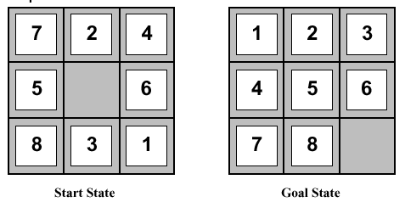
Heuristic Functions
Admissible heuristic example: for the 8-puzzle h₁(n) = number of misplaced tiles h₂(n) = total Manhattan distance i.e. no of squares from desired location of each tile h₁(S) = ?? h₂(S) = ??

Slide 46
Heuristic Functions
Admissible heuristic example: for the 8-puzzle h₁(n) = number of misplaced tiles h₂(n) = total Manhattan distance i.e. no of squares from desired location of each tile h₁(S) = ?? 6 h₂(S) = ?? 4+0+3+3+1+0+2+1 = 14

Slide 47
Heuristic Functions
Dominance
if h₂(n) ≥ h₁(n) for all n (both admissible) then h₂ dominates h₁ and is better for search Typical search costs: d = 14 IDS = 3,473,941 nodes A*(h₁) = 539 nodes A*(h₂) = 113 nodes d = 24 IDS ≈ 54,000,000,000 nodes A*(h₁) = 39,135 nodes A*(h₂) = 1,641 nodes

