Slide 1
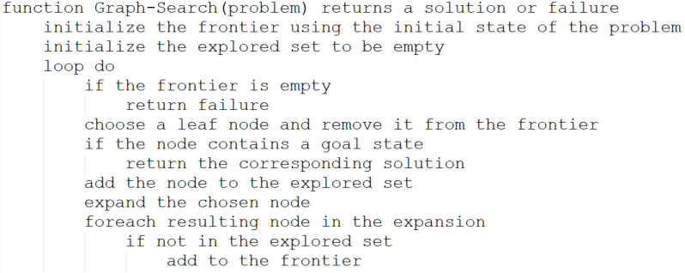
Implementation: General Tree Search

Slide 2
Implementation: General Tree Search

