Slide 1
Recursion
To understand recursion one must first understand recursion.
This is a joke.
very stupid and nerdy joke
This is a joke.

Slide 2
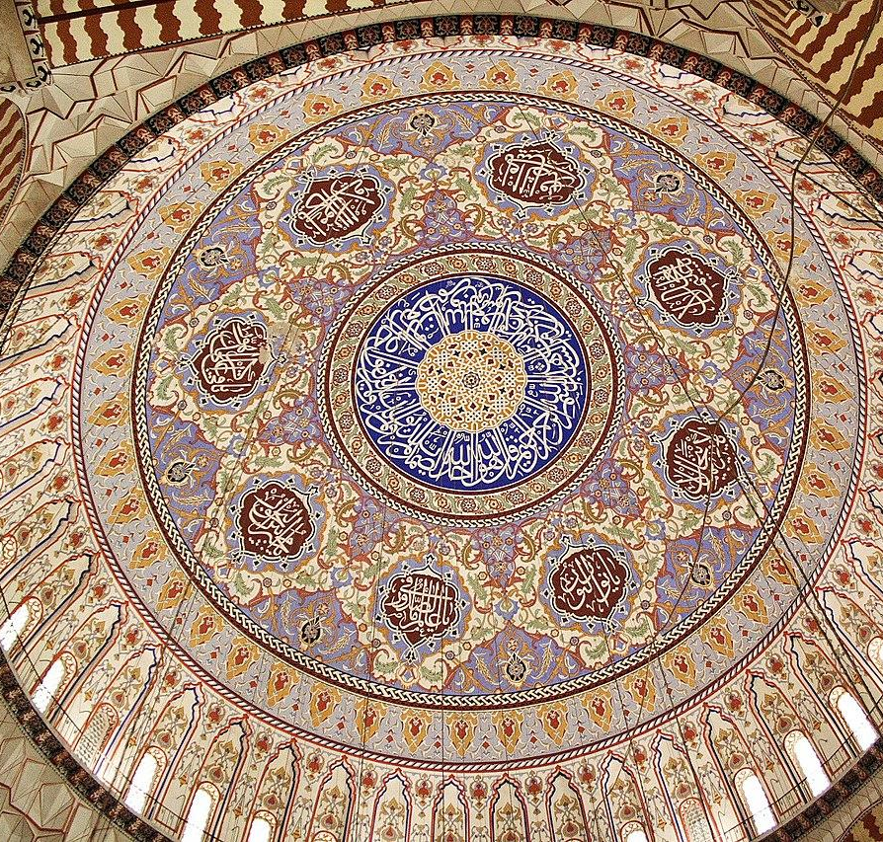
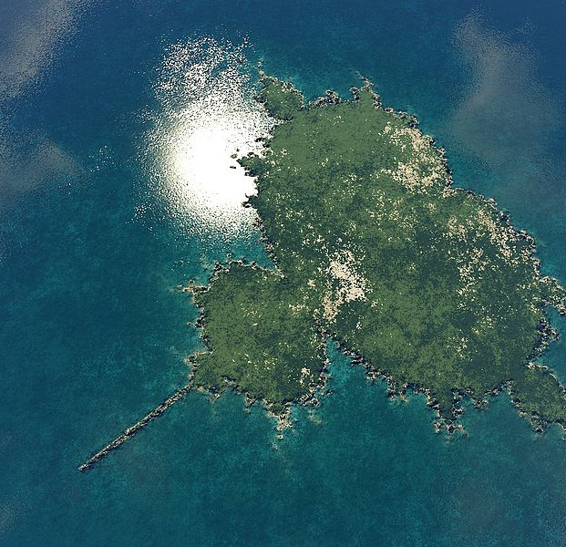
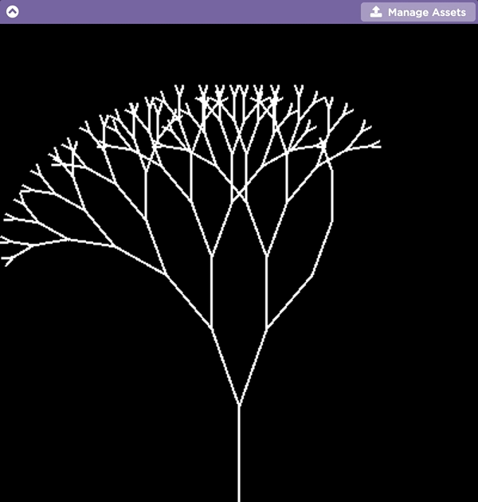
Fractal art is created by repeating simple patterns. It can be found in:
computer-generated art
architecture
computer-generated landscapes and scenery

Slide 3
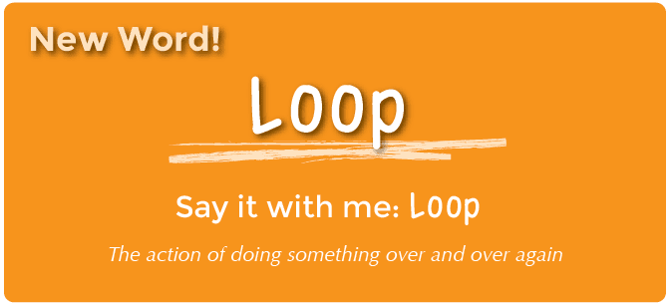
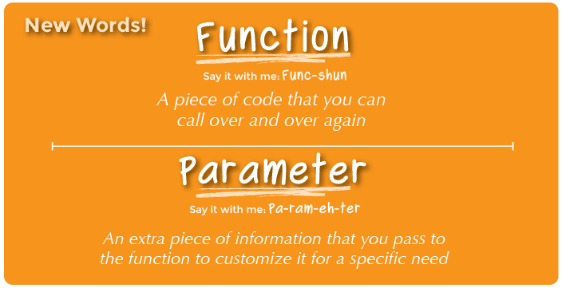
Recursion

Slide 4
Recursion
Not a data structure
Not an algorithm (in the traditional sense)
It's a programming technique to solve large problems by decomposing the problem into smaller problems.

Slide 5
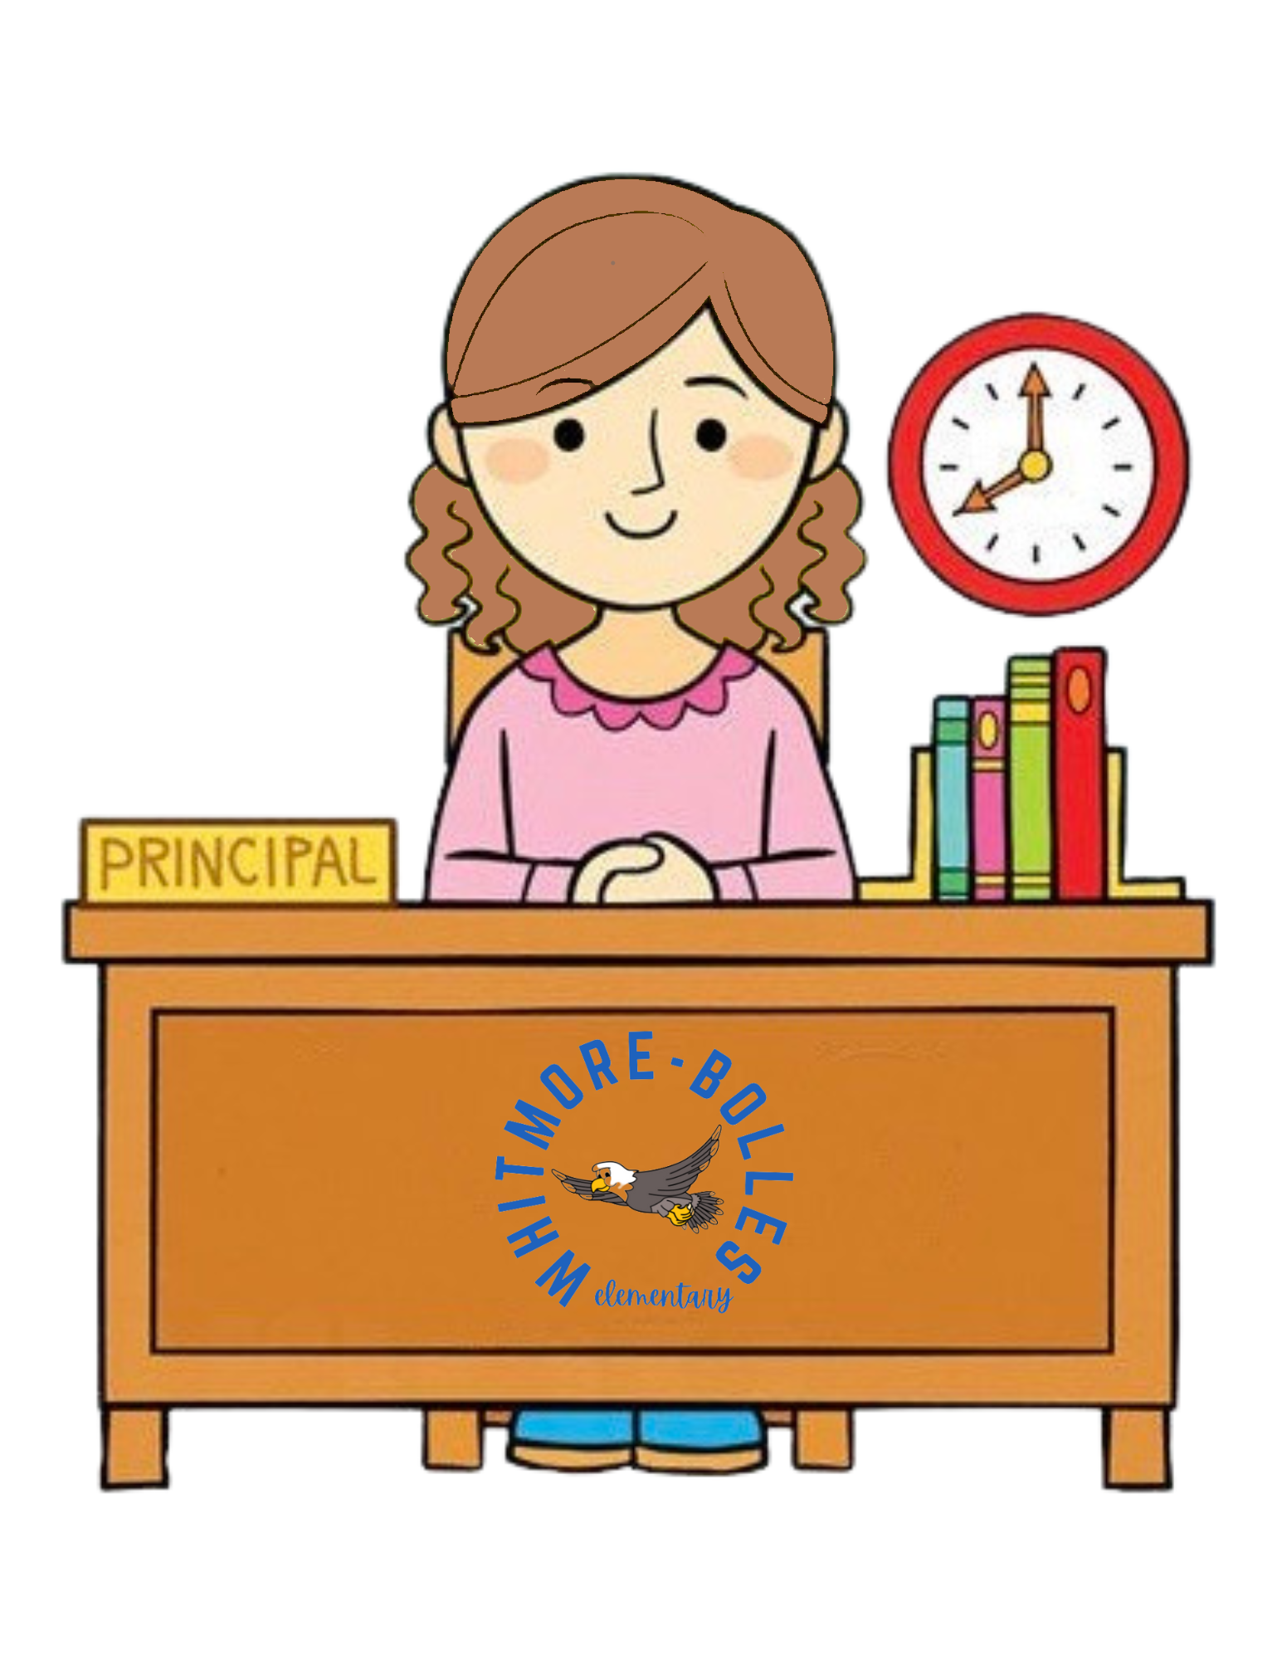





Recursion

Slide 6
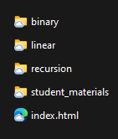
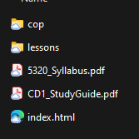

Recursion

Slide 7
Recursion
def countHTML(dir):
if dir.isEmpty():
return 0
count=0
for file in dir:
if file.endsWith(".html"):
count+=1
for subdir in dir:
count += countHTML(subdir)
return count

Slide 8
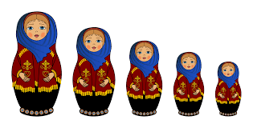
Recursion

Slide 9
Recursion
The Three Laws of Recursion
  A recursive algorithm must have a base case.
  A recursive algorithm must call itself, recursively.
  A recursive algorithm must change its state and move toward the base case.
def fact(n):
if n==1:
return 1
else:
return n * fact(n-1)

Slide 10
Recursion
The Three Laws of Recursion
  A recursive algorithm must have a base case.
  A recursive algorithm must call itself, recursively.
  A recursive algorithm must change its state and move toward the base case.
def fact(n):
if n==1:
return 1
else:
return n * fact(n-1)

Slide 11
Recursion
The Three Laws of Recursion
  A recursive algorithm must have a base case.
  A recursive algorithm must call itself, recursively.
  A recursive algorithm must change its state and move toward the base case.
def fact(n):
if n==1:
return 1
else:
return n * fact(n-1)

Slide 12
Recursion
The Three Laws of Recursion
  A recursive algorithm must have a base case.
  A recursive algorithm must call itself, recursively.
  A recursive algorithm must change its state and move toward the base case.
def fact(n):
if n==1:
return 1
else:
return n * fact(n-1)

Slide 13
Recursion
The Three Laws of Recursion
  A recursive algorithm must have a base case.
  A recursive algorithm must call itself, recursively.
  A recursive algorithm must change its state and move toward the base case.
def fact(n):
if n==1:
return 1
else:
return n * fact(n-1)

Slide 14
Recursion
The Three Laws of Recursion
  A recursive algorithm must have a base case.
  A recursive algorithm must call itself, recursively.
  A recursive algorithm must change its state and move toward the base case.
def fact(n):
if n==1:
return 1
else:
return n * fact(n-1)

