Slide 1
Foundational Concepts of Computer Science

Slide 2
Introductions
Name
Where are you from?
What is your major/program of study?
What did you do over the Winter Break?
If you could travel anywhere in the world for two weeks this summer, where would you go?

Slide 3
Magic Cards
Pick a whole number from 1 – 63.
Don’t say it out loud!
Concentrate on it…

Slide 4
Is your number on this card?
1 | 3 | 5 | 7
9 | 11 | 13 | 15
17 | 19 | 21 | 23
25 | 27 | 29 | 31
33 | 35 | 37 | 39
41 | 43 | 45 | 47
49 | 51 | 53 | 55
57 | 59 | 61 | 63

Slide 5
Is your number on this card?
2 | 3 | 6 | 7
10 | 11 | 14 | 15
18 | 19 | 22 | 23
26 | 27 | 30 | 31
34 | 35 | 38 | 39
42 | 43 | 46 | 47
50 | 51 | 54 | 55
58 | 59 | 62 | 63

Slide 6
Is your number on this card?
4 | 5 | 6 | 7
12 | 13 | 14 | 15
20 | 21 | 22 | 23
28 | 29 | 30 | 31
36 | 37 | 38 | 39
44 | 45 | 46 | 47
52 | 53 | 54 | 55
60 | 61 | 62 | 63

Slide 7
Is your number on this card?
8 | 9 | 10 | 11
12 | 13 | 14 | 15
24 | 25 | 26 | 27
28 | 29 | 30 | 31
40 | 41 | 42 | 43
44 | 45 | 46 | 47
56 | 57 | 58 | 59
60 | 61 | 62 | 63

Slide 8
Is your number on this card?
16 | 17 | 18 | 19
20 | 21 | 22 | 23
24 | 25 | 26 | 27
28 | 29 | 30 | 31
48 | 49 | 50 | 51
52 | 53 | 54 | 55
56 | 57 | 58 | 59
60 | 61 | 62 | 63

Slide 9
Is your number on this card?
32 | 33 | 34 | 35
36 | 37 | 38 | 39
40 | 41 | 42 | 43
44 | 45 | 46 | 47
48 | 49 | 50 | 51
52 | 53 | 54 | 55
56 | 57 | 58 | 59
60 | 61 | 62 | 63

Slide 10
WHAT?!? How did I do that?

Slide 11
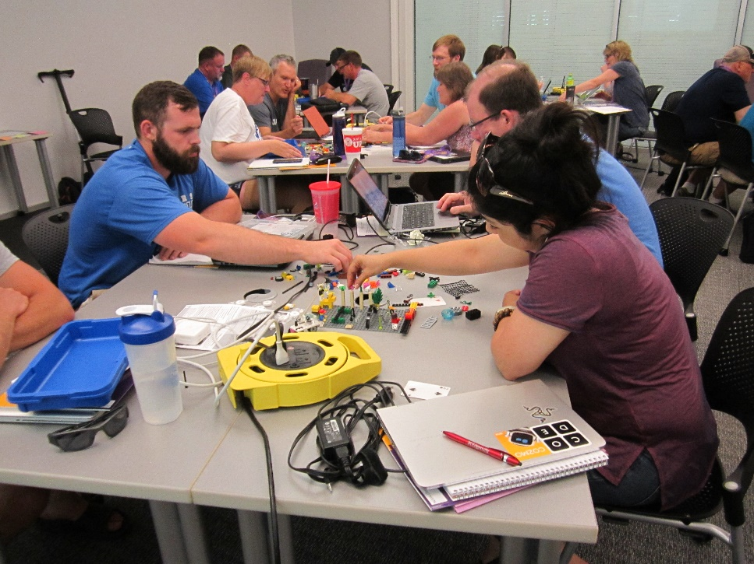
Our Program
5 courses to earn the CS Endorsement
Course
Fundamentals of Programming (CSED 1320)
Foundational Concepts of Computer Science (CSED 2310)
Teaching and Learning of Programming (CSED 3310)
Data Structures and Algorithms (CSED 3320)
Methods of Computer Science (CSED 4330)

Slide 12
Foundational Concepts in Computer Science
The non-programming aspects of computer science
Provides a broad understanding of the discipline and aids those teaching non-programming or AP CSP courses.

Slide 13
Foundational Concepts in Computer Science
Addresses conceptual models of key aspects of computer science to support teaching current K12 computer science (particularly AP-CSP) and allowing teachers to adapt to changes in the discipline.
General topics are how computers work (data representation, instruction cycle, operating system, networking, etc.), social impact (privacy, security, equity, etc.), and important application areas (AI, big data, etc.).

Slide 14
Let's Talk Syllabus
Office Hours
MWF, 11:00-11:50 and 1:00-2:00
bit.ly/SchaferCalendar
Websites
https://cs.uni.edu/~schafer/2310/
https://uni.blackboard.com/

Slide 15
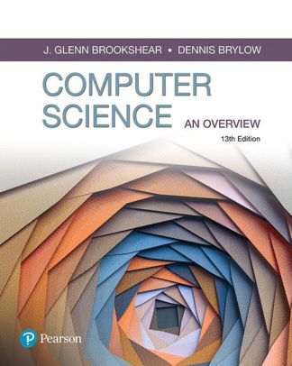
Textbook
Computer Science: An Overview
A well-informed CS teacher should eventually become familiar with everything in this textbook.
We will focus on six chapters
Chapter 1 – Computer Data Storage
Chapter 2 – Computer Organization/Architecture
Chapter 3 – Operating Systems
Chapter 4 – Networking
Chapter 9 – Databases
Chapter 11 – Artificial Intelligence

Slide 16
Course Competencies
To structure this course, we have identified 18 competencies that you should be able to demonstrate.
These have been designed to align with
The CSTA K-12 Standards (https://csteachers.org/k12standards/)
The CSTA Standards for CS Teachers (https://csteachers.org/teacherstandards/).

Slide 17
Assessment and Grading
Approximately every two weeks you will take a competency demo in class
Each will deal with 2 or 3 of the competencies.
Each competency will be evaluated separately and entered into the gradebook (0-4)

Slide 18
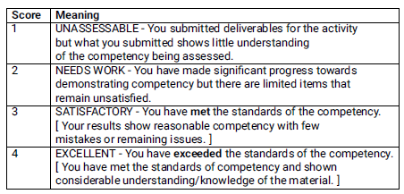
Assessment and Grading

Slide 19
Assessment and Grading
If you do not receive the grade you would like (any grade less than 4) you may meet with me, discuss where you still need to gain competency, and make a second attempt to demonstrate that competency.

Slide 20
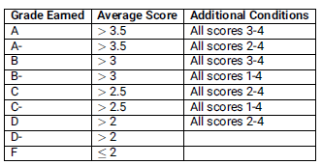
Assessment and Grading

Slide 21
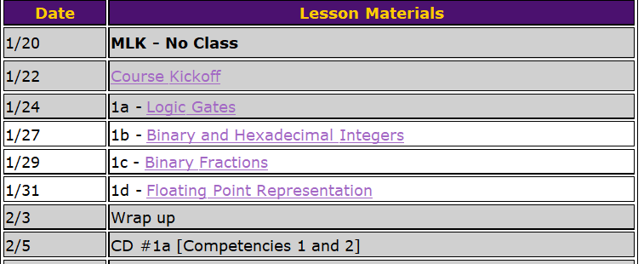
Structure

Slide 22
Daily Routine
Each day will be divided into three sections on its webpage.

Slide 23
Daily Routine
Each day will be divided into three sections on its webpage.

Slide 24
Daily Routine
Each day will be divided into three sections on its webpage

Slide 25
Foundational Concepts of Computer Science
Pay attention to:
Vocabulary
How the pieces work together
How what you are reading fits your mental model
How/when you might address this with students

Slide 26
Questions??

Slide 27
For next time
Read the syllabus
Prep for 1a – Logic Gates

