Slide 1
Sections 2.3 and 2.4
Proof best practice
Completing Direct Proofs

Slide 2
Group Example
Prove: The sum of a two even integers is an even integer.

Slide 3
Why does a computer scientist need to know how to do proofs??
When we study algorithms, we need to know two things:
Does it fulfill its requirement(s)?
If it doesn’t it is worthless.
Worse case scenario, people die.
How long does it take to run?

Slide 4
Directions for Writing Proofs
Copy the statement of the theorem to be proved onto your paper.
Clearly mark the beginning of your proof with the word PROOF.

Slide 5
Directions for Writing Proofs
Make your proof self contained
Explain the meaning and type of each variable (normally at the beginning).
“Suppose m and n are even integers…”
Write your proof in complete, grammatically correct sentences.
m = 2r for some integer r based on the definition of even numbers.

Slide 6
Directions for Writing Proofs
Keep your reader informed about the status of each statement in your proof.
Your reader should never be in doubt about whether something in your proof has been assumed, established, or is still to be deduced.
If it is assumed use words like “Suppose” or “Assume”
If it is still to be shown use “We must show that”

Slide 7
Directions for Writing Proofs
Give a reason for each assertion in your proof.
“By hypothesis”
“By definition of even, m=2r”
Include the “little words” that make the logic clear
Thus, then, so, therefore, consequently, etc..

Slide 8
Directions for Writing Proofs
Clearly display equations and inequalities.
The convention is to display equations and inequalities on separate lines to increase readability.

Slide 9
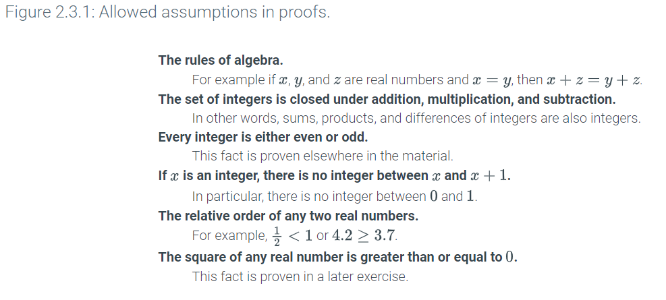
Allowed Assumptions

Slide 10
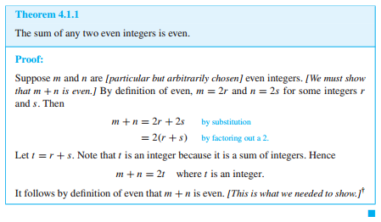
Example

Slide 11
Group Example
Prove: For all integers n, if n is odd then n² is odd.

Slide 12
Group Example
Prove: For all integers n, if n is even then n² is even.

Slide 13
Group Example
Prove: The negative of an even integer is even

Slide 14
Group Example
Prove: For all integers n, if n is odd than 3n+5 is even.

Slide 15
Group Example
Prove: For all integers n, if n is even than 3n+5 is odd.

Slide 16
Group Example
Prove: For any two odd integers, their sum is even.

Slide 17
Group Example
Prove: The sum of any two rational numbers is a rational number.

Slide 18
Group Example
Prove: If k is any odd integer and m is any even integer than k² + m² is odd.

Slide 19
Group Example
Prove: If a is any odd integer and b is any even integer, then 2a + 3b is even.

