Slide 1
Tree traversal and search

Slide 2
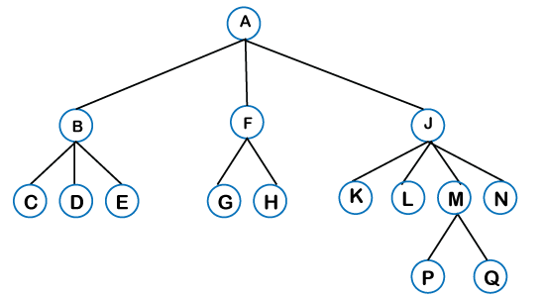
Tree Traversal

Slide 3
Tree Traversal
Pre-order Traversal
A, B, C, D, E, F, G, H, J, K, L, M, P, Q, N
Post-order Traversal
C, D, E, B, G, H, F, K, L, P, Q, M, N, J, A

Slide 4
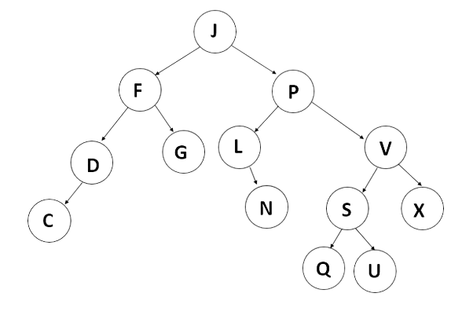
Tree Traversal
Pre-order Traversal
Post-order Traversal

Slide 5
Tree Traversal
Your book doesn't do it.
But with BSTs there is also
In-order Traversal

Slide 6
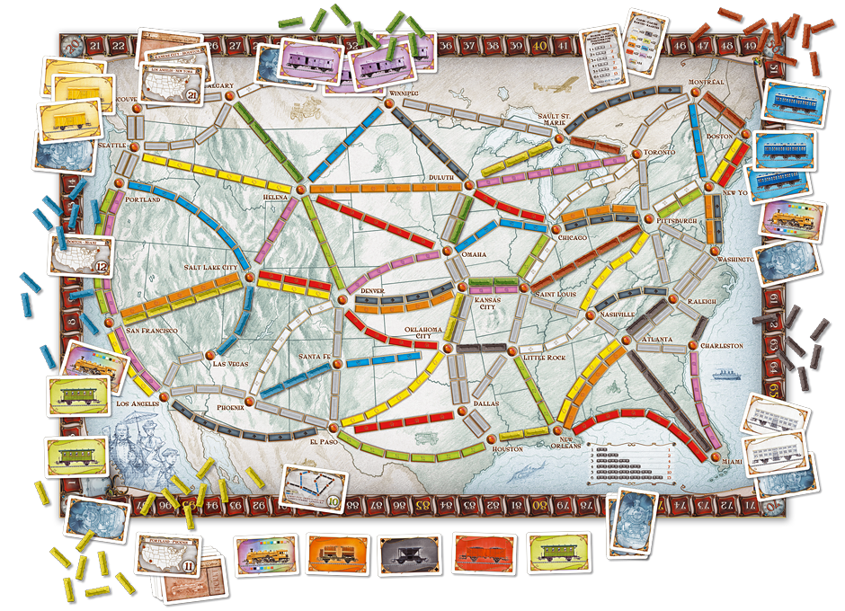
What is the shortest route from Seattle to Miami

Slide 7
Let's draw the search tree
Breadth-First Search
Depth-First Search

Slide 8
Tree Traversal
Breadth First Search
J, F, P, D, G, L, V, C, N, S, X, Q, U
Depth First Search
J, F, D, C, G, P, L, N, V, S, Q, U, X
Same as pre-order traversal

