Slide 1
More with Trees

Slide 2
What are “Trees”
Your book's definition
A tree is an undirected graph that is connected and has no cycles

Slide 3
Trees – Vocabulary
Free tree
Rooted tree
Root
Level
Height
Parent/ancestor
Child/descendant
Leaf
Siblings
Subtree
Spanning Tree

Slide 4
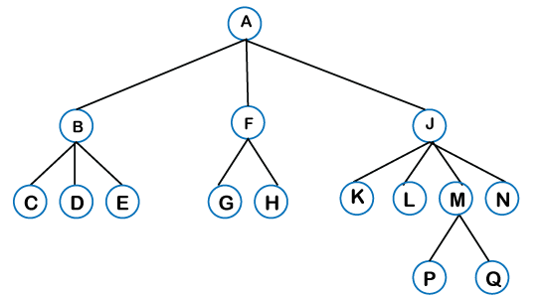
Identify
The root
The height
The level of M
A parent of M
A child of M
A sibling of M
A leaf node

Slide 5
Trees are often called "recursive data structures" Why?

Slide 6
Applications of Trees

Slide 7
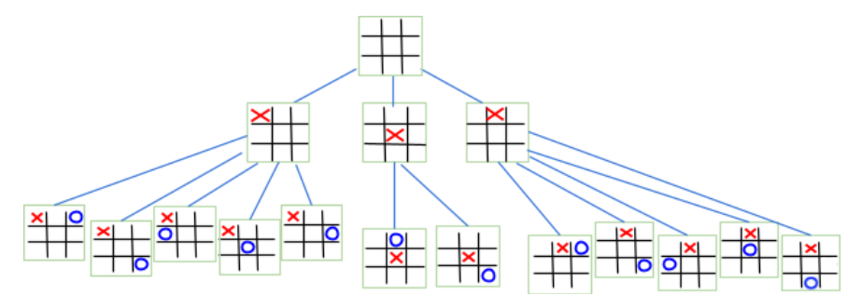
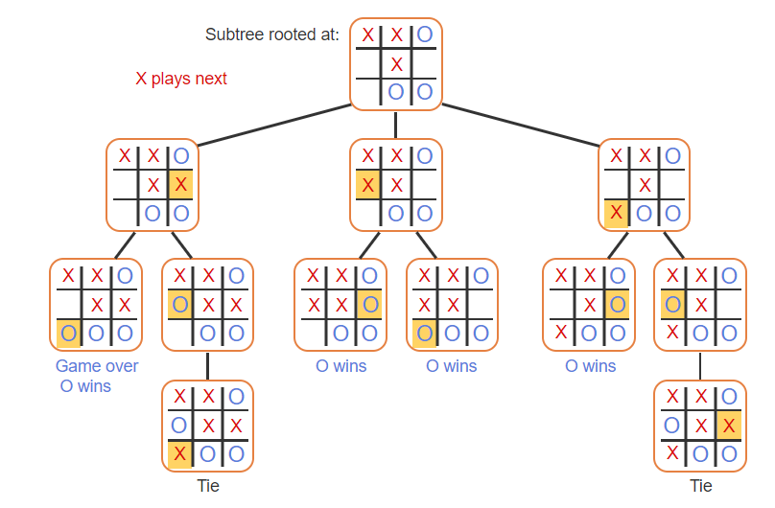
Applications of Trees

Slide 8
Applications of Trees
Huffman Encodings
How much memory does it take to store:
discrete is fun and dr schafer is an awesome teacher

Slide 9
Applications of Trees
discrete is fun and dr schafer is an awesome teacher
Unicode: 52 characters * 2 bytes = 832 bits
ASCII: 52 characters * 1 byte = 416 bits

Slide 10
Applications of Trees
discrete is fun and dr schafer is an awesome teacher
Fixed length
16 UNIQUE characters so we only need 4 bits to keep them separate
52 characters * 4 bits = 208 bits

Slide 11
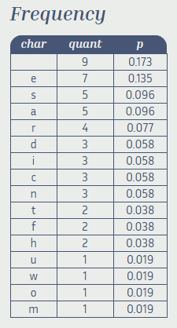
Applications of Trees
discrete is fun and dr schafer is an awesome teacher
Variable Length:

Slide 12
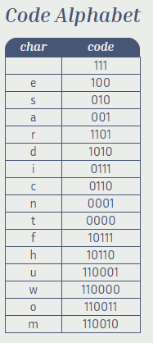
Applications of Trees
discrete is fun and dr schafer is an awesome teacher
Variable Length:

Slide 13
Applications of Trees
discrete is fun and dr schafer is an awesome teacher
Variable Length:
192 bits

Slide 14
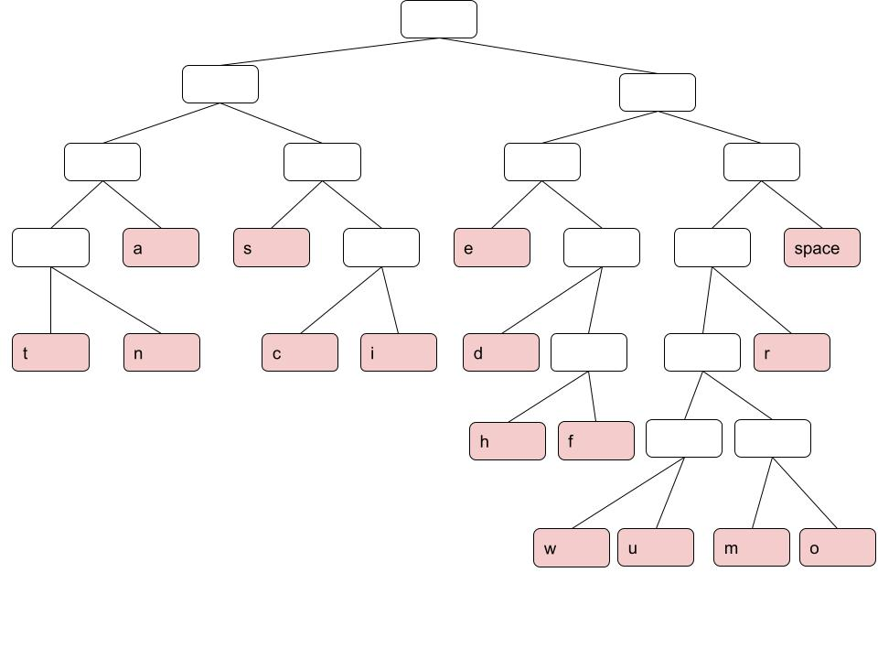
Applications of Trees
discrete is fun and dr schafer is an awesome teacher

Slide 15
Applications of Trees
discrete is fun and dr schafer is an awesome teacher

Slide 16
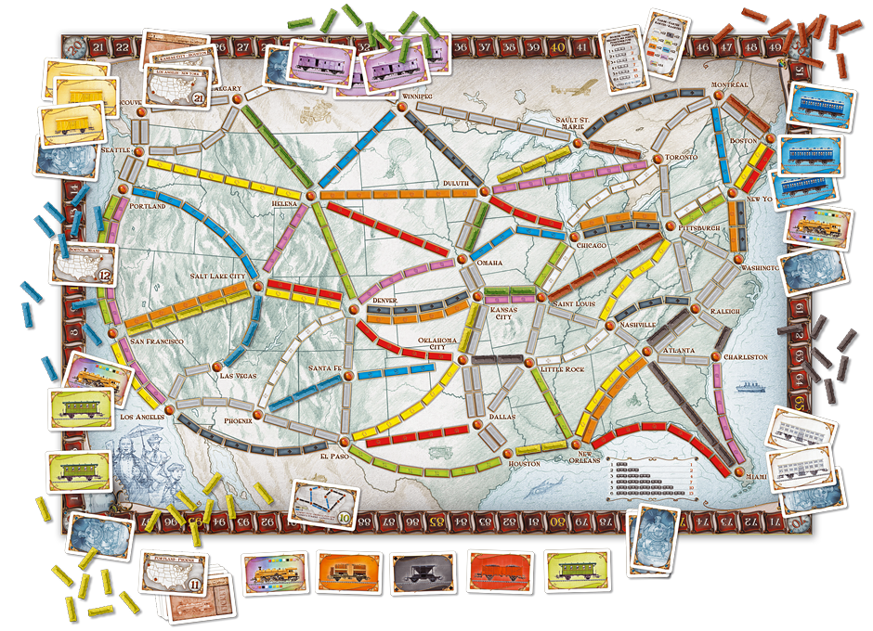
What is the shortest route from Seattle to Miami

Slide 17
Let's draw the search tree

Slide 18
Graph Representation on the Computer
Adjacency List
Matrix

Slide 19
Adjacency List Representation

Slide 20
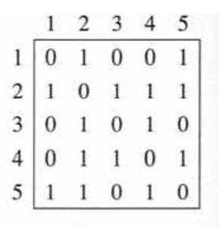
Matrix

Slide 21
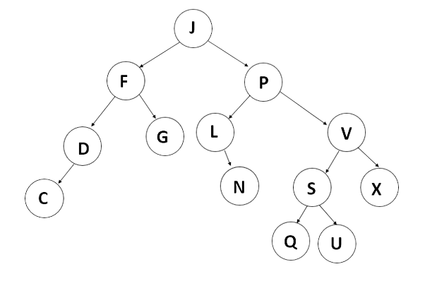
How might we represent a tree?

