Slide 1
Section 14.1
Trees

Slide 2
Using several skills
Three IT Security Analysts - from now on just referred to as "analysts" - and three hackers are travelling together. Each of the analysts is carrying a flash drive containing incredibly sensitive passwords that the hackers would really like to steal.
As they are travelling together, they reach a river that they need to cross. The only way across is a canoe that can hold, at most, two people. They need to find a way to shuttle the six people across the river.

Slide 3
The boat cannot cross the river by itself.
If there are any analysts present on a bank, they must not be outnumbered by hackers (they steal the flash drive).
In other words, N analysts can fight off N hackers but NOT N+1 hackers (where N is a positive integer)
The boat on the bank it is considered "on the bank" even if someone stays on the boat and immediately rows back.
For example, if there is one analyst alone on one bank and the boat rows up with two hackers on it, that analyst is in danger EVEN if you decide to only get one hacker off the boat and send the other hacker back for more people.

Slide 4
How can you get everyone across the river?

Slide 5
What does this have to do with graphs?
How many nodes would there be in this graph?
Hint, how would you "encode" the situation?
Given this, how many encodings are possible?
What is the maximum degree of any node in this graph?
Would this be a connected graph?

Slide 6
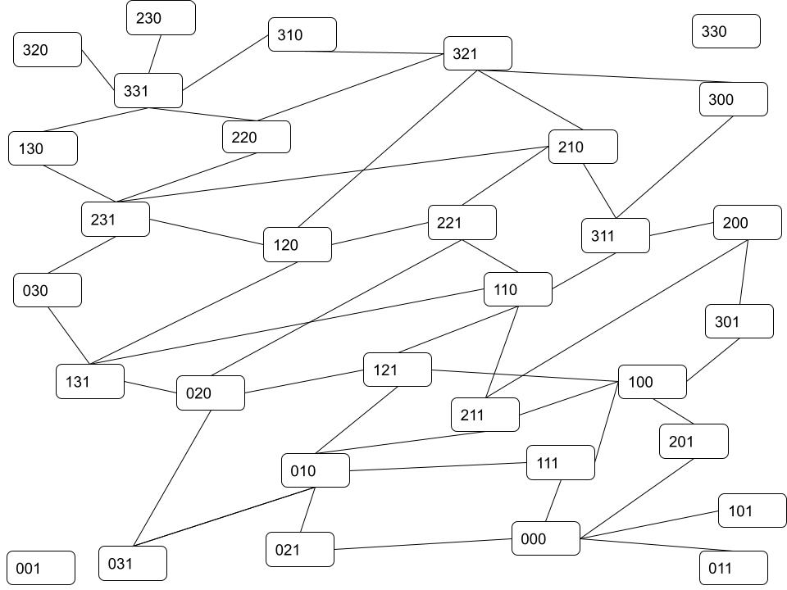
One graph of this space

Slide 7
What are “Trees”
Your book's definition
A tree is an undirected graph that is connected and has no cycles

Slide 8
Trees – Vocabulary
Free tree
Rooted tree
Root
Level
Height
Parent/ancestor
Child/descendant
Leaf
Siblings
Subtree
Spanning Tree

Slide 9
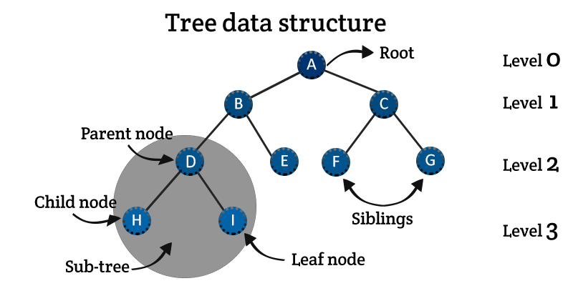

Slide 10
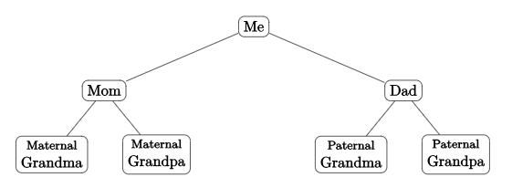
Tree examples

Slide 12
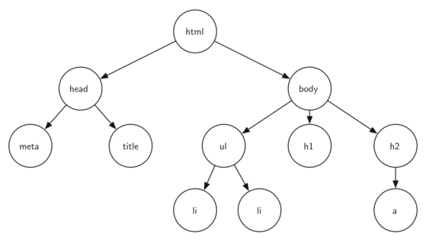

Slide 13
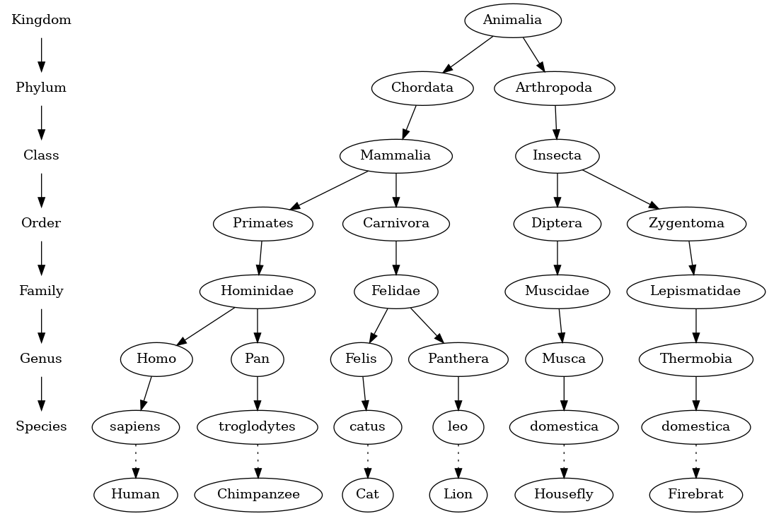

Slide 14
Identify
The root
The height
The level of Felis
The parent of Carnivora
The child of Musca
The sibling to Homo
A leaf node

Slide 15
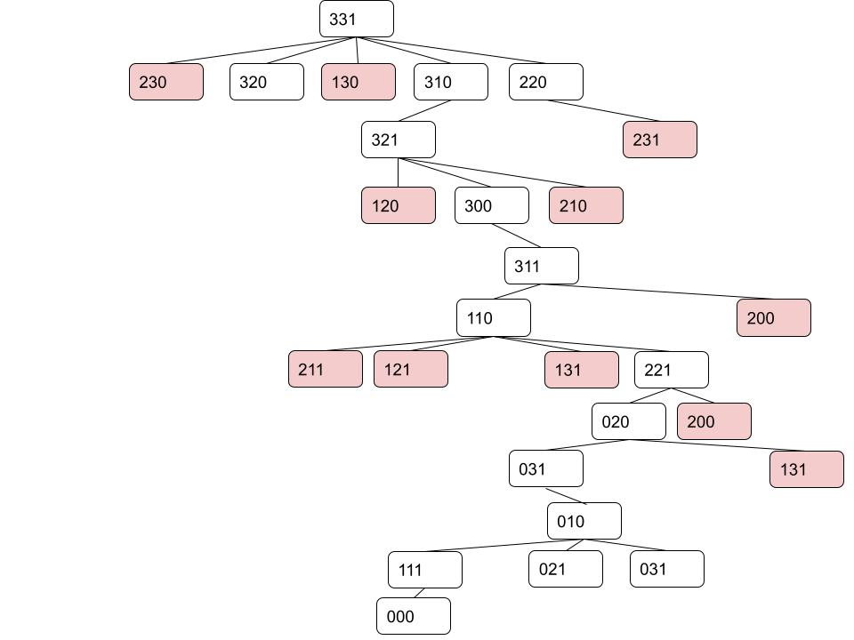
What did the opening problem have to do with trees?

