Slide 1
Section 13.2
Graph Representation

Slide 2
What are “Graphs”
Graphs are fundamental objects in discrete mathematics that model relationships between pairs of objects.

Slide 3
Graphs
C
E
A
F
B
D

Slide 4
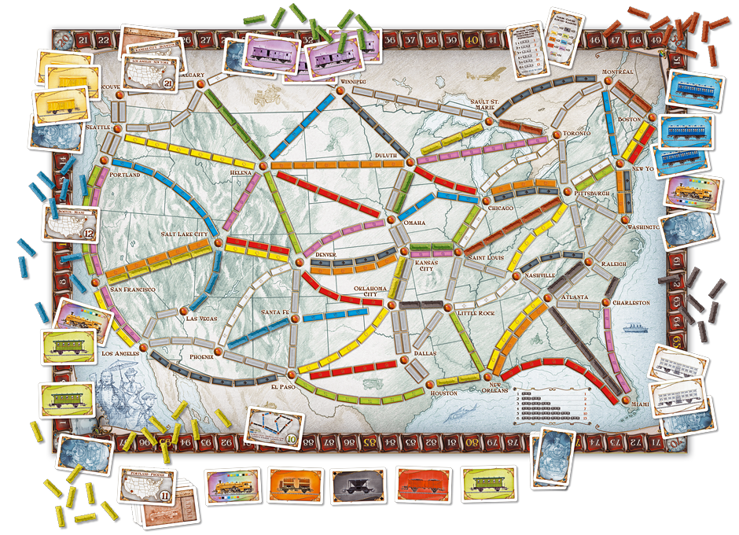

Slide 5
Graphs – Vocabulary
Vertex / Vertices
Edge(s)
Directed Graph
Undirected Graph
Parallel Edge
Self Loop
Adjacent
Endpoints
Incident
Neighbor
Degree
Total Degree
Regular Graph
Subgraph

Slide 6
Introduction: Formal Definition
A graph G = (V,E) consists of a finite set of vertices, V, and a finite set of edges E.
Each edge is a pair (v,w) where v, w ∈ V

Slide 7
Introduction: Formal Definition
A graph G = (V,E) consists of a finite set of vertices, V, and a finite set of edges E.
Each edge is a pair (v,w) where v, w ∈ V
Draw the following graph
G = ( {1,2,3,4,5} , {(1,2),(1,5),(2,3),(2,4),(2,5),(3,4),(4,5)} )

Slide 8
One Solution
1
2
3
5
4

Slide 9
Another Solution
5
1
3
2
4

Slide 10
Introduction: Formal Definition
What is the formal/mathematical definition of this graph?
C
E
A
F
B
D

Slide 11
Graph Representation on the Computer
Adjacency List
Matrix

Slide 12
Adjacency List Representation

Slide 13
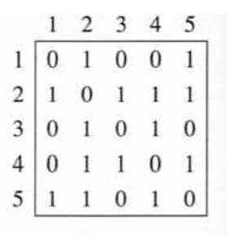
Matrix

Slide 14
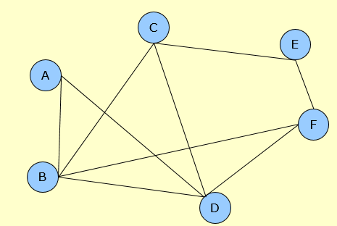
Graph Representation
Adjacency List
Matrix

Slide 15
Graph Representation
When would you use one representation over the other?

Slide 17
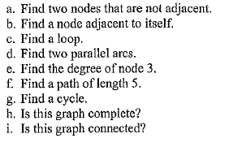
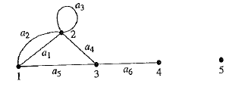
Activity

