Slide 2
Section 13.1
Graphs

Slide 3
What are “Graphs”
Graphs are fundamental objects in discrete mathematics that model relationships between pairs of objects.

Slide 4
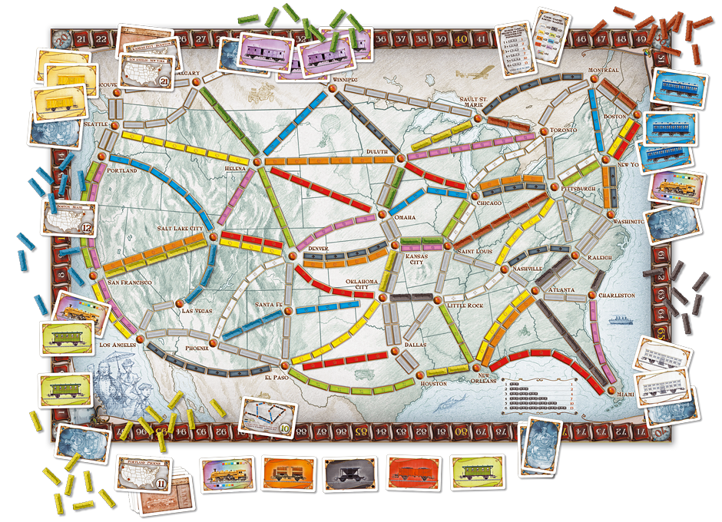

Slide 5
Graphs – Vocabulary
Vertex / Vertices
Edge(s)
Directed Graph
Undirected Graph
Parallel Edge
Self Loop
Adjacent
Endpoints
Incident
Neighbor
Degree
Total Degree
Regular Graph
Subgraph

Slide 6
Graphs – Vocabulary
Vertex / Vertices
Edge(s)
Directed Graph
Undirected Graph

Slide 7
Graphs — an overview
labelled vertices
BOS
DTW
SFO
PIT
JFK
LAX

Slide 8
Graphs — an overview
labelled vertices
BOS
DTW
SFO
PIT
JFK
LAX
undirected
edges

Slide 9
Graphs — an overview
labelled vertices
618
BOS
DTW
SFO
2273
211
190
PIT
318
344
1987
JFK
2145
LAX
2462
labelled edges

Slide 10
Graphs — an overview
labelled vertices
BOS
DTW
SFO
PIT
JFK
LAX
directed edges

Slide 11
Introduction: Formal Definition
A graph G = (V,E) consists of a finite set of vertices, V, and a finite set of edges E.
Each edge is a pair (v,w) where v, w ∈ V

Slide 12
Graphs — an overview
labelled vertices
BOS
DTW
SFO
PIT
JFK
LAX
undirected
edges

Slide 13
Introduction: Formal Definition
A directed graph, or digraph, is a graph in which the edges are ordered pairs
(v, w) ≠ (w, v)
An undirected graph is a graph in which the edges are unordered pairs
(v, w) == (w, v)

Slide 14
Graphs – Definitions
Vertex / Vertices
Edge(s)
Directed Graph
Undirected Graph
Parallel Edge
Self Loop
Adjacent
Endpoints
Incident
Neighbor

Slide 15
Graphs – Definitions
Vertex / Vertices
Edge(s)
Directed Graph
Undirected Graph
Parallel Edge
Self Loop
Adjacent
Endpoints
Incident
Neighbor
Degree
Total Degree

Slide 16
Graphs – Definitions
Vertex / Vertices
Edge(s)
Directed Graph
Undirected Graph
Parallel Edge
Self Loop
Adjacent
Endpoints
Incident
Neighbor
Degree
Total Degree
Regular Graph
Subgraph

Slide 17
Degrees
- directed
out-degree of x: the number of edges (x,y)
in-degree of x: the number of edges (y,x)
degree: sum of in-degree and out-degree
- undirected
degree of x: the number of edges {x,y}
Degrees are often important in determining the running time of an algorithm.

Slide 18
Examples
- Roadmaps
- Communication networks
- WWW
- Electrical circuits
Task schedules
Facebook friends

