Slide 1
Section 12.2
Probability

Slide 2
Activity #1
Consider the action of drawing one card from a well shuffled deck of playing cards. What is the probability of:
The chosen card is a red card.
The chosen card is an even number.
The chosen card is a face card
The card is at least a ten (Aces are high)
The card is at most a 4.

Slide 3
Activity #2
Consider the action of drawing one card from a well shuffled deck of playing cards. What is the probability of:
The chosen card is a red card and a black card?
The chosen card is a red card or a black card?
The chosen card is an even card or a face card?
The chosen card is a red card and an ace?
The chosen card is a red card or an ace?

Slide 4
Activity #2.1
What is the probability that a card is a red card and a black card?
What is the probability of each individual event?
Can these events happen with one card? No.
Thus 0 of the 52 cards fit this description and the probability is 0

Slide 5
Activity #2.2
What is the probability that a card is a red card or a black card?
What is the probability of each individual event?
Can these events happen with one card? Yes.
Can these events happen at the same time? No.
Thus, we simply sum their individual probabilities.
52 out of 52 cards fit this situation and the probability is 1.

Slide 6
Activity #2.3
What is the probability that a card is an even number or a face card?
What is the probability of each individual event?
Can these events happen at the same time? No.
Thus, we simply sum their individual probabilities.
20 + 12 or 32/52 cards fit this situation and the probability is ~0.62

Slide 7
Activity #2.4
What is the probability that a card is a red card and an Ace?
What is the probability of each individual event?
Can these events happen with one card? Yes.
2 out of 52 cards fit this situation and the probability is ~0.038

Slide 8
Activity #2.5
What is the probability that a card is a red card or an Ace?
What is the probability of each individual event?
Can these events happen at different times? Yes
Can these events happen at the same time? Yes.
This means that if we simply add the events (like we did in 2.2 and 2.3) we have double counted the red aces.
We need to eliminate this duplication. Thus, we need to subtract the probability of getting a red ace.
26 red cards + 4 aces – 2 red aces = 28/52

Slide 9
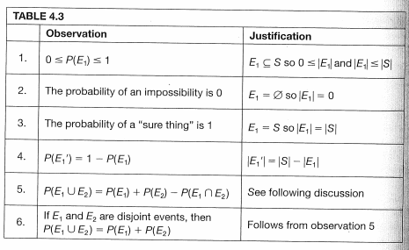
Probability Axioms

Slide 10
Activity #3
I am going to roll two “fair” dice at the same time.
What is the size of the sample space?
What is the probability of getting “snake eyes” (two 1s)
What is the probability of getting doubles?
What is the probability of getting a 1 on at least one die?
What is the probability of getting a total of 5 on the two dice?
What is the probability of getting two consecutive values? (for example, a 3 and a 2)
What is the probability of getting a total greater than 10?
What is the probability that the sum of the two dice is an odd number?

Slide 11
All possibilities
(1,1) (1,2) (1,3) (1,4) (1,5) (1,6)
(2,1) (2,2) (2,3) (2,4) (2,5) (2,6)
(3,1) (3,2) (3,3) (3,4) (3,5) (3,6)
(4,1) (4,2) (4,3) (4,4) (4,5) (4,6)
(5,1) (5,2) (5,3) (5,4) (5,5) (5,6)
(6,1) (6,2) (6,3) (6,4) (6,5) (6,6)

