Slide 1
Fundamentals of
Programming
www.cs.uni.edu/~schafer/1320/

Slide 2
Getting to Know You
Thanks for letting me take your picture
Thanks for everyone who took the time to complete this form.
  http://bit.ly/Schafer_gtky
  It was fun to get to know you.

Slide 3
What would have been on my form?
Name: Dr. Ben Schafer
Hometown: Ames originally
Major: As an undergrad I was a double major of Math and Physics Education
  I taught 7th and 8th grade math and science for four years
  But I took several computer science classes and worked in the summers writing educational, multi-media software.
  Eventually went back to learn more

Slide 4



What would be on my form?
Three fun facts about you
  I love to snowshoe, hike, or kayak depending on the season

Slide 5
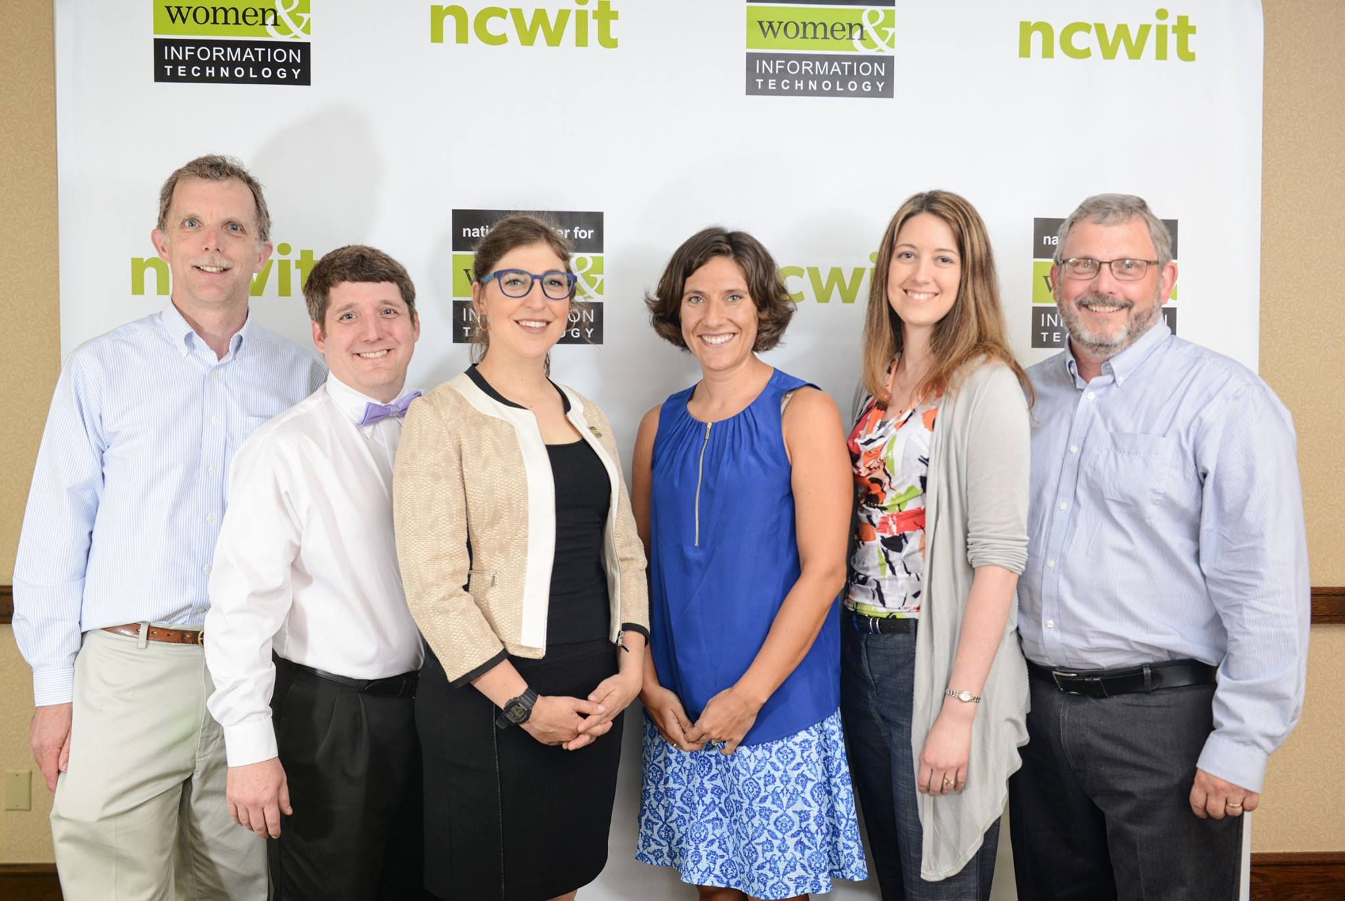
What would be on my form?
Three fun facts about you
  I received an award presented by Mayim Bialik

Slide 6
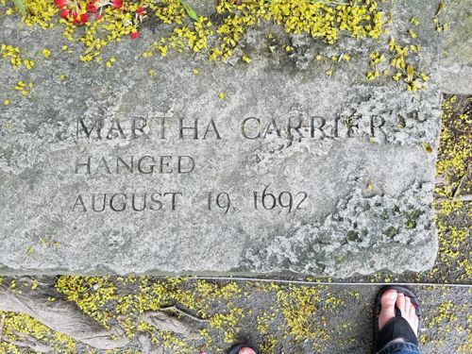
What would be on my form?
Three fun facts about you
  My great(x8) grandmother was hung as a witch during the Salem Witch Trials

Slide 7
Why this course?
Some of you said:
  To learn more about Computer Science
Most of you said:
  Because it's required for my major

Slide 8
How many years of each of the following do you need to graduate high school in Iowa?
  English
  Math
  Science
  Social Studies

Slide 9
How many years of each of the following do you need to graduate high school in Iowa?
  English 4 years
  Math 3 years
  Science 3 years
  Social Studies 3 years

Slide 10
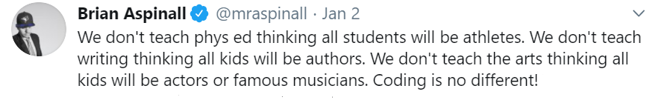

Slide 11
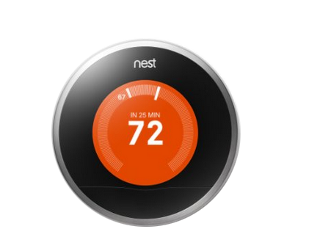
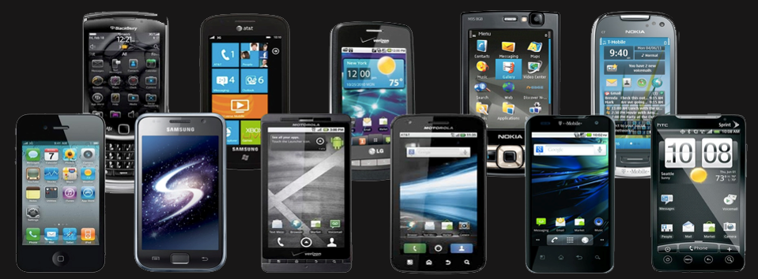

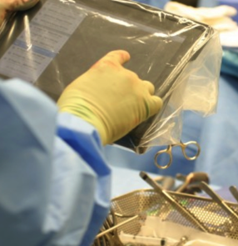


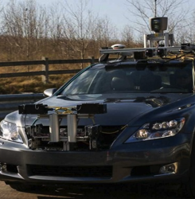

Technology affects EVERY field

Slide 12
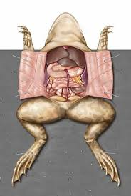
A Basic Circuit
a²+ b²⁼ c²
c
a
Neutral Wire
Hot Wire
Voltage
Source
b

Slide 13
START
Initialization
Projection
Vertex Optimization
Add new vertex
Convergence?
N
Y
k>c(n, Δ)?
N
Y
END

Slide 14
Where does Iowa fit into all of this?
(Since Fall 2023)
High School
  EVERY school must offer a "high quality" CS course
Middle School
  EVERY school must require a CS course
Elementary School
  EVERY school must make CS a significant component for at least one grade band

Slide 15
Where does Iowa fit into all of this?
High School
  EVERY school must offer a "high quality" CS course
Middle School
  EVERY school must require a CS course
Elementary School
  EVERY school must make CS a significant component for at least one grade band
REQUIRE???

Slide 16
What does a career look like for a student graduating in 2037?

Slide 17
Why CS Matters
Computer science is not only a "science" but a liberal art
  a subject that provides students with a critical lens for interpreting the world around them.
Computer science prepares all students to be active and informed contributors to our increasingly technological society whether they pursue careers in technology or not.
Computer science can be life-changing, not just skill training.
Yes, AI will change how we think about computer science (just like it will every other discipline) but it won't eliminate the need to understand computer science.

Slide 18
Course Details
We will use multiple websites this semester
  My personal website
    www.cs.uni.edu/~schafer/1320/
  Blackboard/eLearning
  Scratch
  Runestone Academy
  Autolab

Slide 19
Course Details
The full syllabus is on my class website
  www.cs.uni.edu/~schafer/1320/
I spent a fair amount of time preparing this syllabus.
  Please take 15 minutes to read the syllabus prior to our next class.
  We will start class by answering questions you have

Slide 20
Course Details
How I will handle "student hours"
    MWF 10:00-10:50 – Drop in or reservation
    MWF 12:00-1:00 – Drop in or reservation
    Numerous times in the afternoon and early evening by appointment only
To meet with me:
  https://bit.ly/SchaferScheduler
  If you need something else, PLEASE email me

Slide 21
Course Details
Grades in this class are earned VERY differently than what you are likely used to
  I don't do the whole 90/80/70/60 thing
Why?
  That process seems to be arbitrary
    What does a 17/20 mean?
    And how is it different from a 16 or 18?
  That process seems to focus on points rather than learning
    You got a 50/100 on this exam.
    You can't possibly earn an A anymore.
    Screw you!

Slide 22
Course Details
I base my grading off
  Standards based grading
  Equitable grading (gradingforequity.com)
Why?
  It focusses on whether (or not) you LEARNED the material
    That's LARGELY a yes/no decision
  It allows you to fix something if you didn't learn it the first time
    Almost ALL grades can be replaced if you can show me you worked to learn what you missed the first time through

Slide 23
Course Details
Many activities in this course are "ungraded"
  They are assigned to facilitate your learning
    The fact is that you ARE going to get things wrong before you get things right. You need opportunities to practice and learn
  You are encouraged to take them seriously and give them your full effort
  Some of them will be collected just to see how you are doing

Slide 24
Course Details
Three Units of 4-5 weeks each
  Programming Fundamentals in Scratch
    1 activity grade
    1 competency demo
  Beginning Programming in Python
    1 activity grade
    1 competency demos
  Data analysis in Python
    1 activity grade
    1 competency demo
  1 final exam (2 grades)

Slide 25
Course Details
For Programming Activities
  All programming activities for a single unit will be combined into a single "Problem Set"
  Each program will be evaluated separately.
    If you don't get the score you want the first time than you can improve it and resubmit.
  I will publish a rubric for how multiple programs are combined into a single grade from 1-4.

Slide 26
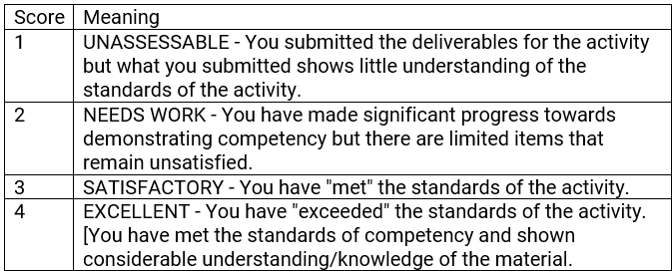
Course Details
Competency Demos
  Each question will receive an initial "grade"

Slide 27
Course Details
Competency Demos
  Each question will receive an initial "grade"
  Based on the question grades I will assign an overall CD grade (NOT necessarily the average of the question grades)
    3 + 3 + 3 + 3 = 12 will likely be an overall grade of 3
    4 + 4 + 2 + 2 = 12 will likely be an overall grade of 2

Slide 28
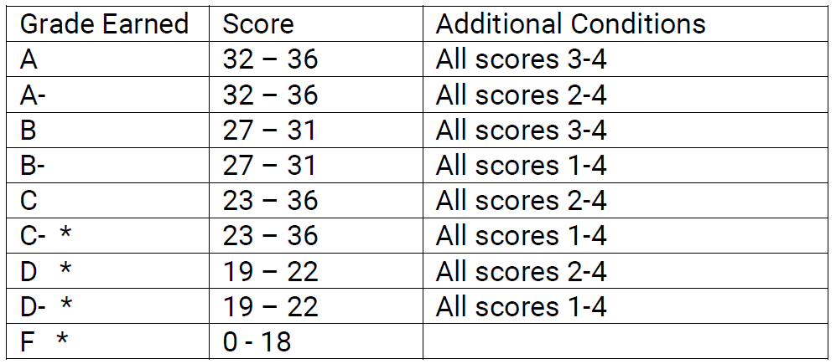
Final Assessment

Slide 29
Syllabus – Scholastic Conduct
I take scholastic conduct SERIOUSLY!
http://www.uni.edu/pres/policies/301.shtml
General rule
  Discussing the ideas in a homework assignment is acceptable.
  Copying code or answers is not.
  Programming “next to each other” is not.
First and foremost, your final submission for any assignment should be your own individual, original work unless otherwise specified.
But here is the thing – my grading policies make cheating STUPID.

Slide 30
Questions at this point?

