Slide 1

Notes:
1

Slide 2
What is Scratch?
Scratch is an ongoing project developed by the Lifelong Kindergarten research group at the MIT Media Lab, in collaboration with KIDS research group at the UCLA Graduate School of Education & Information Studies.
Notes:
2

Slide 3
What is Scratch?
Scratch is a free programmable toolkit that enables kids (target ages 8-18) to create their own games, animated stories, and interactive art and share their creations with one another over the Internet.
Notes:
3

Slide 4
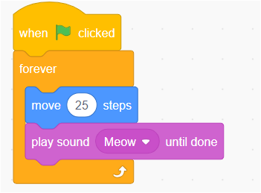
What is Scratch?
Scratch is an easy introductory programming language because users program primarily by connecting program blocks. (Kind of like building a stack of LEGO bricks)
Notes:
4

Slide 5
What is Scratch?
Scratch takes advantage of new computational ideas and capabilities to make it easier for kids to get started with programming (lowering the floor) and to extend the range of what kids can create and learn (raising the ceiling).
Notes:
5

Slide 6
What is Scratch?
Because there is virtually no typing involved it is impossible to get syntax errors.
Notes:
6

Slide 7
What is Scratch?
The ultimate goal is to help kids become fluent with digital media, empowering them to express themselves creatively and make connections to powerful ideas.
Notes:
7

Slide 8
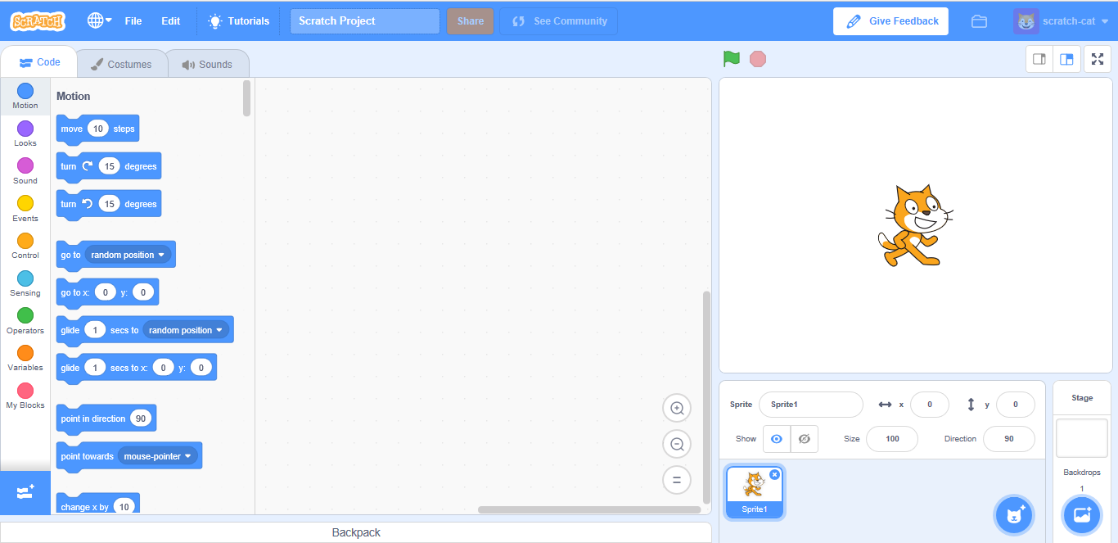
Getting Started With Scratch
Stage
Sprite List
(“the green room”)
The Script Area
Code Block Area
Notes:
8

Slide 9
Meeting Your Sprite!
You will notice that the default sprite is an orange cat. (A sprite is a small graphic that can be moved independently around the screen, producing animated effects.)
You can choose a different sprite to program from a library in Scratch, or you can draw your own!
Notes:
9

Slide 10
Programming In Scratch!
The first thing you need to do is to click on the sprite you want to program, and select the “Scripts” tab.
Since your cat sprite is the only thing that can be animated, make sure you have it selected.
The Scripts area is where you “build” your program by using the programming blocks.
Notes:
10

Slide 11
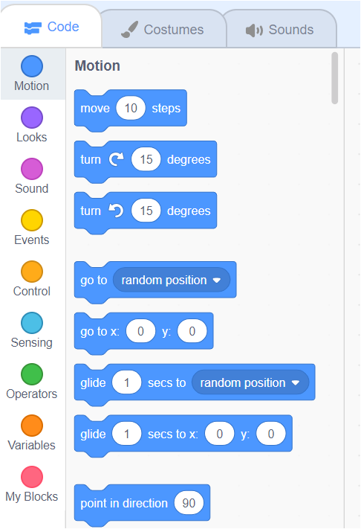
Programming In Scratch!
On the left side of your Scratch window, you will see a menu with 9 block pallets.
Each of these switches to a portion of the block options featuring programming blocks in that particular area.
Notes:
11

Slide 12
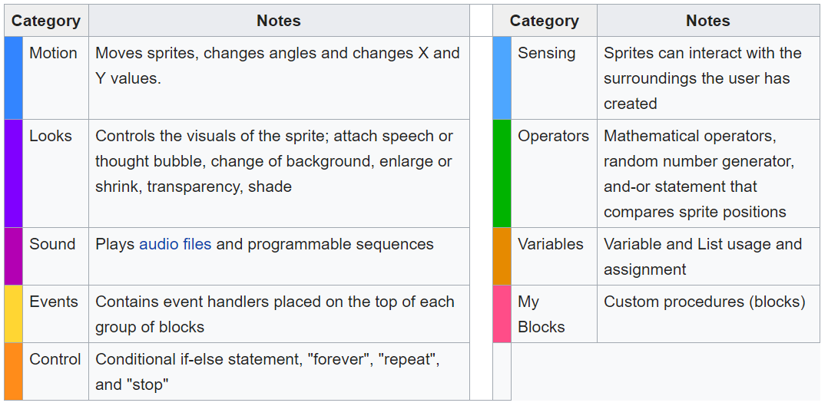
Block Pallets

Slide 13
Motion
When you click on the motion button, you will see the programming blocks that can be used with your sprite.
Notes:
13

Slide 14
POGIL Activity
Let's have you explore Scratch for a few minutes with your group.

Slide 15
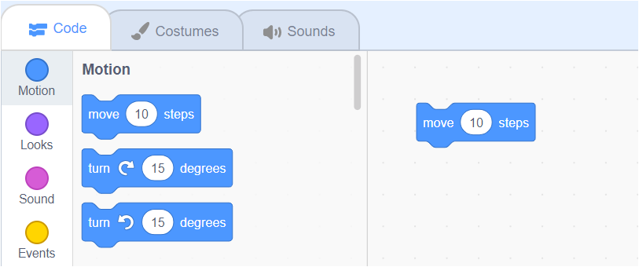
Motion
Drag out the “move 10 steps” block.
“Circular-edged” boxes contain “numbers” but the values are changeable.
Change the “10” to “50” by clicking in the block and typing in 50.
Notes:
15

Slide 16
Motion
To see your sprite move 50 pixels to the right, click on the block in the Script area. Cool, isn’t it?!
Notes:
16

Slide 17
What Is A Pixel?
We’ve been talking about pixels – what is a pixel?
A pixel is one of the small units that make up an image on a computer or television screen.
It is derived from the words picture and element to make pixel!
Notes:
17

Slide 18
Motion
You can also set the motion block to move a negative number of pixels by typing a negative number in the block.
This will move your sprite that number of pixels in the opposite direction.
Notes:
18

Slide 19
Motion
Drag out a second “move 10 steps” block.
Change the “10” to “-50” by clicking in the block and typing in -50.
To see your sprite move 50 pixels to the LEFT, click on the block in the Script area.
Notes:
19

Slide 20
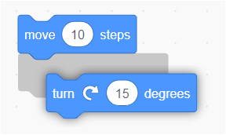
More Motion
Now, add the “turn 15 degrees” block to the other block of code.
When you see the gray shadow below the first block of code, you can release your mouse. That shadow means that the 2 blocks will “snap” together.
Notes:
20

Slide 21
More Motion
Again, you can change the number of degrees by clicking in that area and typing in the number of degrees you’d like your sprite to rotate.
Double click on the blocks to see your sprite move and rotate in a single sequence of actions!
Notes:
21

Slide 22
The Scratch Stage
180
-240
240
-180
The Scratch stage is 480 pixels wide and 360 pixels high.
Notes:
22

Slide 23
The Scratch Stage
0
-90
90
180
Sprites can face different “directions” based on a degree turn from 0 (north)
Notes:
23

Slide 24
Another Helpful Tool
You can delete a block by right clicking and choosing “delete” or, more easily, by just dragging it from the Script area!
Notes:
24

