Slide 1
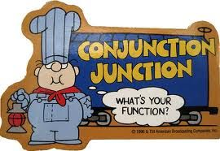
Functions

Slide 2
Write out the ALGORITHM for what you did this morning as you got ready to come to campus.

Slide 3
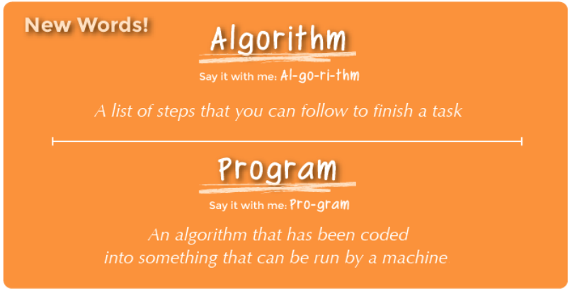
Vocabulary Review

Slide 4
Write out the ALGORITHM for what you did this morning as you got ready to come to campus.
  Was there a place in your algorithm where you used a loop?
  Was there a place in your algorithm where you used an event?
  Was there a place in your algorithm where you used a conditional?

Slide 5
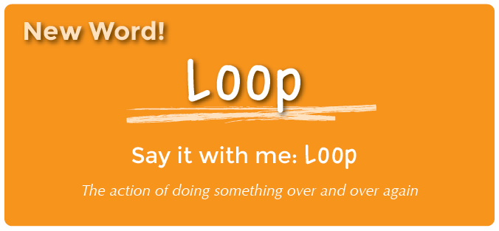

Slide 7
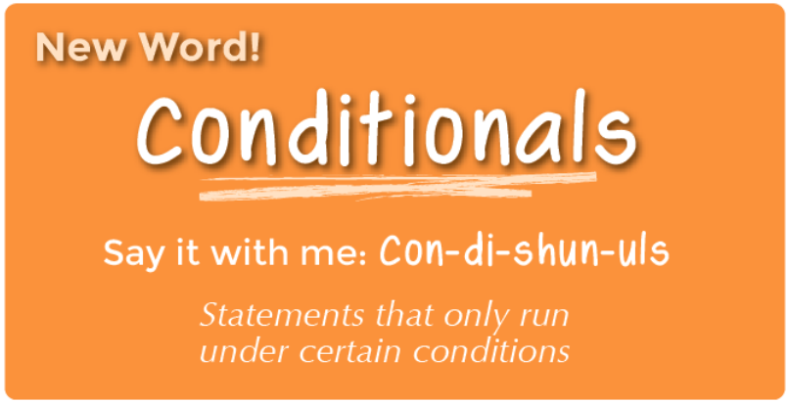

Slide 8
Write out the ALGORITHM for what you did this morning as you got ready to come to campus.
  Was there a place in your algorithm where you used a loop?
  Was there a place in your algorithm where you used an event?
  Was there a place in your algorithm where you used a conditional?

Slide 9
Write out the ALGORITHM for what you did this morning as you got ready to come to campus.
  Was there a place in your algorithm where you used a loop?
  Was there a place in your algorithm where you used an event?
  Was there a place in your algorithm where you used a conditional?
Clearly there are differences between and event and a conditional. But what are they?

Slide 10
Vocabulary Review

Slide 11
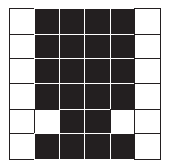
What would the algorithm/program look like for this shape?

Slide 13
What would the algorithm/program look like for this shape if you used loops?

Slide 14
That was BETTER, but it is still pretty long
What might we do that could make our program even shorter?

Slide 15
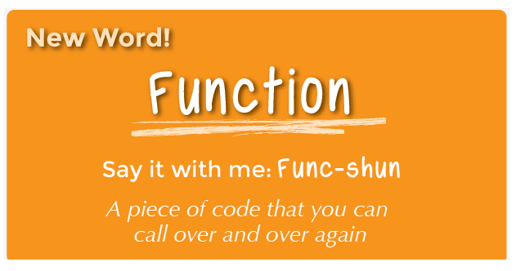
Unplugged Activity

Slide 16
What would the algorithm/program look like for this shape if you used functions?

Slide 17
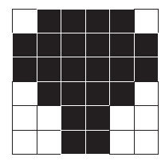
What would the algorithm/program look like for this shape if you used functions?

Slide 18
Could we have used functions with the Chicken Dance?
    https://www.youtube.com/watch?v=4xmV5uHWNag

Slide 19
Unplugged Activity – Today is SONG day!
Who remembers the song “Little Bunny Foo Foo?”
Let’s sing it.

Slide 20
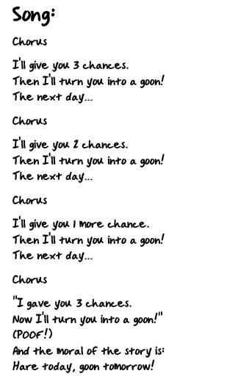
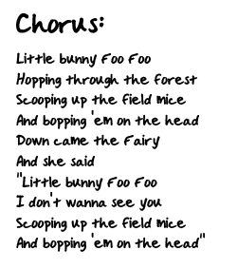
Unplugged Activity – Today is SONG day!

Slide 21
Unplugged Activity – Songwriting
How did you know to sing that “Little Bunny Foo Foo” part several times? It’s only written down once.
What happened?
  We defined a chorus – a chunk of song we are going to use several times
  We wrote down every place we wanted to use the chorus (“called” the chorus)
  Every time the chorus was “called” you sang the chorus!

Slide 22
Unplugged Activity – Songwriting
Why do you suppose we only wrote the chorus down once?
What are other benefits of only writing the chorus once?
Could you have done the same thing using a loop?

Slide 23
Unplugged Activity – Songwriting

Slide 24
Unplugged Activity – Songwriting
The chorus is acting like something we use in computer science – a Function.
Why might a computer scientist want to be able to write/use a function?

Slide 25
Your Turn
See if you can identify the Chorus/Function in this song

Slide 26
But what about this song
Old MACDONALD had a farm
E-I-E-I-O
And on his farm he had a lamb
E-I-E-I-O
With a baa baa here
And a baa baa there
Here a baa, there a baa
Everywhere a baa baa
Old MacDonald had a farm
E-I-E-I-O
Old MACDONALD had a farm
E-I-E-I-O
And on his farm he had some chickens
E-I-E-I-O
With a cluck cluck here
And a cluck cluck there
Here a cluck, there a cluck
Everywhere a cluck cluck
Old MacDonald had a farm
E-I-E-I-OOOOOOO.........
Old MACDONALD had a farm
E-I-E-I-O
And on his farm he had a cow
E-I-E-I-O
With a moo moo here
And a moo moo there
Here a moo, there a moo
Everywhere a moo moo
Old MacDonald had a farm
E-I-E-I-O
Old MACDONALD had a farm
E-I-E-I-O
And on his farm he had a pig
E-I-E-I-O
With a oink oink here
And a oink oink there
Here a oink, there a oink
Everywhere a oink oink
Old MacDonald had a farm
E-I-E-I-O
Old MACDONALD had a farm
E-I-E-I-O
And on his farm he had a duck
E-I-E-I-O
With a quack quack here
And a quack quack there
Here a quack, there a quack
Everywhere a quack quack
Old MacDonald had a farm
E-I-E-I-O
Old MACDONALD had a farm
E-I-E-I-O
And on his farm he had a horse
E-I-E-I-O
With a neigh neigh here
And a neigh neigh there
Here a neigh, there a neigh
Everywhere a neigh neigh
Old MacDonald had a farm
E-I-E-I-O

Slide 27
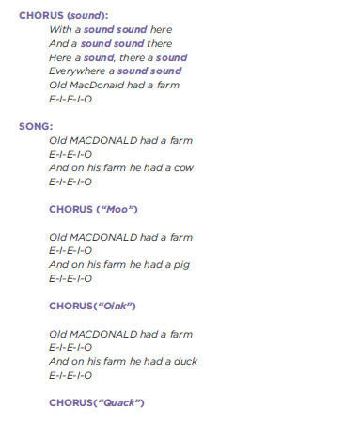

Slide 28

Your Turn

Slide 29
Unplugged Activity – Songwriting
Would you rather write lyrics over and over again or define a chorus?
Does it make sense to make a new chorus for every time it’s needed in a song?
Do you think it’s possible to make multiple choruses for the same song?

Slide 30
Debrief
What do you like about the lesson itself?
Where might your students struggle with this?
What might you try differently?
What additional activities could you do?

