Slide 1
Getting Loopy

Slide 2
What did we do in our last lesson?
Do you have any questions before we move on?
What was your favorite part of the last lesson?
Notes:
And why is studying computer science important to our country?
One good reason is this is where the jobs are.
Here are [CLICK] national projections on STEM jobs in our country from the Bureau of Labor Statistics
This graph shows that out of all the NEW “STEM” jobs in our economy, more than 60% will be in computing related occupations

Slide 3
Getting Loopy Unplugged Activity
I need a volunteer to come up and follow my directions.
I need a second volunteer to come up and follow my directions.
Notes:
And why is studying computer science important to our country?
One good reason is this is where the jobs are.
Here are [CLICK] national projections on STEM jobs in our country from the Bureau of Labor Statistics
This graph shows that out of all the NEW “STEM” jobs in our economy, more than 60% will be in computing related occupations

Slide 4
Getting Loopy Unplugged Activity
Which of those sets of instructions was easier for me to ask?
Which of those sets of instructions was easier for the volunteers to follow?
Would your answers have “changed” if I had wanted the volunteers to do the action 100 times?
Notes:
And why is studying computer science important to our country?
One good reason is this is where the jobs are.
Here are [CLICK] national projections on STEM jobs in our country from the Bureau of Labor Statistics
This graph shows that out of all the NEW “STEM” jobs in our economy, more than 60% will be in computing related occupations

Slide 5
Notes:
And why is studying computer science important to our country?
One good reason is this is where the jobs are.
Here are [CLICK] national projections on STEM jobs in our country from the Bureau of Labor Statistics
This graph shows that out of all the NEW “STEM” jobs in our economy, more than 60% will be in computing related occupations

Slide 6
Getting Loopy Unplugged Activity
Can you think of some other places where we use loops?
Notes:
And why is studying computer science important to our country?
One good reason is this is where the jobs are.
Here are [CLICK] national projections on STEM jobs in our country from the Bureau of Labor Statistics
This graph shows that out of all the NEW “STEM” jobs in our economy, more than 60% will be in computing related occupations

Slide 7
Getting Loopy Unplugged Activity
Notes:
And why is studying computer science important to our country?
One good reason is this is where the jobs are.
Here are [CLICK] national projections on STEM jobs in our country from the Bureau of Labor Statistics
This graph shows that out of all the NEW “STEM” jobs in our economy, more than 60% will be in computing related occupations

Slide 8
Let’s have a DANCE PARTY!
Notes:
And why is studying computer science important to our country?
One good reason is this is where the jobs are.
Here are [CLICK] national projections on STEM jobs in our country from the Bureau of Labor Statistics
This graph shows that out of all the NEW “STEM” jobs in our economy, more than 60% will be in computing related occupations

Slide 9
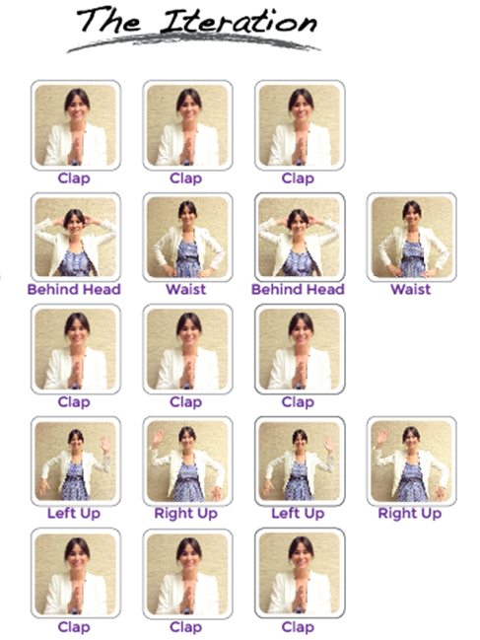
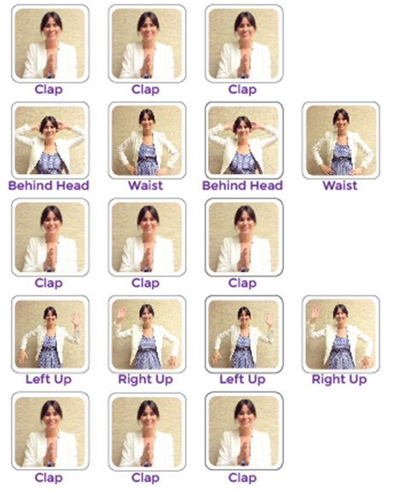
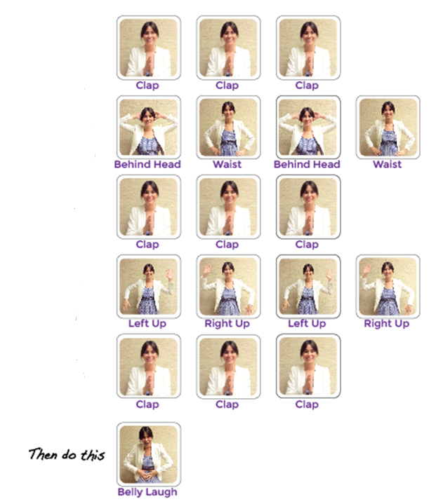

Slide 10
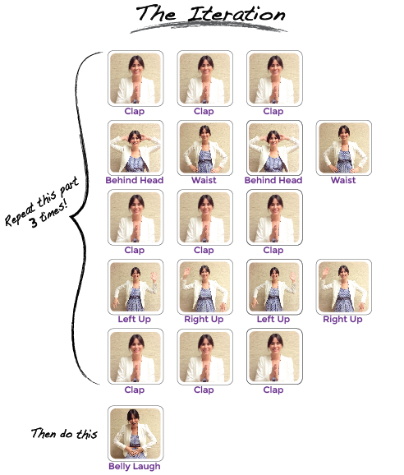

Slide 11
Where DID we use a loop?
Notes:
And why is studying computer science important to our country?
One good reason is this is where the jobs are.
Here are [CLICK] national projections on STEM jobs in our country from the Bureau of Labor Statistics
This graph shows that out of all the NEW “STEM” jobs in our economy, more than 60% will be in computing related occupations

Slide 12
Getting Loopy Unplugged Activity
What would the look like if we only repeated the main part 2 times? What about 100 times?
Could we use the same loops with different dance moves?
Can you think of any dances that are done inside a loop
Notes:
And why is studying computer science important to our country?
One good reason is this is where the jobs are.
Here are [CLICK] national projections on STEM jobs in our country from the Bureau of Labor Statistics
This graph shows that out of all the NEW “STEM” jobs in our economy, more than 60% will be in computing related occupations

Slide 13
Where COULD we have used loops?
Notes:
And why is studying computer science important to our country?
One good reason is this is where the jobs are.
Here are [CLICK] national projections on STEM jobs in our country from the Bureau of Labor Statistics
This graph shows that out of all the NEW “STEM” jobs in our economy, more than 60% will be in computing related occupations

Slide 15
3

Slide 16
3
v
2

Slide 17
3
v
2
3
2
3

Slide 18
3
2
2
v
v
3
2
2
v
v
3

Slide 19
3
v
2
3
2
3

Slide 20
3
2
2
3

Slide 21
Your turn
Let’s pick another dance:
Chicken Dance:
https://www.youtube.com/watch?v=4xmV5uHWNag
Notes:
And why is studying computer science important to our country?
One good reason is this is where the jobs are.
Here are [CLICK] national projections on STEM jobs in our country from the Bureau of Labor Statistics
This graph shows that out of all the NEW “STEM” jobs in our economy, more than 60% will be in computing related occupations

Slide 22
Debrief
What do you like about the lesson itself?
Where might your students struggle with this?
What might you try differently?
What additional activities could you do?
Notes:
And why is studying computer science important to our country?
One good reason is this is where the jobs are.
Here are [CLICK] national projections on STEM jobs in our country from the Bureau of Labor Statistics
This graph shows that out of all the NEW “STEM” jobs in our economy, more than 60% will be in computing related occupations

