Slide 1
Graph Paper Programming

Slide 2
Any questions yet about using the
Code.org website

Slide 3
What did we do in our last lesson?
Do you have any questions before we move on?
What was your favorite part of the last lesson?

Slide 4
Graph Paper Programming
Two new vocabulary words:
Algorithm
Program

Slide 5
Listen for these vocabulary words:
Algorithm
Program

Slide 6
Graph Paper Programming
Did you hear our new vocabulary words:
Algorithm
Program
What do these words mean?

Slide 7
Graph Paper Programming

Slide 8
Graph Paper Programming
Today we will be programming each other to behave like robots
What is a robot?
Does a robot really "understand" what people say?

Slide 9
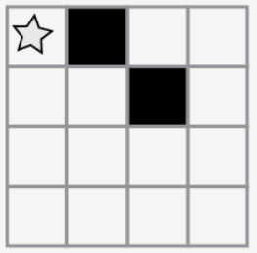
Graph Paper Programming
Today we will be programming each other to create drawings on small sections of graph paper.
We will always start in the upper left hand corner of the graph paper.

Slide 10
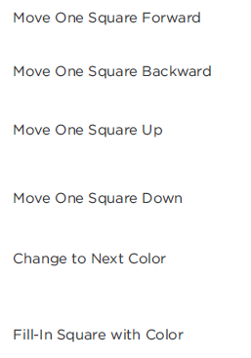
Graph Paper Programming
We will move through the graph paper using six commands:

Slide 11
Graph Paper Programming
What would be one possible algorithm to create this image:

Slide 12
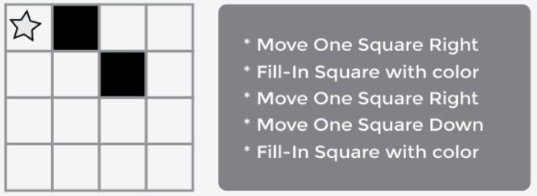
Graph Paper Programming
This is one solution

Slide 13
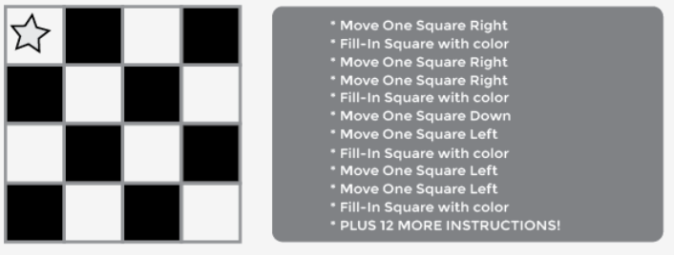
Graph Paper Programming
That’s simple enough. But they can get pretty complicated too.

Slide 14
Graph Paper Programming
That’s simple enough. But they can get pretty complicated too.

Slide 15
Graph Paper Programming
With some substitutions we can do this much more easily.
Instead of having to write out an entire phrase for each instruction, we can use symbols.

Slide 16
Graph Paper Programming
So we could rewrite the previous algorithm to look like this

Slide 17
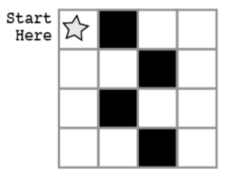
Activity 1
Write a program for this image:

Slide 18
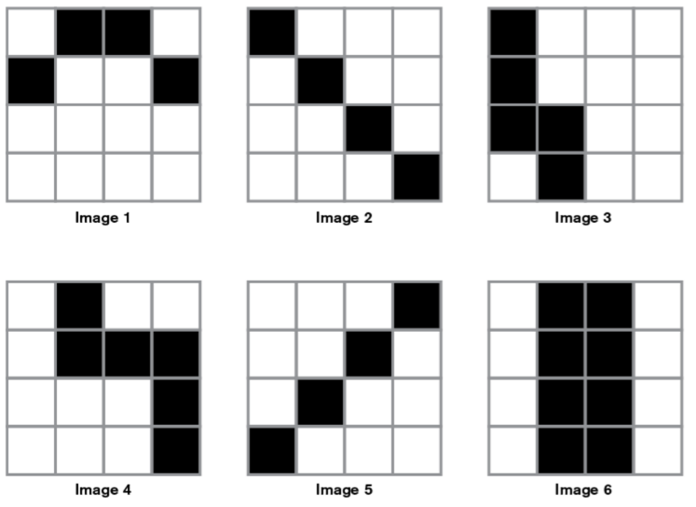
Activity 2
Pick one and write the program

Slide 19
Activity 2
Graph Paper Programming
Pick one and write the program on your handout.
Exchange it with another group and “run” their program.
Did your results agree with one of the existing images?

Slide 20
Debrief
What do you like about the lesson itself?
Where might your students struggle with this?
What might you try differently?
What additional activities could you do?

