Slide 1
Conditionals with Cards
Unplugged Lesson

Slide 2
Unplugged Activity – Conditionals w/ Cards
Notes:
And why is studying computer science important to our country?
One good reason is this is where the jobs are.
Here are [CLICK] national projections on STEM jobs in our country from the Bureau of Labor Statistics
This graph shows that out of all the NEW “STEM” jobs in our economy, more than 60% will be in computing related occupations

Slide 3
Unplugged Activity – Conditionals w/ Cards
Let’s look at an example of a conditional
If you can be quiet for 30 seconds
I will let you leave class 5 minutes early today
GO!
Notes:
And why is studying computer science important to our country?
One good reason is this is where the jobs are.
Here are [CLICK] national projections on STEM jobs in our country from the Bureau of Labor Statistics
This graph shows that out of all the NEW “STEM” jobs in our economy, more than 60% will be in computing related occupations

Slide 4
Unplugged Activity – Conditionals w/ Cards
What was my condition?
If the condition was true, what action happened?
If the condition was false, what action happened?
Notes:
And why is studying computer science important to our country?
One good reason is this is where the jobs are.
Here are [CLICK] national projections on STEM jobs in our country from the Bureau of Labor Statistics
This graph shows that out of all the NEW “STEM” jobs in our economy, more than 60% will be in computing related occupations

Slide 5
Unplugged Activity – Conditionals w/ Cards
Can you come up with other examples of conditionals we use in our daily lives?
Notes:
And why is studying computer science important to our country?
One good reason is this is where the jobs are.
Here are [CLICK] national projections on STEM jobs in our country from the Bureau of Labor Statistics
This graph shows that out of all the NEW “STEM” jobs in our economy, more than 60% will be in computing related occupations

Slide 6
Unplugged Activity – Conditionals w/ Cards
Let’s look at a simple conditional example with some cards.
Notes:
And why is studying computer science important to our country?
One good reason is this is where the jobs are.
Here are [CLICK] national projections on STEM jobs in our country from the Bureau of Labor Statistics
This graph shows that out of all the NEW “STEM” jobs in our economy, more than 60% will be in computing related occupations

Slide 7
Unplugged Activity – Conditionals w/ Cards
Let’s look at a simple conditional example with some cards.
Notes:
And why is studying computer science important to our country?
One good reason is this is where the jobs are.
Here are [CLICK] national projections on STEM jobs in our country from the Bureau of Labor Statistics
This graph shows that out of all the NEW “STEM” jobs in our economy, more than 60% will be in computing related occupations

Slide 8
Unplugged Activity – Conditionals w/ Cards
Let’s look at a simple conditional example with some cards.
Notes:
And why is studying computer science important to our country?
One good reason is this is where the jobs are.
Here are [CLICK] national projections on STEM jobs in our country from the Bureau of Labor Statistics
This graph shows that out of all the NEW “STEM” jobs in our economy, more than 60% will be in computing related occupations

Slide 9
Unplugged Activity – Conditionals w/ Cards
Let’s look at a simple conditional example with some cards.
Notes:
And why is studying computer science important to our country?
One good reason is this is where the jobs are.
Here are [CLICK] national projections on STEM jobs in our country from the Bureau of Labor Statistics
This graph shows that out of all the NEW “STEM” jobs in our economy, more than 60% will be in computing related occupations

Slide 10
Unplugged Activity – Conditionals w/ Cards
What was the condition?
If the condition was true, what happened?
If the condition was false, what happened?
Notes:
And why is studying computer science important to our country?
One good reason is this is where the jobs are.
Here are [CLICK] national projections on STEM jobs in our country from the Bureau of Labor Statistics
This graph shows that out of all the NEW “STEM” jobs in our economy, more than 60% will be in computing related occupations

Slide 11
Unplugged Activity – Conditionals w/ Cards
Let’s look at a slightly more complex conditional example with some cards.
Suppose that if I draw a 7 you get to go home five minutes early.
What would you do if I drew a 7?
What would you do if I DIDN’T draw a 7
Notes:
And why is studying computer science important to our country?
One good reason is this is where the jobs are.
Here are [CLICK] national projections on STEM jobs in our country from the Bureau of Labor Statistics
This graph shows that out of all the NEW “STEM” jobs in our economy, more than 60% will be in computing related occupations

Slide 12
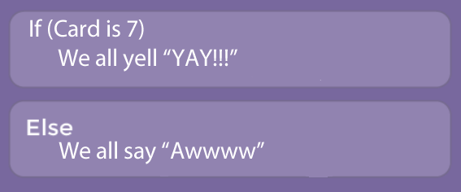
Unplugged Activity – Conditionals w/ Cards
Let’s look at a slightly more complex conditional example with some cards.
Notes:
And why is studying computer science important to our country?
One good reason is this is where the jobs are.
Here are [CLICK] national projections on STEM jobs in our country from the Bureau of Labor Statistics
This graph shows that out of all the NEW “STEM” jobs in our economy, more than 60% will be in computing related occupations

Slide 13
Unplugged Activity – Conditionals w/ Cards
Let’s look at a slightly more complex conditional example with some cards.
Notes:
And why is studying computer science important to our country?
One good reason is this is where the jobs are.
Here are [CLICK] national projections on STEM jobs in our country from the Bureau of Labor Statistics
This graph shows that out of all the NEW “STEM” jobs in our economy, more than 60% will be in computing related occupations

Slide 14
Unplugged Activity – Conditionals w/ Cards
Let’s look at a slightly more complex conditional example with some cards.
Notes:
And why is studying computer science important to our country?
One good reason is this is where the jobs are.
Here are [CLICK] national projections on STEM jobs in our country from the Bureau of Labor Statistics
This graph shows that out of all the NEW “STEM” jobs in our economy, more than 60% will be in computing related occupations

Slide 15
Unplugged Activity – Conditionals w/ Cards
Let’s look at a slightly more complex conditional example with some cards.
Notes:
And why is studying computer science important to our country?
One good reason is this is where the jobs are.
Here are [CLICK] national projections on STEM jobs in our country from the Bureau of Labor Statistics
This graph shows that out of all the NEW “STEM” jobs in our economy, more than 60% will be in computing related occupations

Slide 16
Unplugged Activity – Conditionals w/ Cards
What was the condition?
If the condition was true, what happened?
If the condition was false, what happened?
Notes:
And why is studying computer science important to our country?
One good reason is this is where the jobs are.
Here are [CLICK] national projections on STEM jobs in our country from the Bureau of Labor Statistics
This graph shows that out of all the NEW “STEM” jobs in our economy, more than 60% will be in computing related occupations

Slide 17
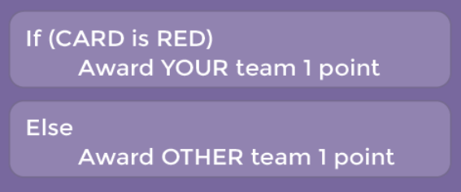
Unplugged Activity – Conditionals w/ Cards
Now you try it in your groups.
Take turns drawing a card:
Notes:
And why is studying computer science important to our country?
One good reason is this is where the jobs are.
Here are [CLICK] national projections on STEM jobs in our country from the Bureau of Labor Statistics
This graph shows that out of all the NEW “STEM” jobs in our economy, more than 60% will be in computing related occupations

Slide 18
Unplugged Activity – Conditionals w/ Cards
What was the condition?
If the condition was true, what happened?
If the condition was false, what happened?
Notes:
And why is studying computer science important to our country?
One good reason is this is where the jobs are.
Here are [CLICK] national projections on STEM jobs in our country from the Bureau of Labor Statistics
This graph shows that out of all the NEW “STEM” jobs in our economy, more than 60% will be in computing related occupations

Slide 19
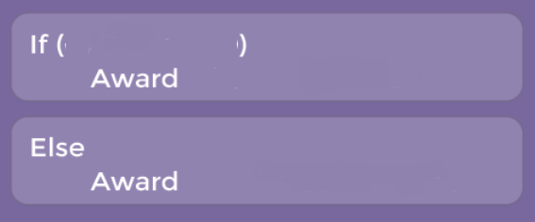
Unplugged Activity – Conditionals w/ Cards
Now YOU make one up with your partners
Notes:
And why is studying computer science important to our country?
One good reason is this is where the jobs are.
Here are [CLICK] national projections on STEM jobs in our country from the Bureau of Labor Statistics
This graph shows that out of all the NEW “STEM” jobs in our economy, more than 60% will be in computing related occupations

Slide 20
Unplugged Activity – Conditionals w/ Cards
But sometimes two outcomes isn’t enough and need to handle multiple possibilities.
When this happens we use the idea of “nested conditionals”
That is when we handle a second conditional as part of the actions of a first conditional.
Notes:
And why is studying computer science important to our country?
One good reason is this is where the jobs are.
Here are [CLICK] national projections on STEM jobs in our country from the Bureau of Labor Statistics
This graph shows that out of all the NEW “STEM” jobs in our economy, more than 60% will be in computing related occupations

Slide 21
Unplugged Activity – Conditionals w/ Cards
Nested conditional example.
Suppose that if I draw a 7 you get to go home five minutes early.
What would you do if I drew a 7?
Suppose that if I get something higher than a 7 it is regular release time.
What would you do?
Finally, if I draw something less than a 7 then you have to stay 10 minutes longer.
What would you do?
Notes:
And why is studying computer science important to our country?
One good reason is this is where the jobs are.
Here are [CLICK] national projections on STEM jobs in our country from the Bureau of Labor Statistics
This graph shows that out of all the NEW “STEM” jobs in our economy, more than 60% will be in computing related occupations

Slide 22
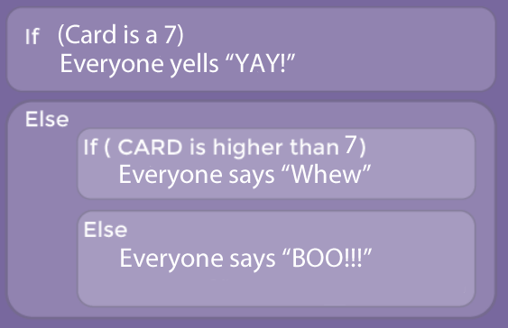
Unplugged Activity – Conditionals w/ Cards
Nested conditional example:
Notes:
And why is studying computer science important to our country?
One good reason is this is where the jobs are.
Here are [CLICK] national projections on STEM jobs in our country from the Bureau of Labor Statistics
This graph shows that out of all the NEW “STEM” jobs in our economy, more than 60% will be in computing related occupations

Slide 23
Unplugged Activity – Conditionals w/ Cards
Nested conditional example:
Notes:
And why is studying computer science important to our country?
One good reason is this is where the jobs are.
Here are [CLICK] national projections on STEM jobs in our country from the Bureau of Labor Statistics
This graph shows that out of all the NEW “STEM” jobs in our economy, more than 60% will be in computing related occupations

Slide 24
Unplugged Activity – Conditionals w/ Cards
Nested conditional example:
Notes:
And why is studying computer science important to our country?
One good reason is this is where the jobs are.
Here are [CLICK] national projections on STEM jobs in our country from the Bureau of Labor Statistics
This graph shows that out of all the NEW “STEM” jobs in our economy, more than 60% will be in computing related occupations

Slide 25
Unplugged Activity – Conditionals w/ Cards
Nested conditional example:
Notes:
And why is studying computer science important to our country?
One good reason is this is where the jobs are.
Here are [CLICK] national projections on STEM jobs in our country from the Bureau of Labor Statistics
This graph shows that out of all the NEW “STEM” jobs in our economy, more than 60% will be in computing related occupations

Slide 26
Unplugged Activity – Conditionals w/ Cards
What is the initial condition?
If the condition was true, what happened?
If the condition was false, what happened?
Notes:
And why is studying computer science important to our country?
One good reason is this is where the jobs are.
Here are [CLICK] national projections on STEM jobs in our country from the Bureau of Labor Statistics
This graph shows that out of all the NEW “STEM” jobs in our economy, more than 60% will be in computing related occupations

Slide 27
Unplugged Activity – Conditionals w/ Cards
What is the nested condition?
If the condition was true, what happened?
If the condition was false, what happened?
Notes:
And why is studying computer science important to our country?
One good reason is this is where the jobs are.
Here are [CLICK] national projections on STEM jobs in our country from the Bureau of Labor Statistics
This graph shows that out of all the NEW “STEM” jobs in our economy, more than 60% will be in computing related occupations

Slide 28
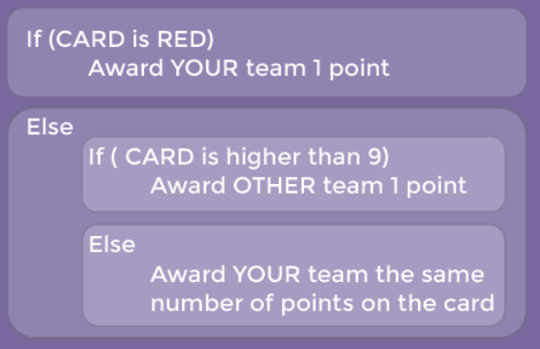
Unplugged Activity – Conditionals w/ Cards
Nested conditional example to try with your groups:
Notes:
And why is studying computer science important to our country?
One good reason is this is where the jobs are.
Here are [CLICK] national projections on STEM jobs in our country from the Bureau of Labor Statistics
This graph shows that out of all the NEW “STEM” jobs in our economy, more than 60% will be in computing related occupations

Slide 29
Unplugged Activity – Conditionals w/ Cards
What was the condition?
If the condition was true, what happened?
If the condition was false, what happened?
Notes:
And why is studying computer science important to our country?
One good reason is this is where the jobs are.
Here are [CLICK] national projections on STEM jobs in our country from the Bureau of Labor Statistics
This graph shows that out of all the NEW “STEM” jobs in our economy, more than 60% will be in computing related occupations

Slide 30
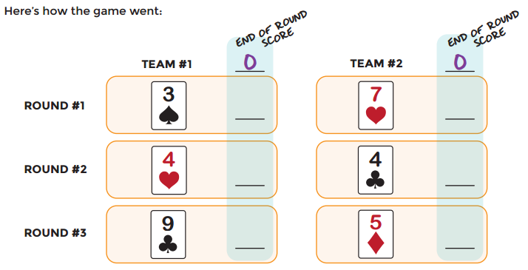
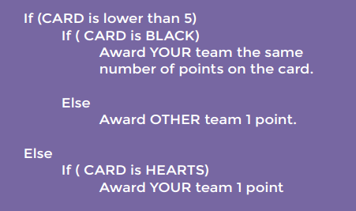
Unplugged Activity – Conditionals w/ Cards
Notes:
And why is studying computer science important to our country?
One good reason is this is where the jobs are.
Here are [CLICK] national projections on STEM jobs in our country from the Bureau of Labor Statistics
This graph shows that out of all the NEW “STEM” jobs in our economy, more than 60% will be in computing related occupations

Slide 31
Unplugged Activity – Conditionals w/ Cards
3 1
3 6
3 6
Notes:
And why is studying computer science important to our country?
One good reason is this is where the jobs are.
Here are [CLICK] national projections on STEM jobs in our country from the Bureau of Labor Statistics
This graph shows that out of all the NEW “STEM” jobs in our economy, more than 60% will be in computing related occupations

Slide 32
Debrief
What do you like about the lesson itself?
Where might your students struggle with this?
What might you try differently?
What additional activities could you do?
Notes:
And why is studying computer science important to our country?
One good reason is this is where the jobs are.
Here are [CLICK] national projections on STEM jobs in our country from the Bureau of Labor Statistics
This graph shows that out of all the NEW “STEM” jobs in our economy, more than 60% will be in computing related occupations

