Slide 1
Getting Started with Code.org

Slide 2
As we get started
Questions about the syllabus or the course website?

Slide 4
Getting Started
The first ~4 weeks of this course we are going to learn the fundamentals of computer science using the "Express Course" which is part of the CS Fundamentals curriculum from Code.org.

Slide 5
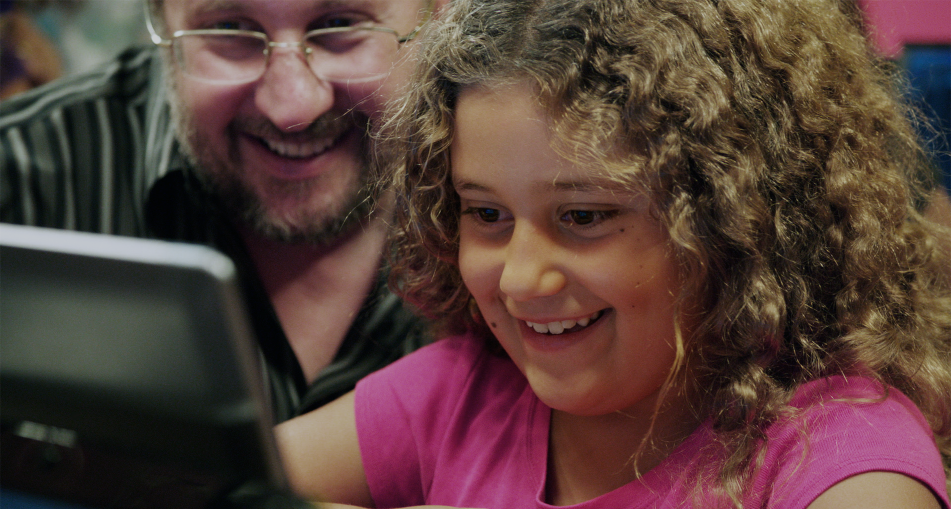
Our Vision:
every school
every student
opportunity

Slide 6
Who is Code.org?
A public 501c3 nonprofit dedicated to bringing computer science to every school, and increasing participation by women and underrepresented students.
Producer of online courses
The organizer of the Hour of Code campaign

Slide 7
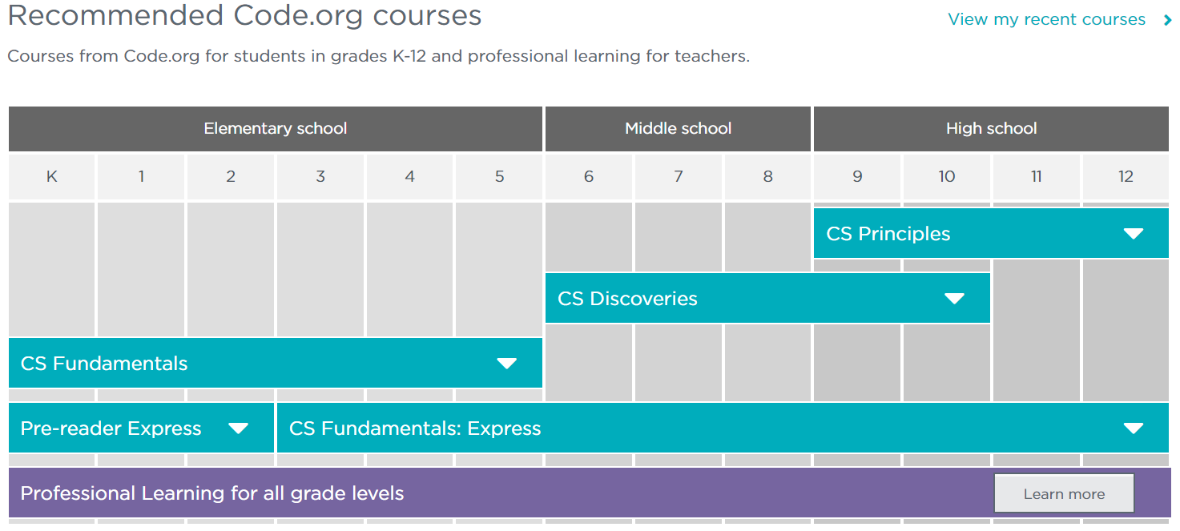
The Code.org K-12 curriculum
@TeachCode | #LeadCode | #CSforAll

Slide 8
CS Fundamentals: CS in grades K-5
Short (15-20 lessons) courses for elementary school
Free, open-source, online “games”
"Lectures" by Mark Zuckerberg, Chris Bosh, Bill Gates, etc.
Aligned to reinforce Math, Science, ELA standards
Any district, school, or teacher can participate

Slide 9
Mixture of Modalities
Lessons consist of a combination of
Unplugged Lessons
Plugged Lessons

Slide 10
Getting Started
What do you "see" when you think about a computer scientist?
Many people think about a person who sits alone at their computer all day drinking coffee (or energy drinks)
In reality, computer science is a highly engaging and collaborative science

Slide 12
Computer Scientists solve problems
Can you think of a problem that a computer scientist could solve?

Slide 13
Computer Scientists solve problems
Once an issue has been identified, it may seem too overwhelming to tackle.
That's why computer scientists learn to break down a problem into individual pieces and solve things one piece at a time
It's sort of like putting together a really big jigsaw puzzle.

Slide 14
Computer Scientists solve problems
Because of this, computer scientists aren't ALL programmers.
They include:
Artists
Authors
Psychologists
Creative Problem Solvers
Scientists
Every industry needs computer scientists

Slide 15
Our Activity
The best computer scientists understand what is like to BE a computer.
So today, we are going to learn to understand how computers read and store data

Slide 16
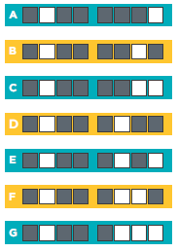
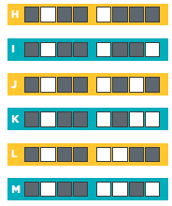
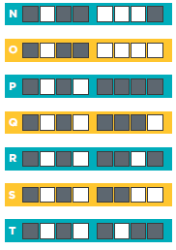
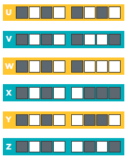

Slide 17
What am I encoding?
C
S

Slide 18
What am I encoding?
D
O

Slide 19
You Try
In the grid I give you encode your first and last initial.
DON'T write the letters in the boxes at the end of the rows.
Trade your grid with the person next to you.
Decode their grid.
Tell them what you got.
Did either of you make a mistake?

Slide 20
Debrief
What do you like about the lesson itself?
Where might your students struggle with this?
What might you try differently?
What additional activities could you do?

Slide 21
Before our next session
Create a teacher account on Code.org and join my class section
(URLs are all linked on my website)
Wearing you "student" hat
complete the puzzles from Lessons 1 and 2 (linked on the website)

